Slide 1
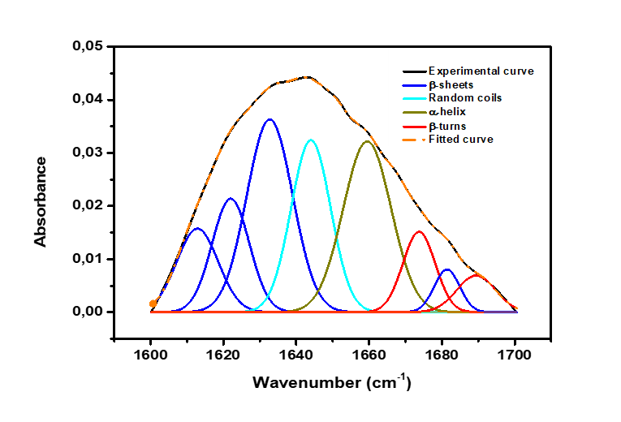
Freeze dried
Oven dried
Supplementary Figure 3: Deconvolution of Amide I region of caterpillar protein concentrate

