Slide 1
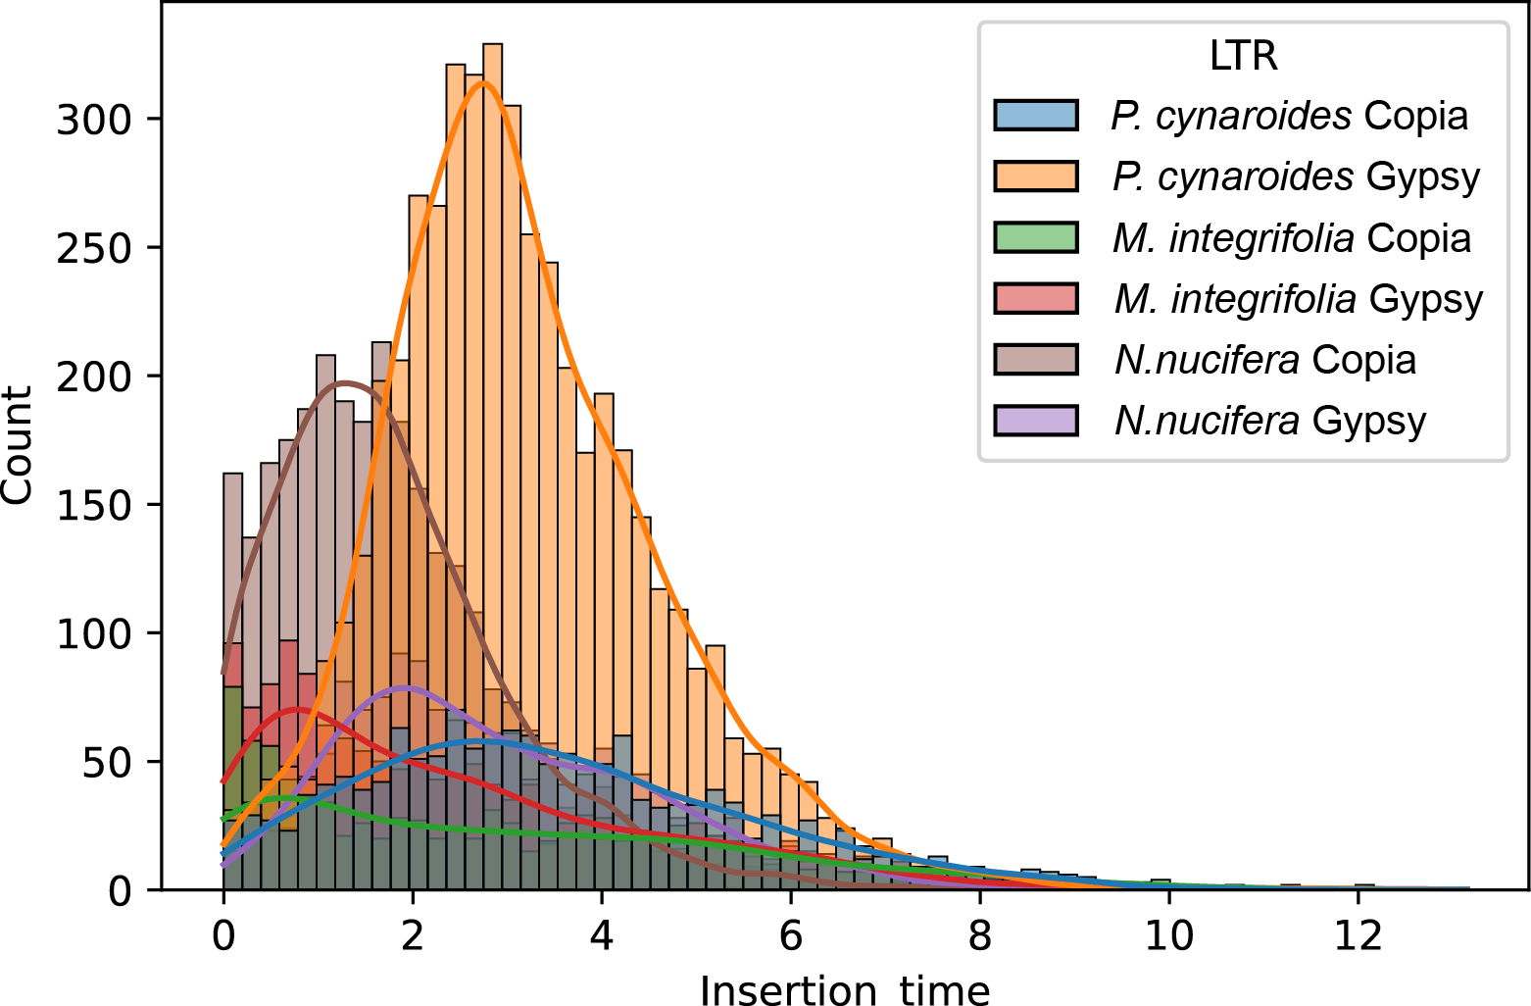
Supplemental Figure 4. Insertion time of Gypsy and Copia in P. cynaroides, M. integrifolia, and N. nucifera.

