Slide 1
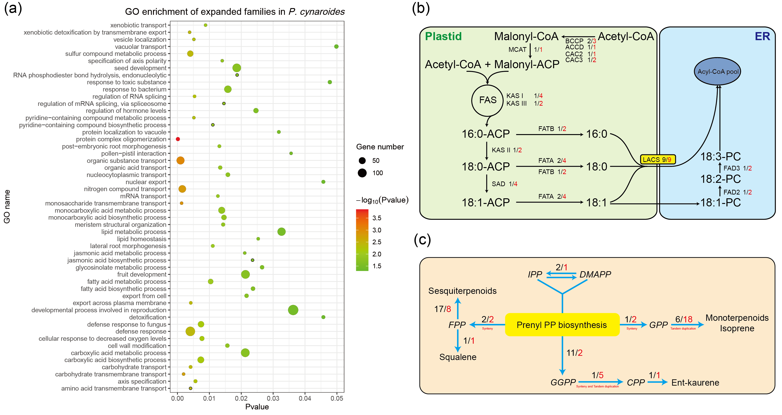
Supplemental Figure 9. Reconstruction of metabolic pathways involved in fatty acid biosynthesis and terpene biosynthesis in P. cynaroides.
A. GO enrichment of 1,345 expanded families in P. cynaroides (P < 0.05).
B. Fatty acid synthesis pathway in P. cynaroides. Number in red means the gene number in P. cynaroides, number in black means the gene number in Arabidopsis.
C.Terpenoid biosynthesis pathway in P. cynaroides. Number in red means the gene number in P. cynaroides, number in black means the gene number in Arabidopsis. Synteny means the expanded genes in the syntenic blocks from the whole-genome duplication. Tandem duplication means the expanded genes are tandem duplication.

