Slide 1
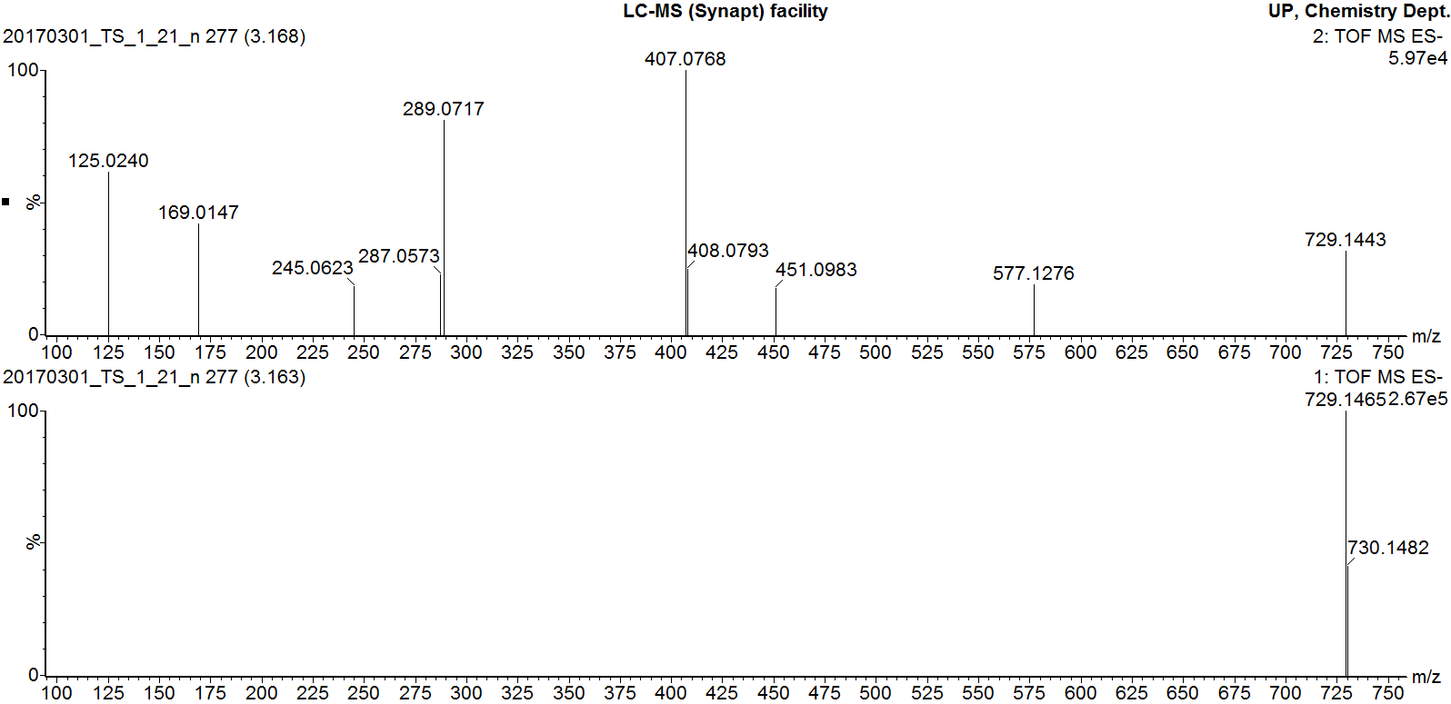
MS/MS fragmentation of peak 5
MS fragmentation of peak 5
Additional file 9
MS and MS/MS fragmentation pattern of peak 5

