Slide 1
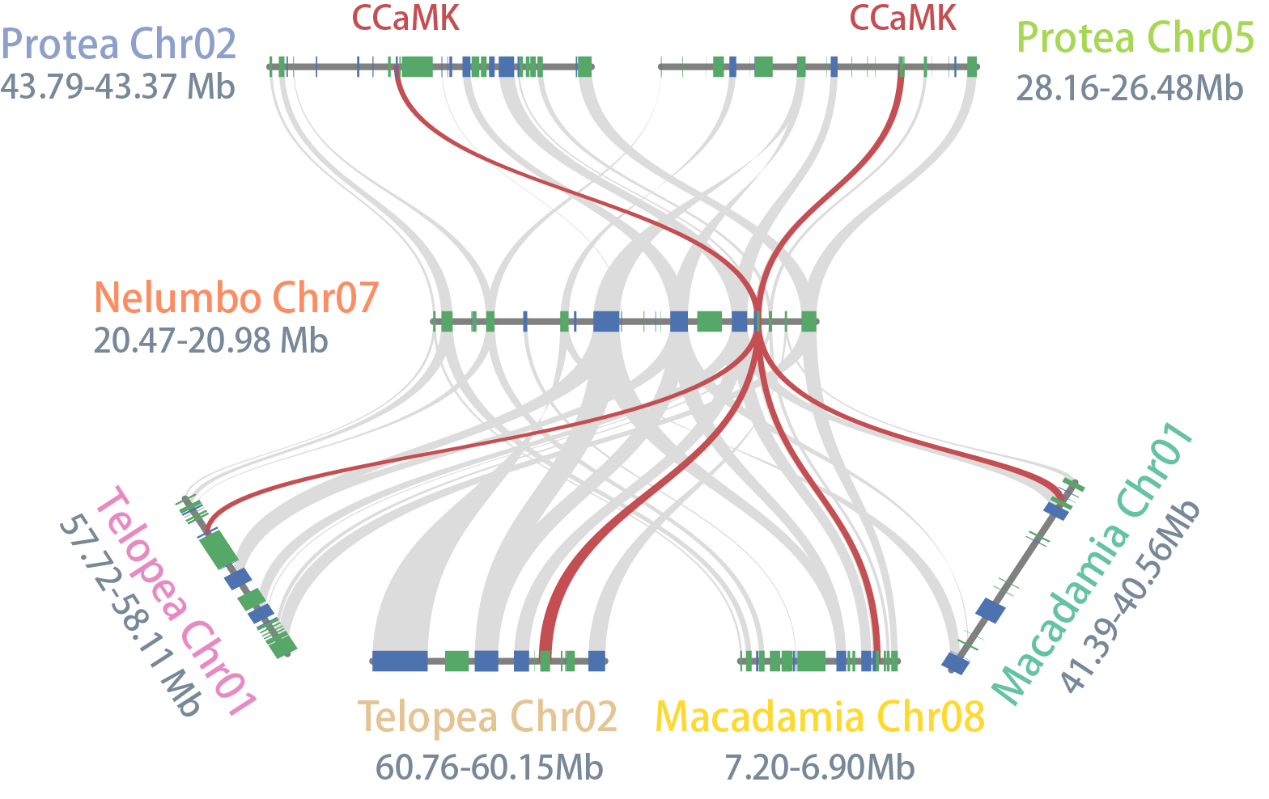
Supplemental Figure 8. The duplications of CCaMK (DMI3) in Proteaceae species derived from the whole-genome duplication event.

