Slide 1
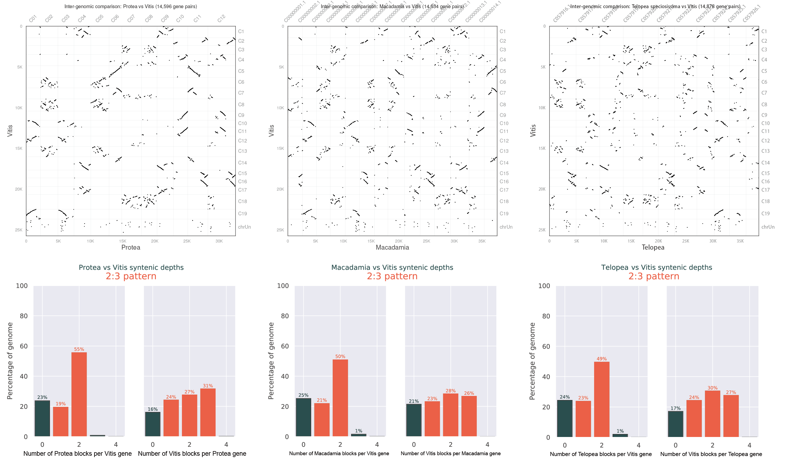
Supplemental Figure 6. Syntenic relationships comparing P. cynaroides, M. integrifolia and T. speciosissima with V. vinifera.

