Slide 1
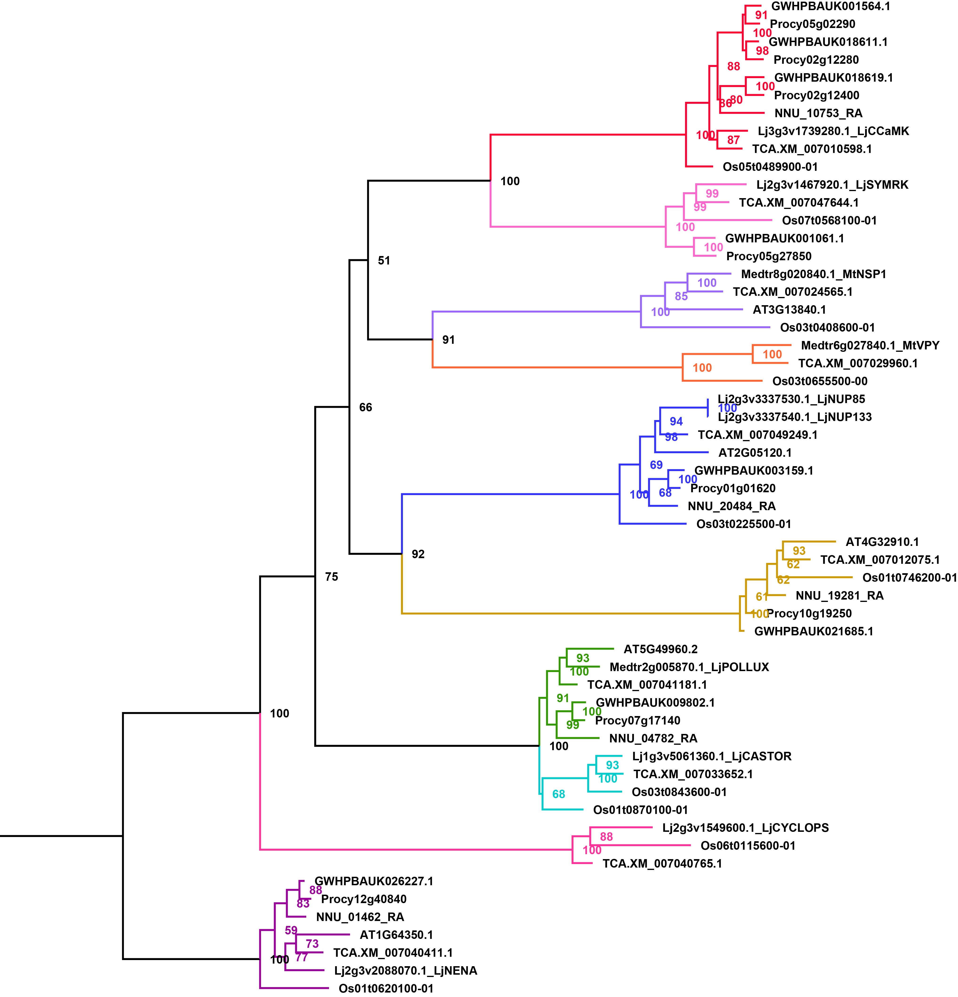
Supplemental Figure 11. The phylogenetic tree of common symbiotic pathway (CSP) genes involved in arbuscular mycorrhizal symbiosis. Different genes are indicated by different colors.

