Slide 1
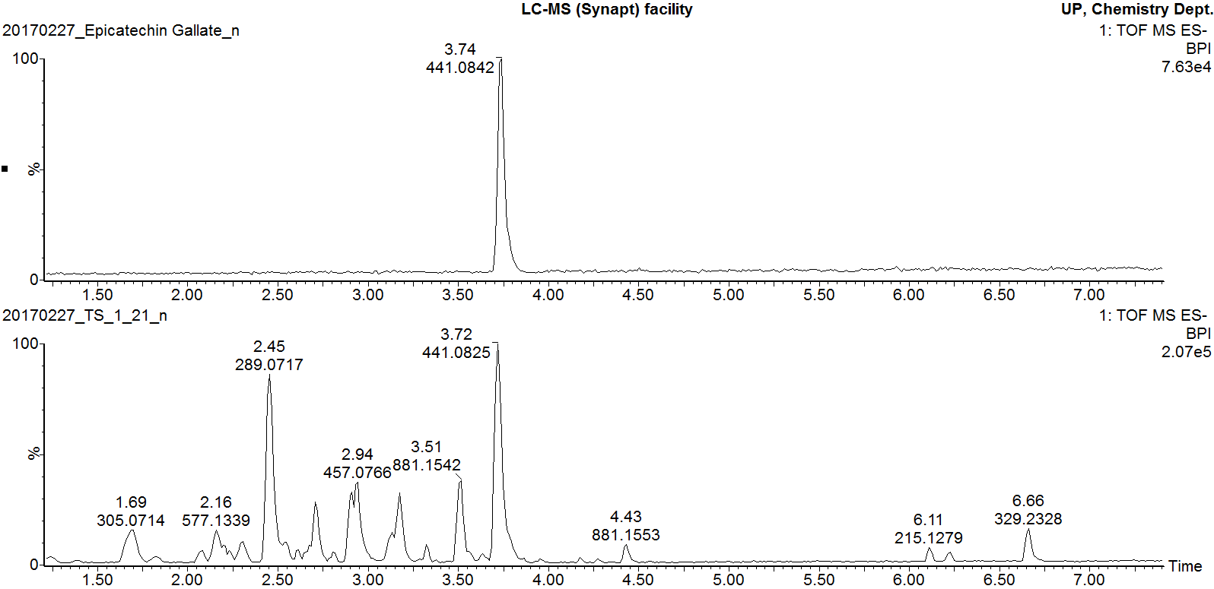
Epicatechin gallate pure standard
Marula stem ethanol extract
Additional file 12
Negative mode BPI chromatogram of epicatechin gallate standard overlaid with that of Marula stem ethanol extract

