Slide 1
APPENDIX A
SUPPLEMENTARY FIGURES

Slide 2
A
5’ adapter
Protospacer
Scaffold
3’ adapter
B
T7_gRNA2_F
Scaff_gRNA2_R
C
T7 Promoter
D
sgRNA
E
Cas9
Fig. A.1: The synthesis, amplification and transcription of the sgRNA and assembly of the RNP.
A) Once designed, the sgRNA molecule sequence was synthesized by Twist Biosciences (San Francisco, USA) as a dsDNA molecule and included adapters flanking the sgRNA sequence. B) The sgRNA sequence was amplified using primers targeting only the sgRNA region, with the forward primer also harbouring the sequence for the T7 promoter. C) The resulting PCR product harboured a T7 promoter region, the protospacer as well as the scaffold sequence. D) Transcription of the PCR product was performed to produce the full length sgRNA as a ssRNA molecule. E) The sgRNA was combined with the Cas9 enzyme to produce the ribonucleoprotein (RNP) which was then used for in vitro and in vivo cleavage of the target region.

Slide 3
MAT1-2-7
AF
O127R
A
872 bp
B
737 bp
135 bp
Fig. A.2: in vitro gRNA test
Primers targeting the genomic region harbouring the 5’ terminus of the MAT1-2-7 gene were used to produce the A) fragment harbouring the gRNA_2 target region. When successfully cut by the RNP, the resulting two DNA molecule are B) 737 and 135 bp in length.

Slide 4
A
5’
5’ homologous flank
TGA TCA
5’ homologous flank
3’
dDNA_F
dDNA_HF
dDNA_R
dDNA_HR
B
Construct 1
Construct 2
C
5’
HygR
3’
HygF
HygR
D
Construct 3
E
Construct 1 + 3
F
Construct 2 + 3
G
Full Length construct
Fig. A.3: The synthesis, amplification and assembly of the dDNA construct.
The full-length dDNA construct consists of sequence from A) the Twist BioScience-synthesized pre-dDNA as well as C) the hygromycin B resistance cassette. B) The 5’ and 3’ regions of the pre-dDNA were amplified using primers with overhangs homologous to the terminal regions of the hygromycin resistance cassette to produce constructs 1 and 2. D) The hygromycin resistance cassette was amplified with primers targeting the entire region to produce construct 3. E) Constructs 1 and 3 were combined to form a construct harbouring the 5’ homologous flank, the BclI restriction site and the hygromycin resistance cassette. F) Constructs 2 and 3 were combined to form a construct harbouring the 3’ homologous flank and the hygromycin resistance cassette. G) The preceding two constructs were combined into a single, full-length construct.

Slide 5
2581 bp
A
MAT1-2-7
AF
BR
B
HygR
AF
BR
ygF
HyR
2981 bp
1730 bp
4359 bp
Fig. A.4: PCRs confirming the integration of the dDNA into the target region.
A) In the wildtype isolate, the primers AF and BR can successfully produce a PCR product of approximately 2500bp. The same primer combination produces a much longer fragment of more than 4000bp in B) the mutant strains. Additionally, primers targeting the 5’ and 3’ integration regions only produce PCR products in the mutant strains, providing fragments of 1730 and 2981bp, respectively.

Slide 6
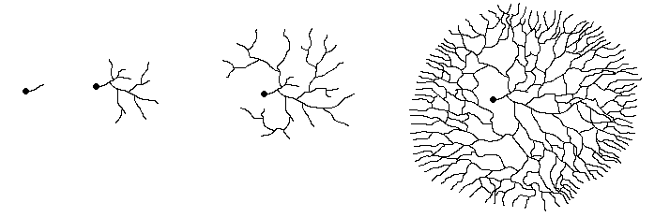
MEA-50
MEA-ST
Fig. A.5: Assessing the stability of the integration of the hygromycin resistance cassette and the disruption of the MAT1-2-7 gene. Confirmed knockout strains were transferred from MEA-50 media to MEA-ST media and back again three times to whether these strains would maintain the hygromycin resistance cassette when cultured in the absence of antibiotic.

Slide 7
459 bp
MAT1-2-1
188 bp
α pheromone
148 bp
a pheromone
302 bp
α pheromone
receptor
180 bp
a Pheromone
receptor
Fig. A.6: RT-PCR primers targeting the MAT and pheromone genes. The MAT1-2-1, α pheromone receptor and a pheromone receptor primers were designed to flank these genes’ introns so that gDNA contamination could be identified if it was present. In each case, the number indicated above the green line is the length of the PCR product produced from a cDNA template and thus does not include the intronic sequence. Gene structure diagrams are not to scale.

Slide 8
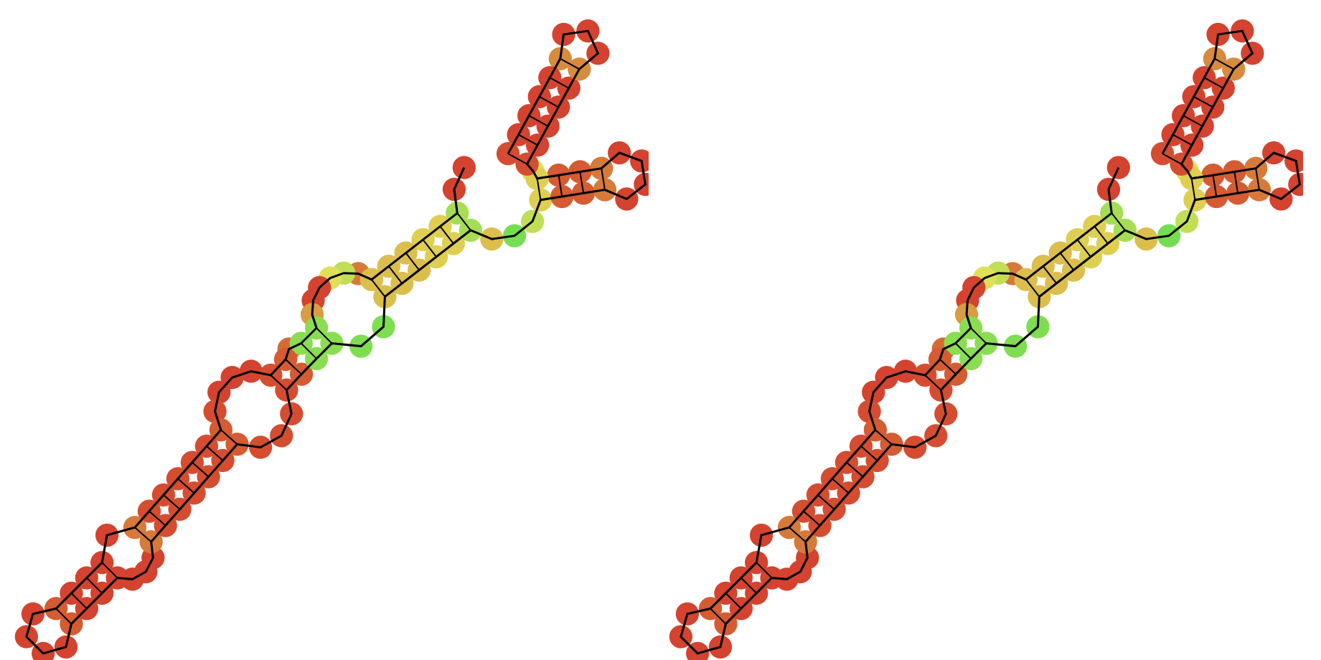
A
B
Fig. A.7: The secondary structures of sgRNA_2. The predicted (A) minimal free energy and (B) centroid structures of sgRNA_2 are identical. In both structures, high binding probabilities are indicated by red and dark orange coloured nucleotides, while lower probabilities are indicated in light orange, yellow and green. Both structures also have three stem loop structures, with five ring structures in the major stem loop. The black arrows indicate the region encoding the protospacer with lower secondary structure binding probabilities, which allows it to interact with the target DNA.

Slide 9
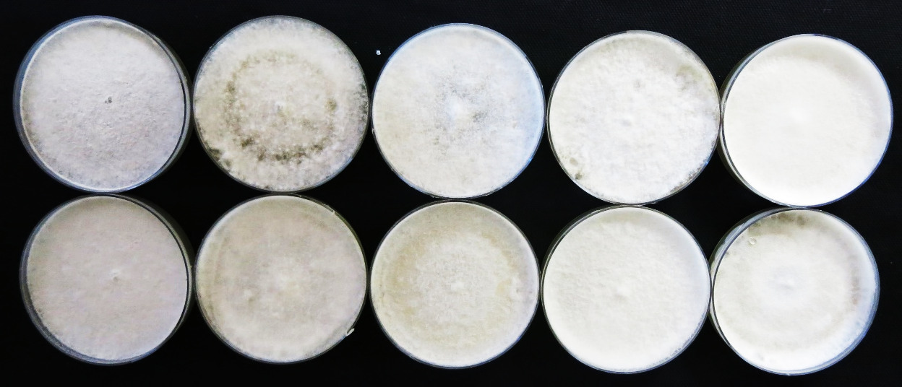
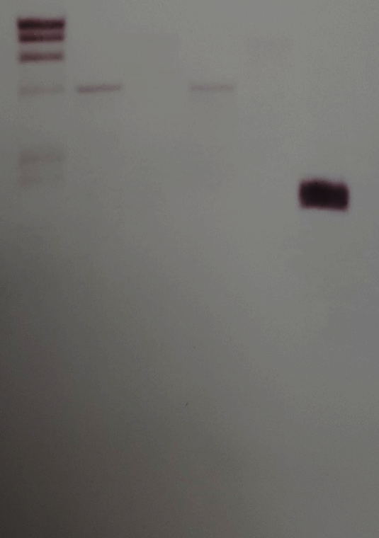
A
MEA-50
MEA-ST
MEA-50
MEA-ST
MEA-50
ΔMAT127-H1
ΔMAT127-H4
B
M H1 E1 H4 E4 +
M H1 E1 H4 E4 +
23kb
9.4 kb
6.5 kb
4.3 kb
2.3 kb
2kb
Fig. A.8 Integration stability and copy number of the hygromycin resistance cassette. A) The two mutant isolates, ΔMAT127-H1 and ΔMAT127-H4, were alternatively transferred between hygromycin B supplemented media (MEA-50) and unsupplemented media (MEA-ST) to assess the stability of the hygromycin resistance cassette’s integration in the H. omanensis genome. Sustained growth was observed on MEA-50 plates, subsequent to growth on MEA-ST plates, indicating that the cassette has been successfully integrated. B) In both mutant isolates, the hygromycin cassette was integrated only once into the genome. Lefthand panel: The digested gDNA from both mutant isolates on a 0.75% agarose gel. Righthand panel: The digested gDNA from both mutant isolates after being transferred to the nylon membrane and hybridized with the DIG-labelled probe.
M: DIG-labeled DNA marker, H1: ΔMAT127-H1 DNA digested with HindIII, E1: ΔMAT127-H1 digested with EcoRI, H4: ΔMAT127-H4 digested with HindIII, E4: ΔMAT127-H4 digested with EcoRI, +: positive control, PCR product of the entire hygromycin cassette.

Slide 10
A
B
C
D
E
F
Fig. A.9: A schematic illustrating the sexual development of Huntiella species. A) Sexual reproduction begins with the production of the production of light-coloured, round protoascomata. This is followed by B) the emergence of a dark, beak-like structure from the young ascomatal base, which develops into C) an extended neck. D) During this process, the ascomatal base also darkens. E) Once mature, F) a sticky mass of ascospores is exuded from the tip of the neck.

