Slide 1
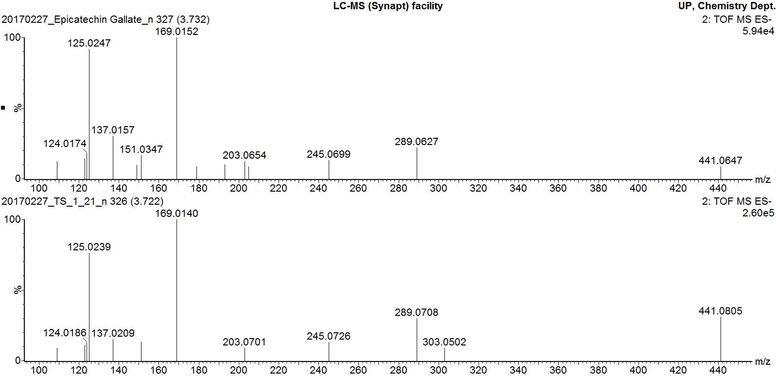
MS/MS fragmentation of epicatechin gallate standard
MS/MS fragmentation of peak 7
Additional file 11
MS/MS fragmentation of epicatechin gallate pure standard overlaid with MS/MS fragmentation of peak 7

