Slide 1
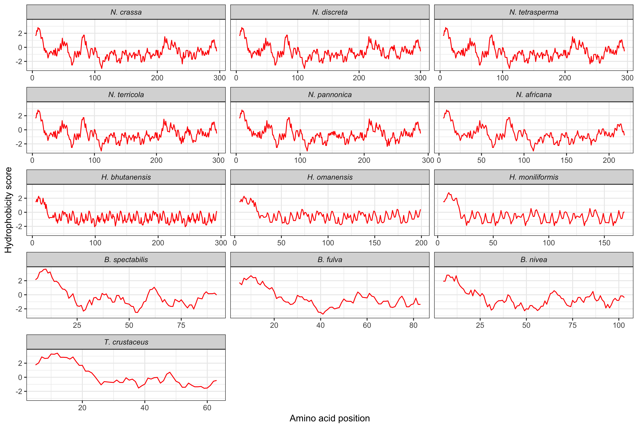
Fig C.1: Plots confirming the presence of a hydrophobic region at the N-terminal of each of the α-factor pheromone proteins.

Slide 2
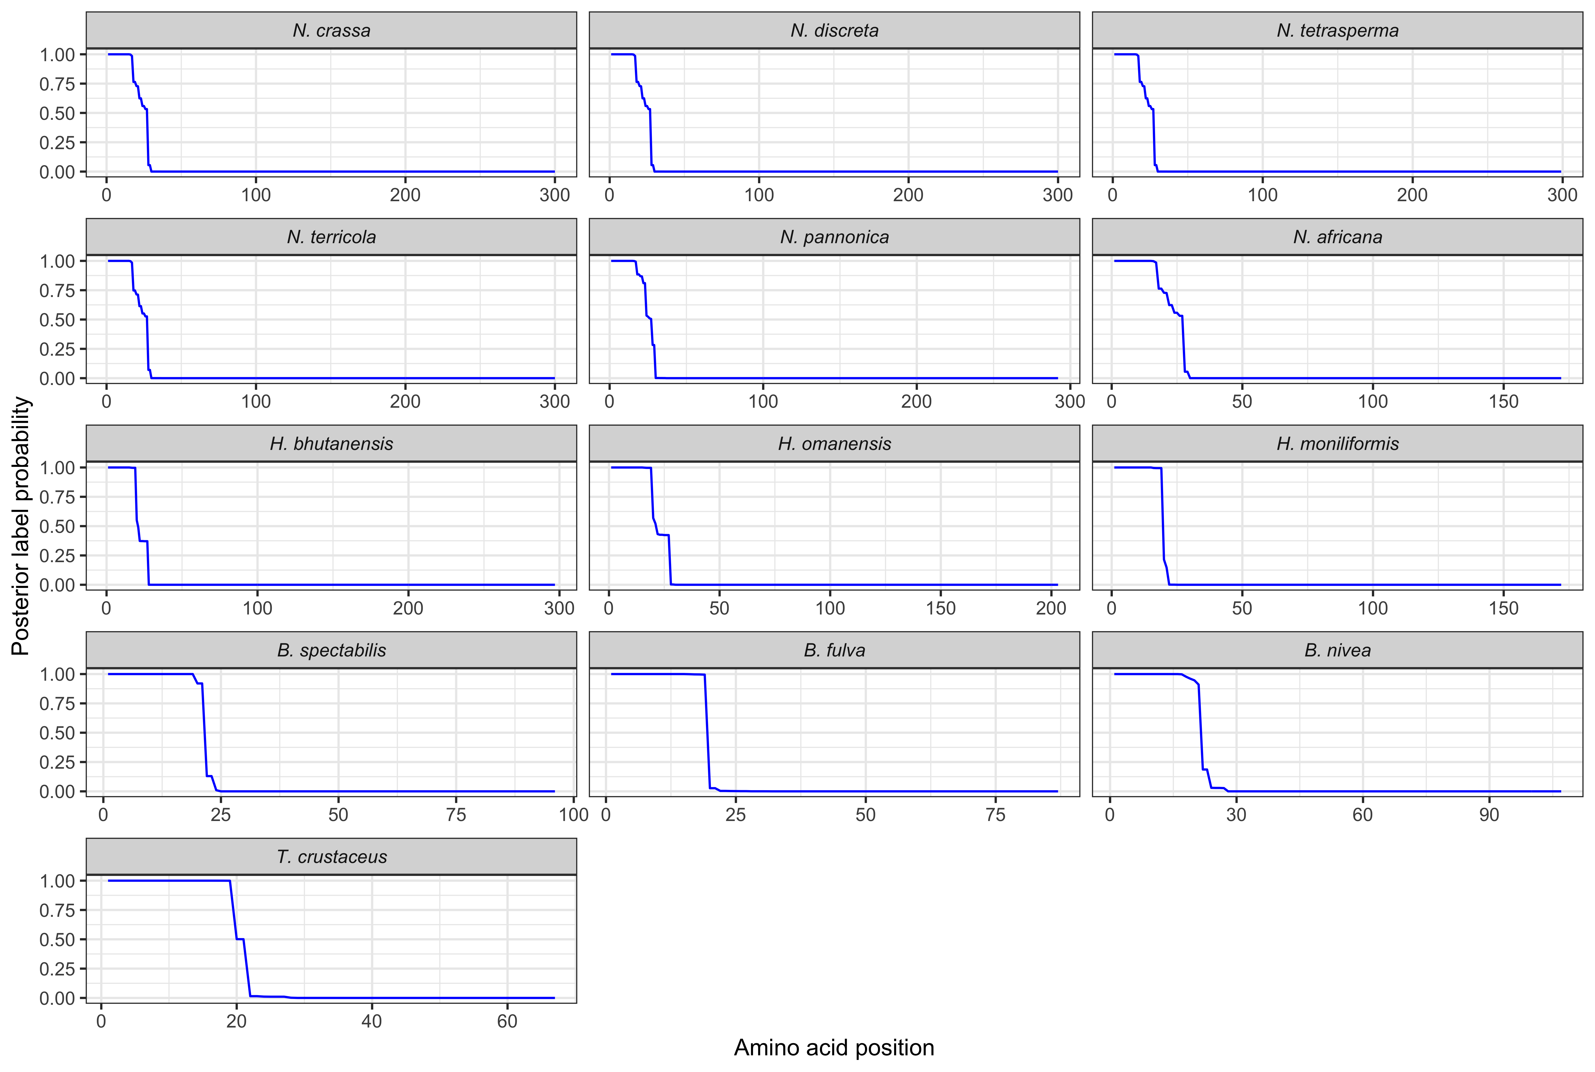
Fig C.2: Plots confirming the presence of a signal peptide at the N-terminal of each of the α-factor pheromone proteins.

