Slide 1
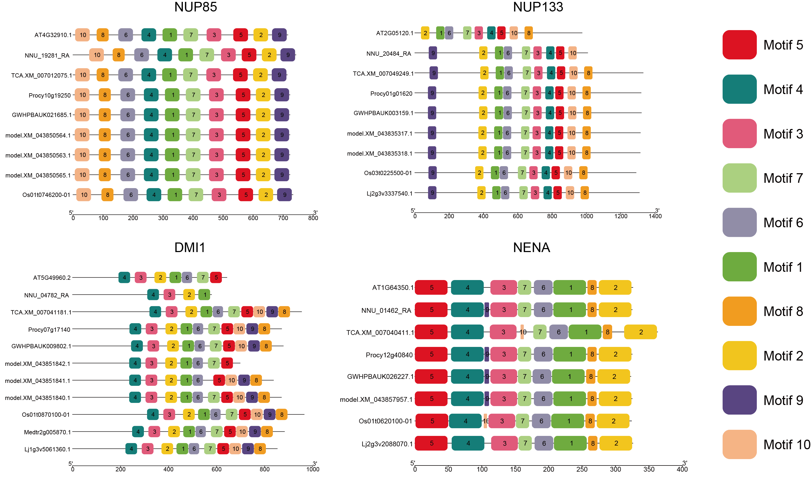
Supplemental Figure 7. The conserved motifs of NUP85, NUP133, POLLUX/DMI1 and NENA were identified using MEME suite

