Slide 1
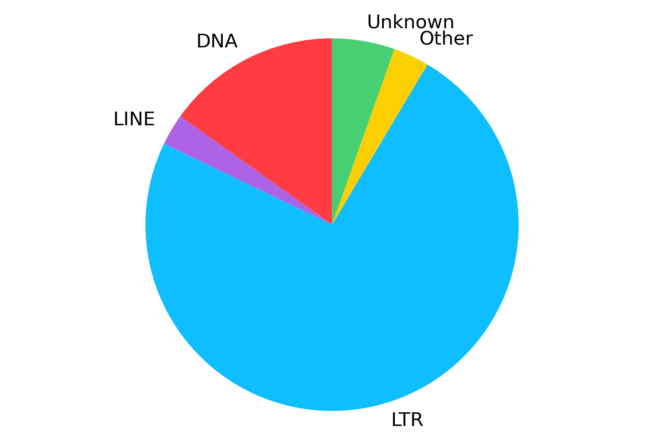
Supplemental Figure 3. Repeat content of the assembly showing the relative proportions of the DNA element, long terminal (LTR), long interspersed (LINE), and other and unclassified repeats

