Slide 1
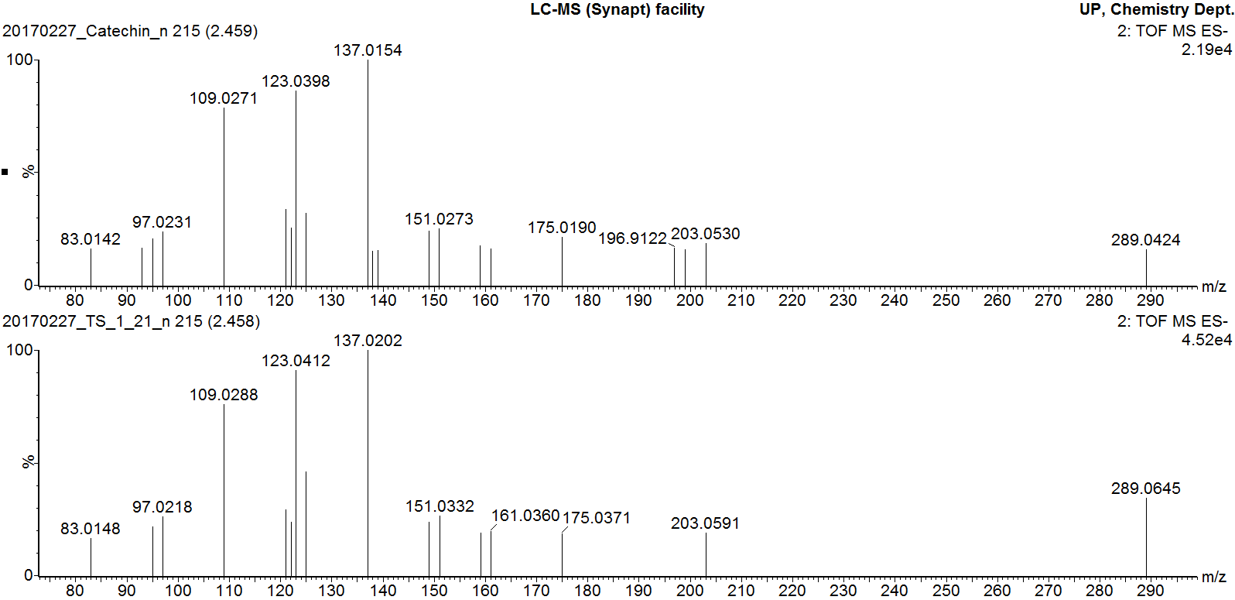
MS/MS fragmentation of catechin standard
MS/MS fragmentation of peak 2
Additional file 5
MS/MS fragmentation pattern of catechin pure standard overlaid with MS/MS fragmentation of peak 2

