Slide 1
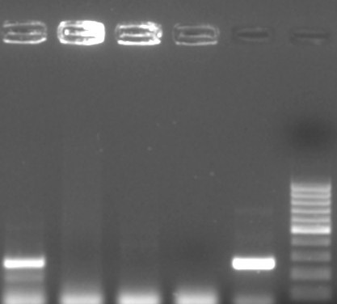
1
2
3
NC
PC
M
Fig S2: Gel electrophoresis image illustrating amplification of esxB gene fragment using M. smegmatis derived primers. Lanes 1 is a positive sample, lane NC is a negative control, while lane PC is M. smegmatis positive control, and lane M is a 100bp Molecular weight marker (100 bp O’gene Ruler from Thermo Fisher Scientific)

