Slide 1
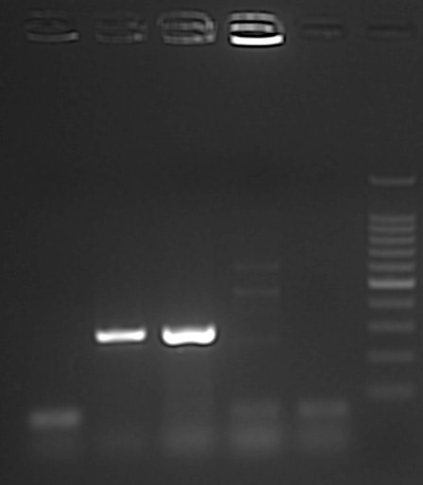
1
2
3
4
5
M
Fig S3: Gel electrophoresis image illustrating amplification of esxA gene fragment using M. bovis derived primers. Lanes 1 and 4 are negative samples, Lane 2, is a positive sample and lane 3 is M. bovis control while lane 5 is a negative control, and lane M, a 100bp Molecular weight marker (100 bp O’gene Ruler from Thermo Fisher Scientific)

