Slide 1
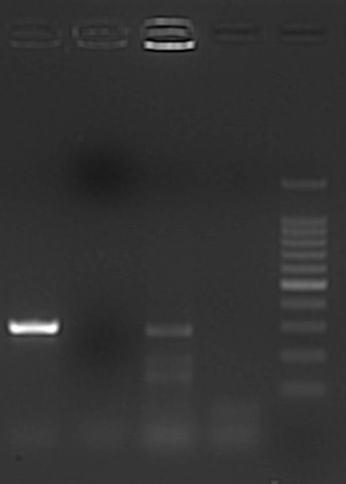
2
1
3
4
M
Fig S4: Gel electrophoresis image illustrating amplification of esxB gene fragment using M. bovis derived primers. Lanes 1 is M. bovis control, Lane 2, is a negative sample and lane 3 is a positive sample while lane 4 is a negative control, and lane M, a 100bp Molecular weight marker (100 bp O’gene Ruler from Thermo Fisher Scientific)

