Slide 1
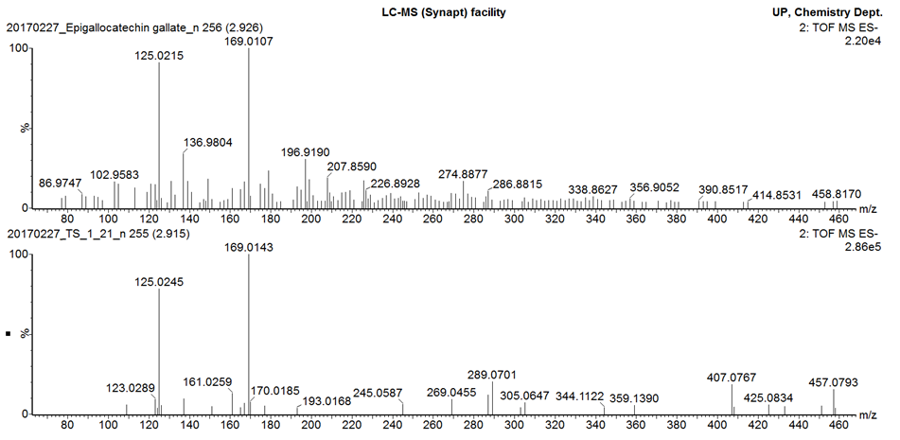
MS/MS fragmentation of epigallocatechin gallate pure standard
MS/MS fragmentation of peak 4
Additional file 7
MS/MS fragmentation pattern of epigallocatechin gallate pure standard overlaid with MS/MS fragmentation of peak 4

