Slide 1


Department of
Library Services
Identify best partners for research or publications

Slide 2
Contents
Motivation (Slide 3)
ResearchGate (Slides 4-9)
Scopus (Slides 10-21)
International Conferences (Slides 22-26)

Slide 3
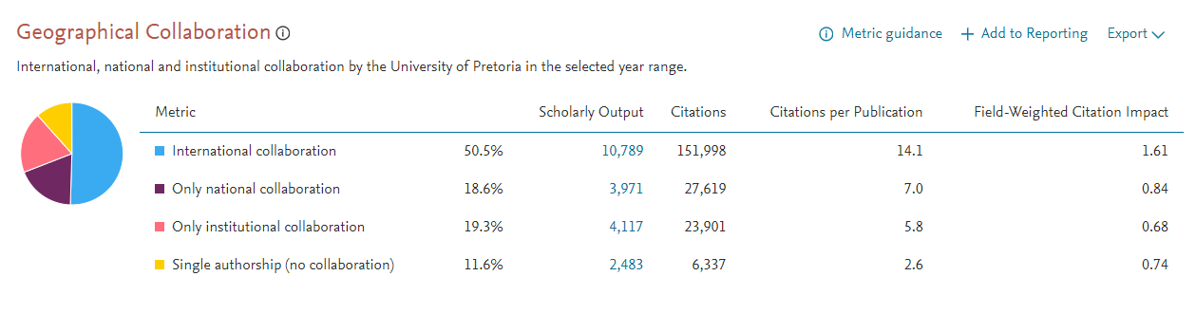
UP international co-authorship, 2018-2023

Slide 4
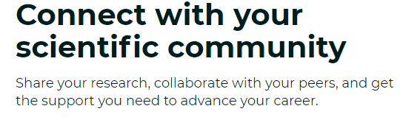


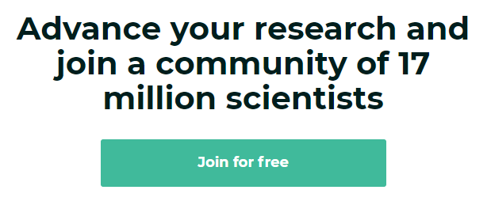
ResearchGate: https://www.researchgate.net

Slide 5
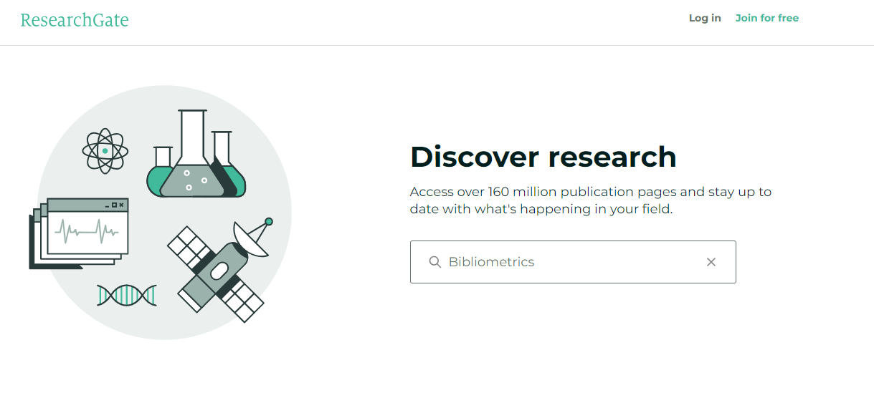
Search for researchers, publications and more

Slide 6
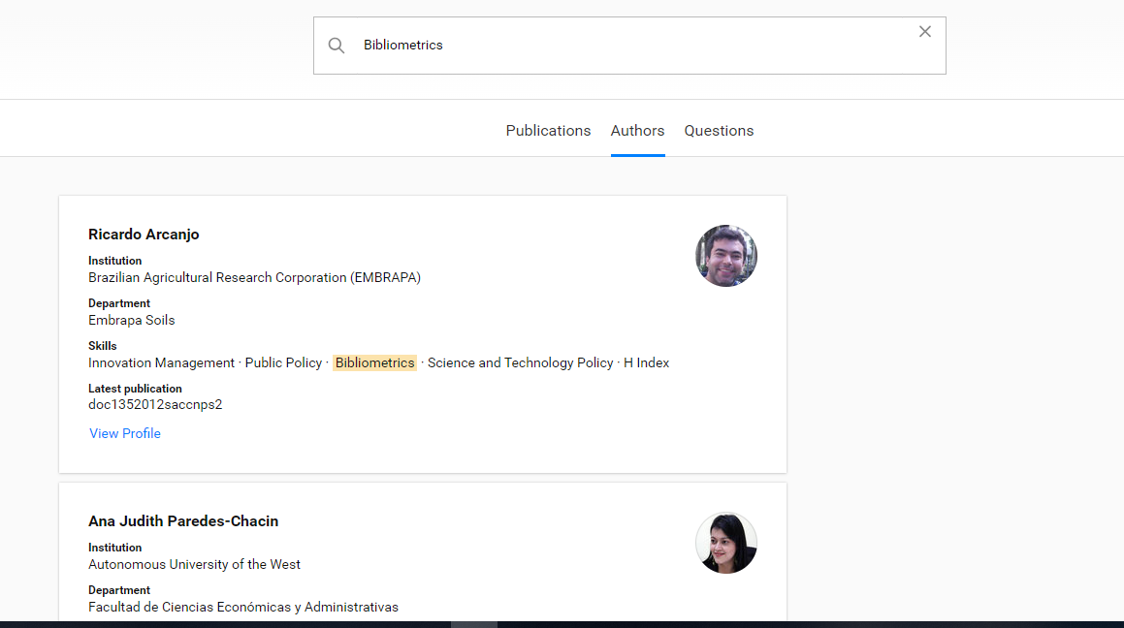
ResearchGate Search Results

Slide 7
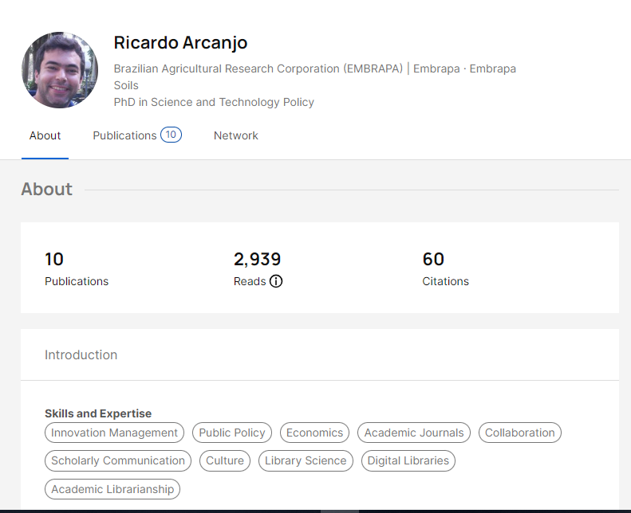
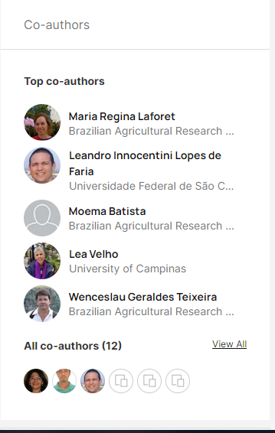
ResearchGate Author Profile

Slide 8
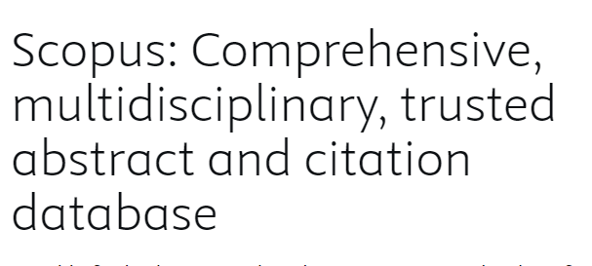
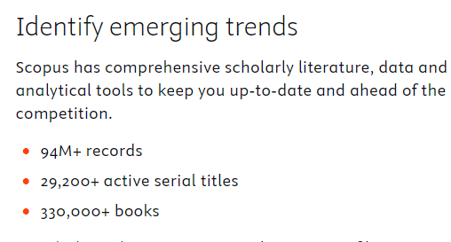
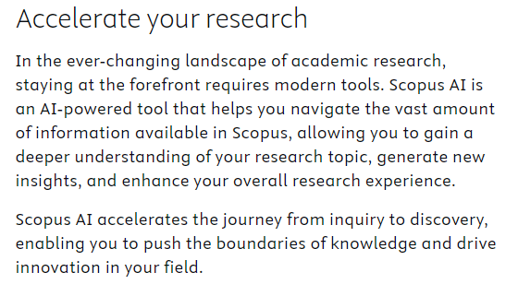
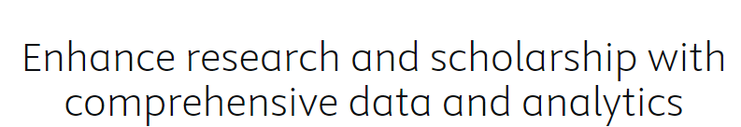
Scopus

Slide 9
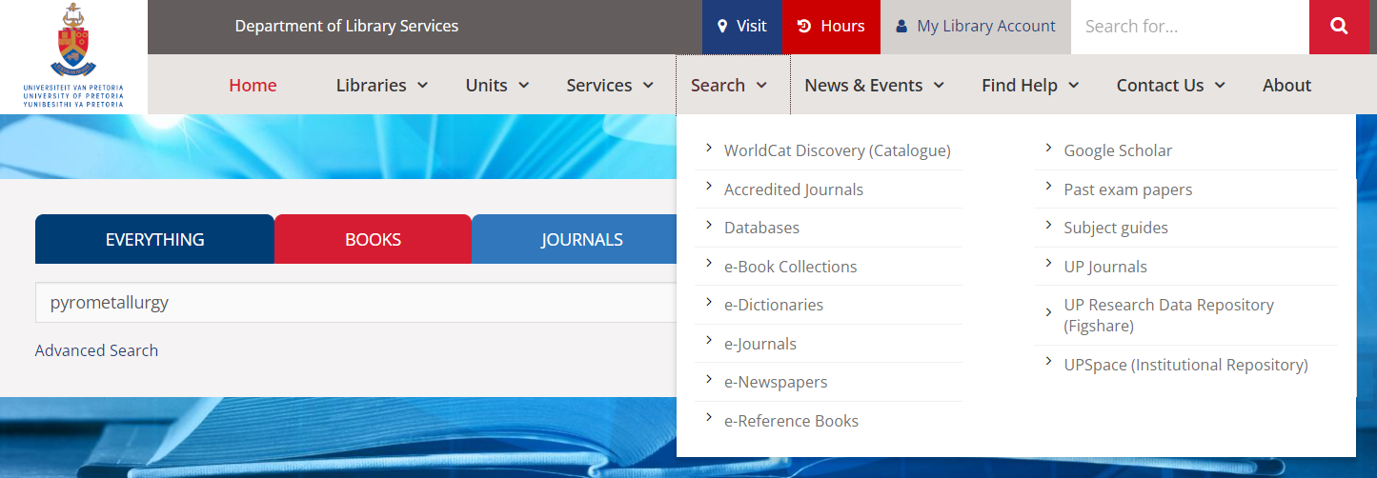

Finding Scopus

Slide 10
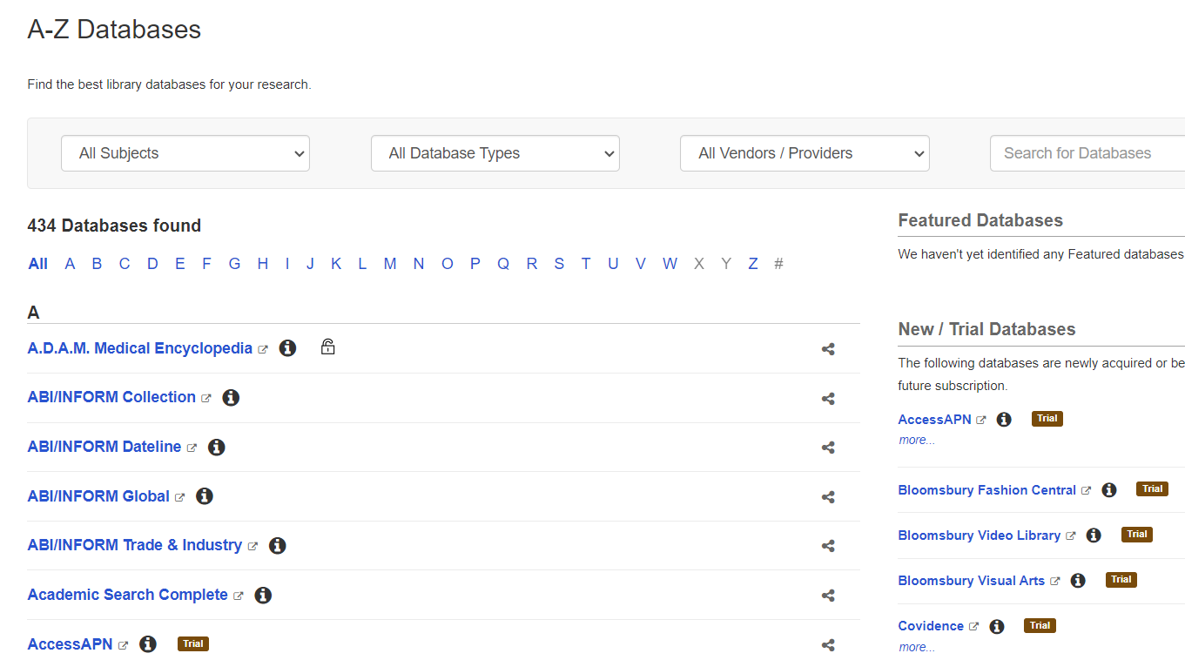
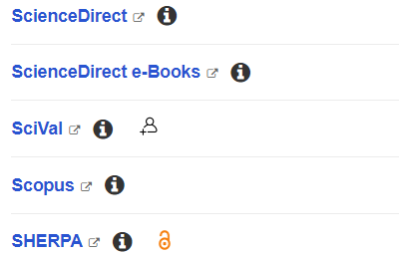
Finding Scopus Database

Slide 11
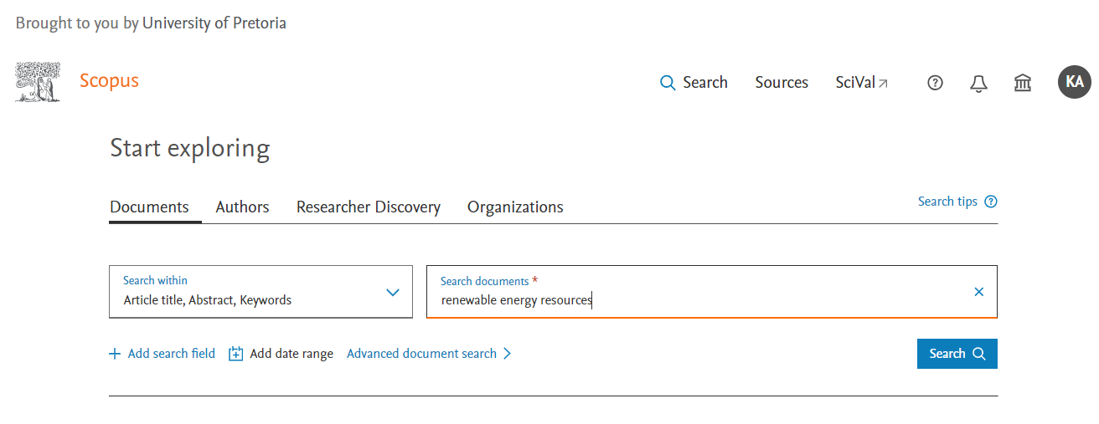
Scopus Keyword

Slide 12
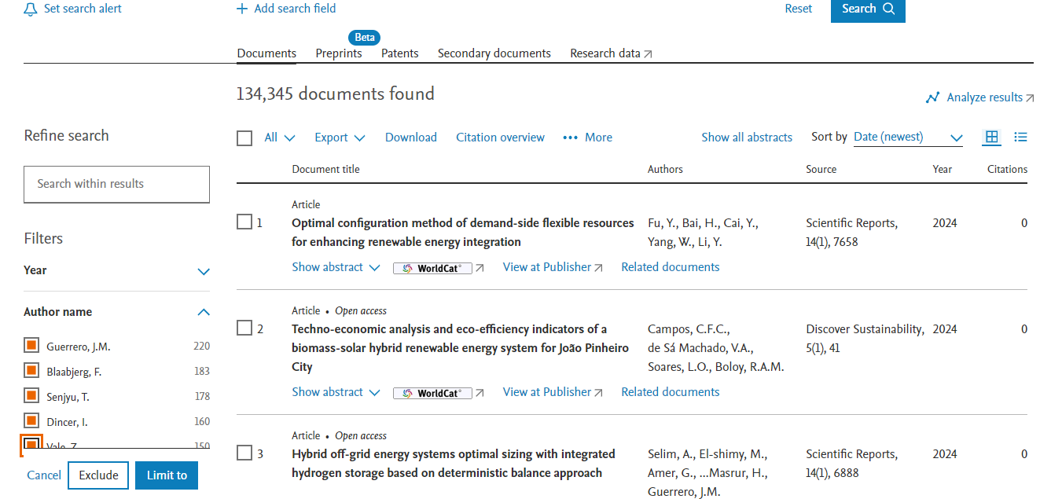
Finding Scopus

Slide 13
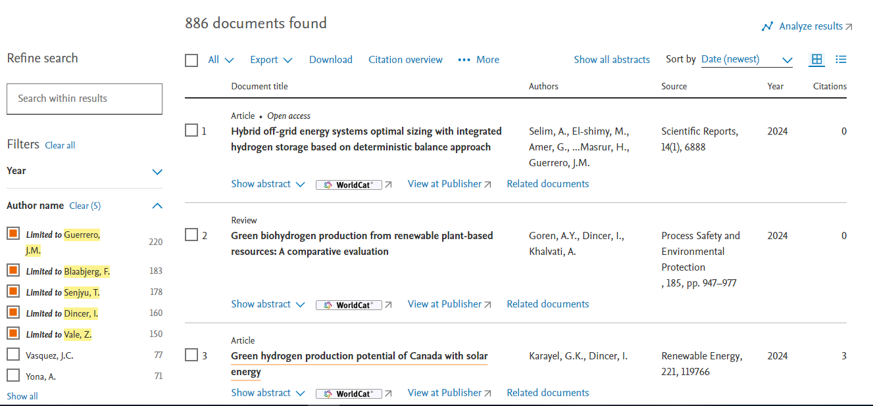

Selecting an Author

Slide 14
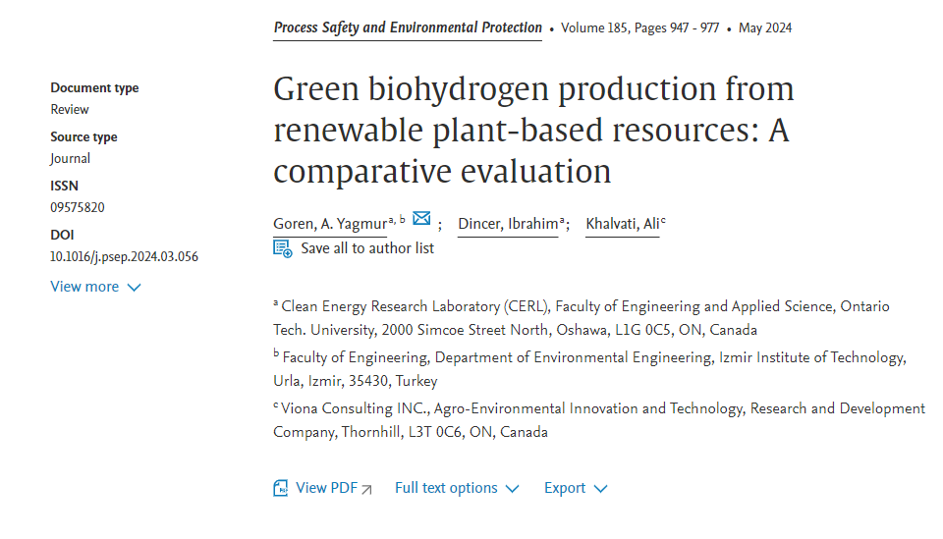
Author Details

Slide 15
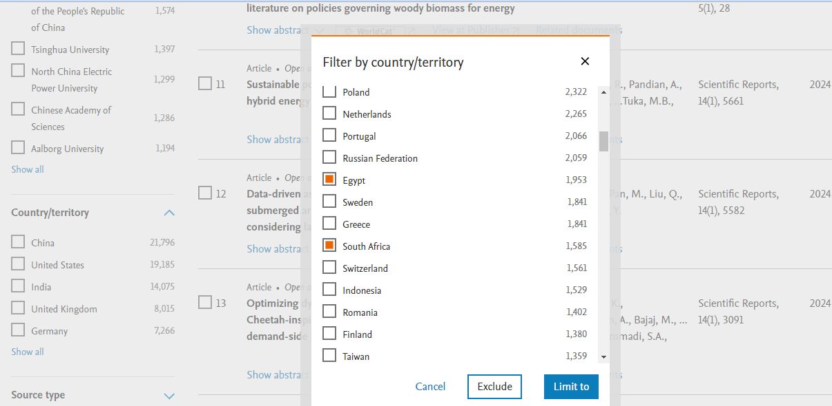
Refining by Geographical Location

Slide 16
Conferences
Identify conferences to attend
Professional organisations/Associations
Conal conference alerts, https://conferencealerts.com/
AllConferences.com is a Global Online Conference Directory

Slide 17
Tips and tricks to make conferences work for you
Networking at a live conference
Networking at an online conference
Submit a paper or a poster

Slide 18
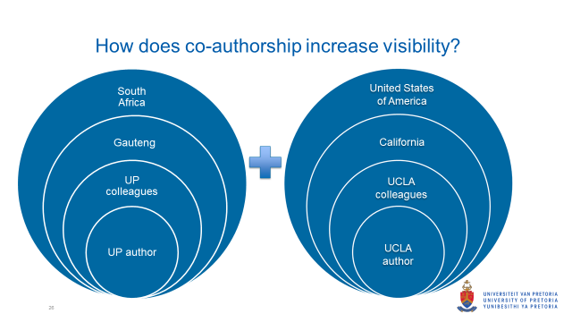
Co- Authorship and Visibility

Slide 19
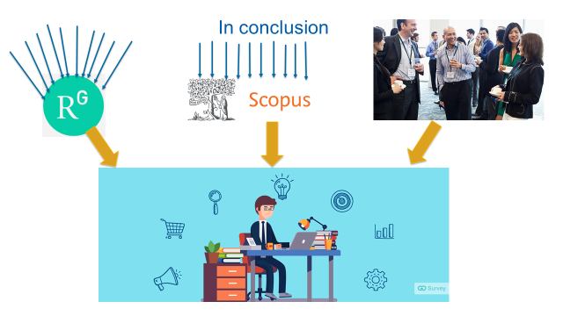
Conclusion

Slide 20
Any question?
Katlego.Aphane@up.ac.za

