Slide 1
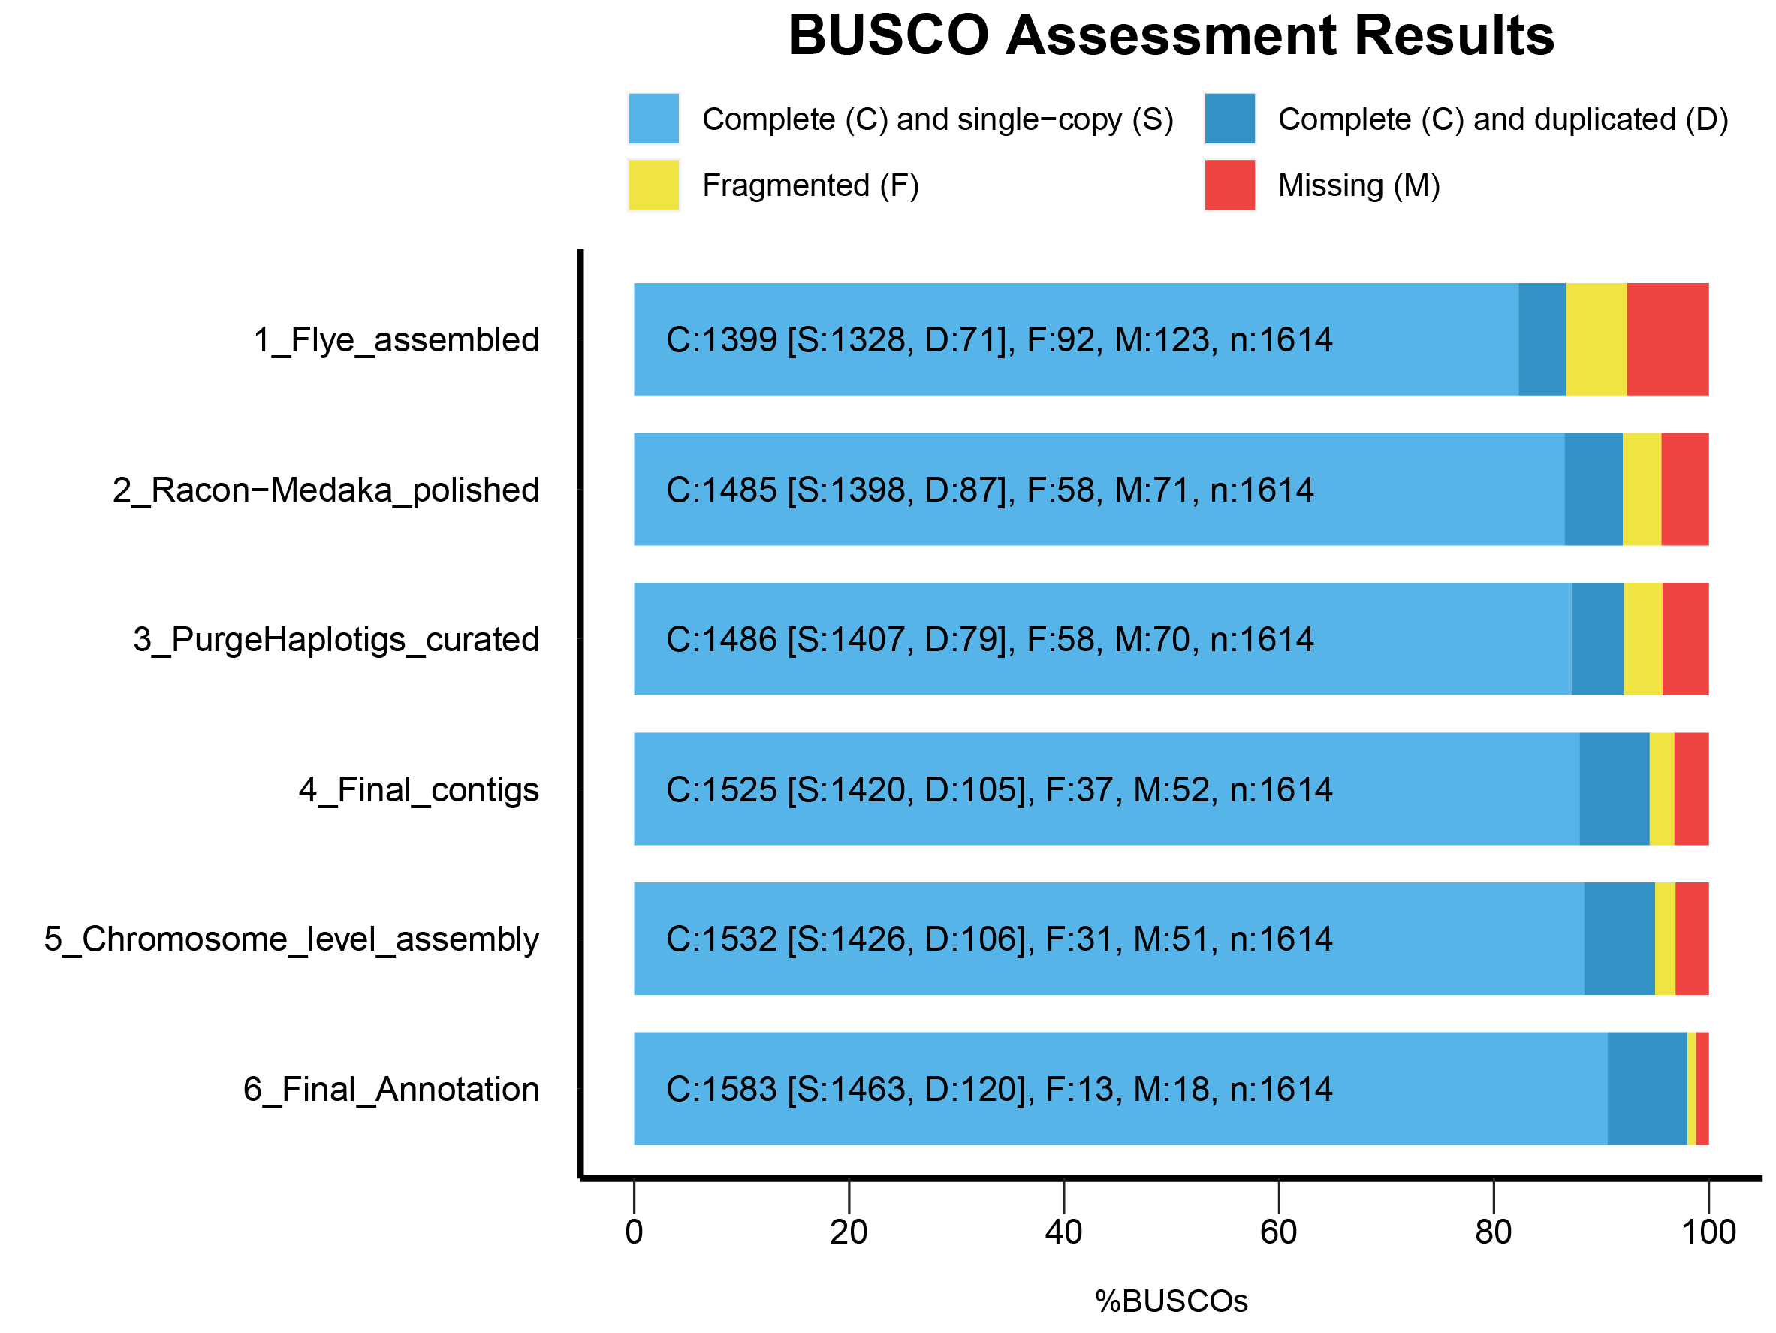
Supplemental Figure 2. BUSCO scores were obtained from runs with the embryophyta_odb10 dataset (n=1614) on the intermediate stages and the final assembly and annotation.

