Slide 1
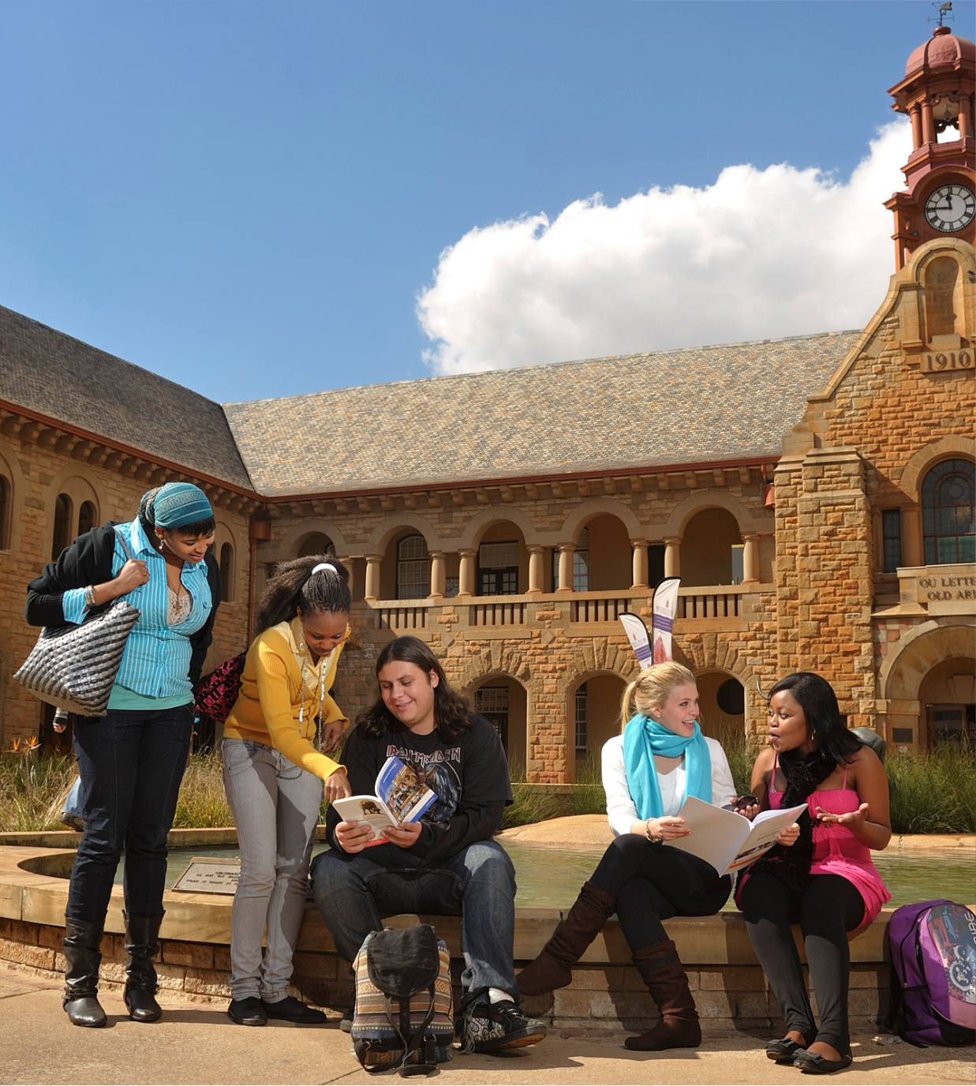
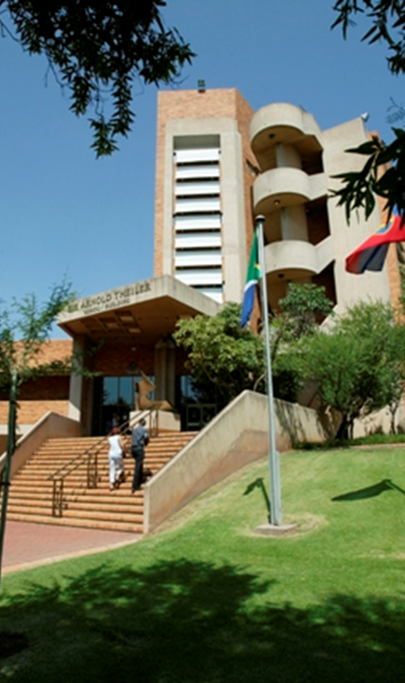
ClickUP module experience: VRE520. Partners in equipping UG students to write a scientific research report. -Tertia Coetsee-
Notes:
I would like to share experience that Susan March and I gained while presenting part of a ClickUP module for our 5th year students in 2019. Veterinary Research Report (VRE 520 and VRE 600) is an undergraduate module that begins in the second semester of the fifth year of the BVSc curriculum. This module is about learning how to do research in veterinary science and how to write a research report in a prescribed scientific format. This module was first presented in 2019. Susan and I are co-lecturers of this module.
This module begins with a brief introduction to research methodologies. Followed by the selection of a research topic, conducting their research and writing a research report in one of three prescribed scientific formats (literature review, a case study report or an experimental research report.) Each student is supervised by an academic staff member.

Slide 2
Outcome 1: Literature search and reference management
Students need to identify the relevant literature from research databases for a specific research topic and compile it using EndNote.
Perform a literature search using the catalogue WorldCat Discovery and databases (CAB, Google Scholar & Web of Science) for a specific research topic
Identify relevant literature from the search results
Export the identified literature references to EndNote
Use the EndNote references for in-text citations and their reference list
Notes:
The library part (Outcome 1 ) offers training on searching for literature using various databases and using EndNote, to manage literature found and to use them in the research report as in-text citations and to create a reference list according to a specific referencing style.
Last year, we started off with a orientation session in the "Computer Lab" where we informed the students on every step of Outcome one, what to do, how to conduct their searching, and where to find links and information. This year, due to the covid-19 lockdown we have to do it online via Blackboard Collaborate.

Slide 3
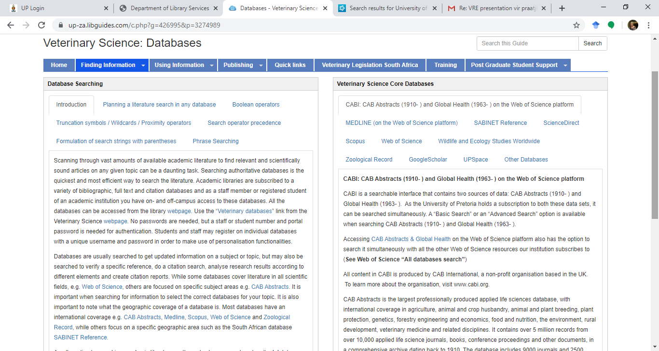
Notes:
As part of our orientation session we direct the students to this LibGuide named Veterinary Science: Databases. On this LibGuide users are firstly informed on how to search, using keywords and conducting a search strategy, using Boolean search operators etc. All core Veterinary databases are also identified, with a description of the databasis and links to direct them to the databasis.
We also instruct them to use the Endnote LibGuide, links are provided.

Slide 4
Outcome 1 Self-study
Power points available in ClickUP on the Library Reference page:
How to search CABAbstracts on the Web of Science platform
How to search Google Scholar
How to search the Worldcat Discovery catalogue
How to use Endnote (parts 1 and 2)
Notes:
VRE520 is mainly a self-study module.
All the electronic resources needed for self-study of outcome 1 are provided in ClickUP on the Library Reference Page.
The following Power points are available in the Learning Resources section in ClickUP

Slide 5
Outcome 1 Self-study
Links available in ClickUP on the Library Reference Page:
A list of Veterinary Science databases
The library’s research support LibGuide to give information about database searching
The WorldCat Discovery catalogue
The Endnote LibGuide
Notes:
The following links to resources and information sources are also available through the Library reference page.

Slide 6
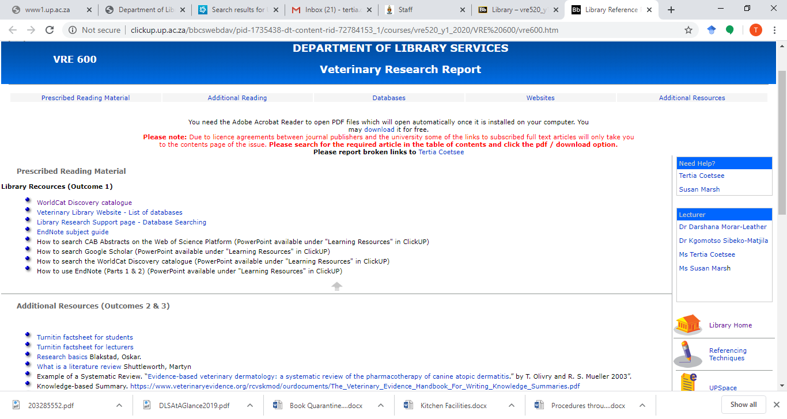
Notes:
We provide a Library reference page on ClickUP

Slide 7
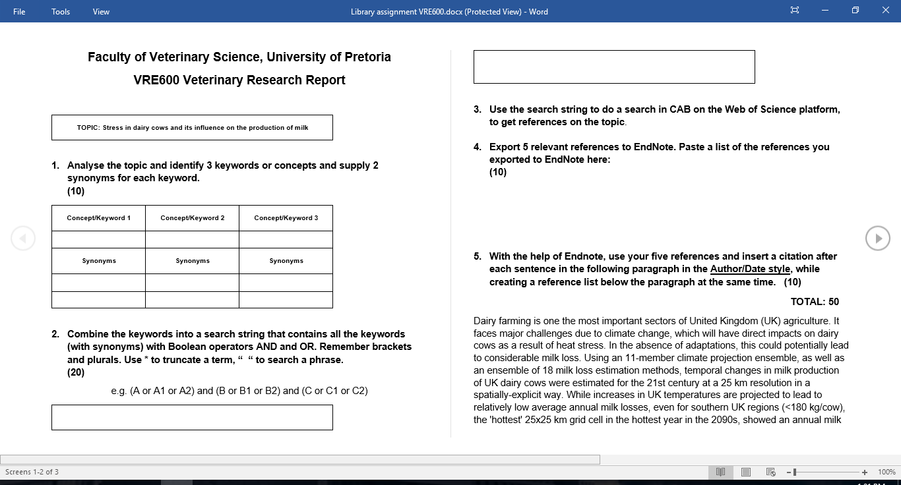
Assignment
Notes:
The students have one assignment that needs to be completed for Outcome 1. This contributes 10% to their year mark.
The assignment give students the opportunity to practice their skills in searching for information on a topic that we provide, select relevant references, manage these references with Endnote, insert in-text references in a paragraph supplied to them and create a reference list at the end of the paragraph according to a specific referencing technique. For the assignment we suggest the Author-Date referencing technique.
The idea behind the assignment is that after completion of outcome 1 the student will be equipped to follow the same approach when finding literature and writing their research report. The assignment is on ClickUP, students complete it in a given time frame and we mark it online and can add remarks, so that the student can see were they can improve when they do their research for the report.
Generally the students fared very well. About 80 percent got full marks, a few were careless, with search strategy, or with citing or forgot to use the correct boolean search operators, but mostly we were very pleased with their results.

Slide 8
Thank you!
Notes:
Thank You

