Slide 1
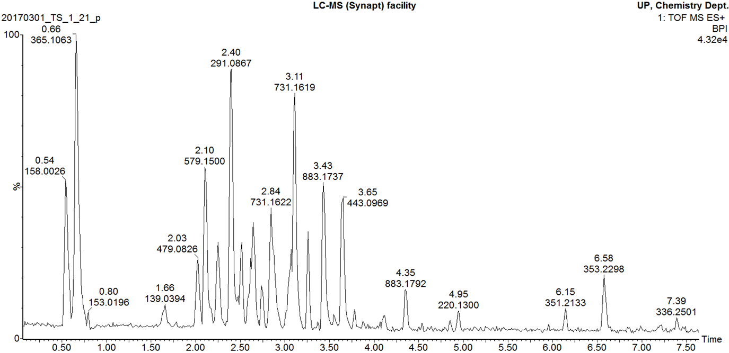
Additional file 1
Positive mode Base Peak Ion (BPI) chromatogram of Marula stem ethanol extract

