Slide 1
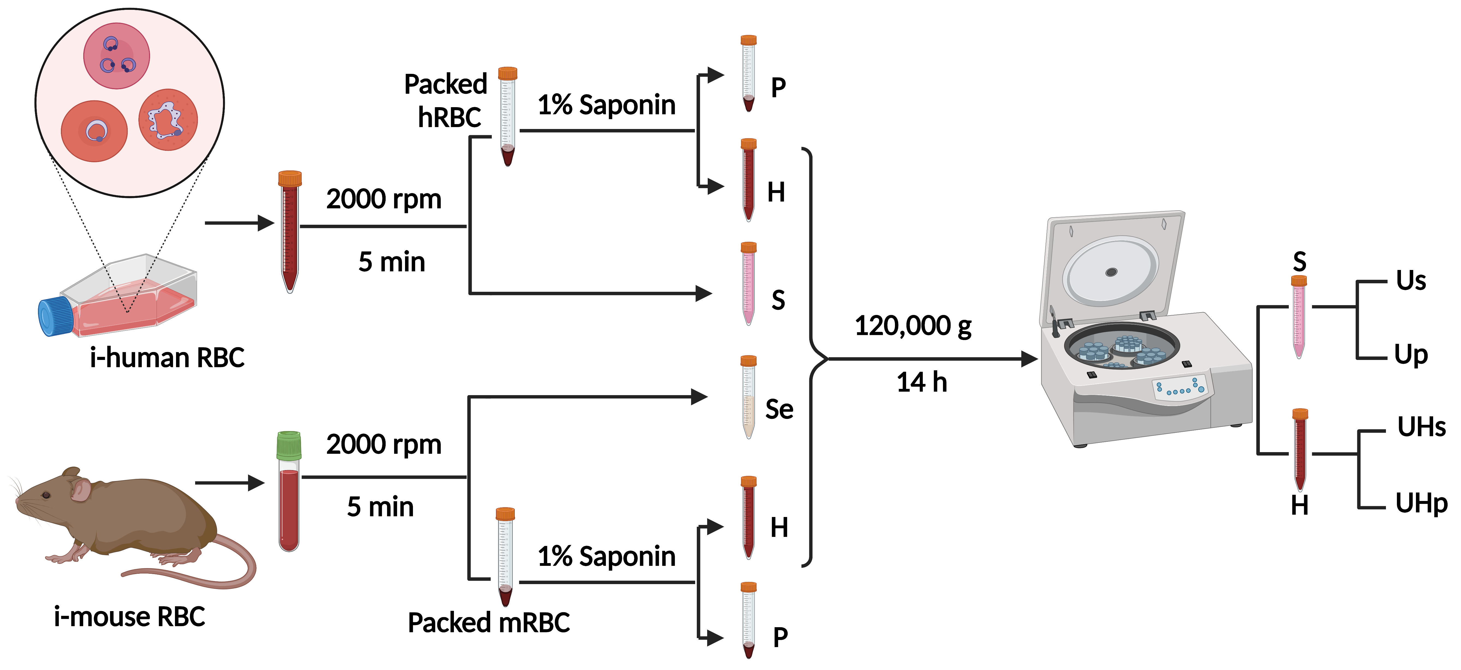
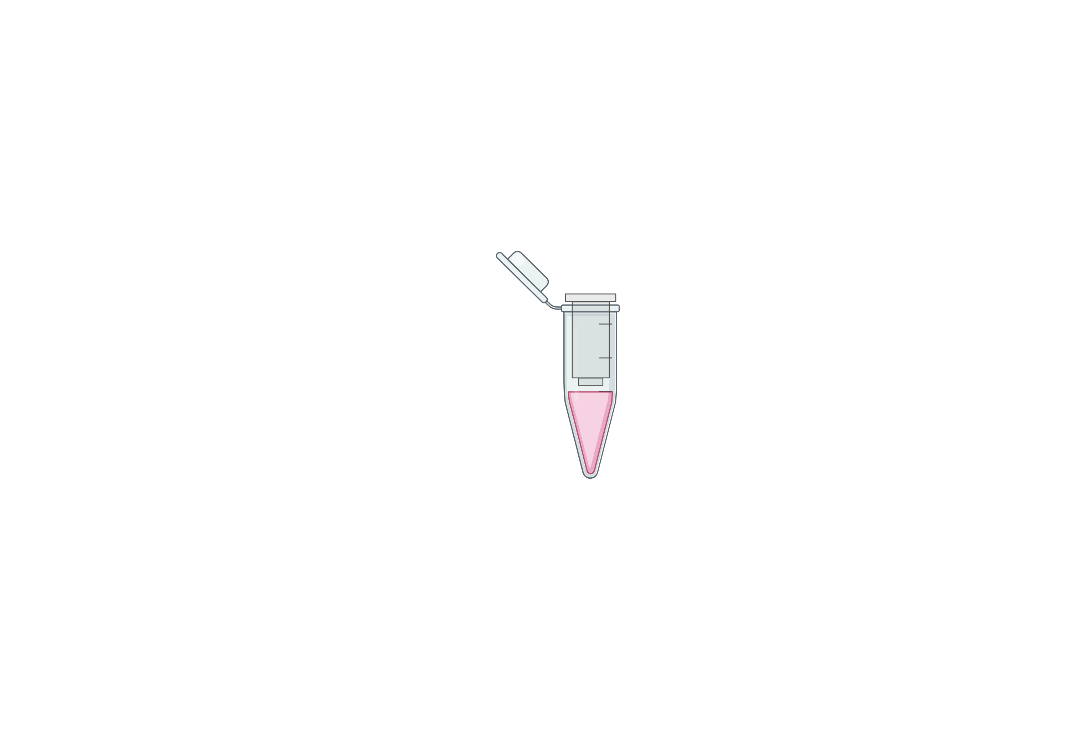

Figure S1
A
B
Es
250 µl samples + ExoQuick ULTRA
3000g
EVs
10 min
Purification
EVs
EVs
Figure S1. Workflow of extracellular vesicles isolation from the B. duncani exportome. (A) The diagram illustrates the process of isolating extracellular vesicles from various in vitro and in vivo sources, including B. duncani culture S, H, P fractions and serum (Se), H, P fractions from mouse infected erythrocytes with Babesia duncani. The vesicle isolation method involves subjecting the samples to ultracentrifugation to separate the supernatant fraction (Us/UHs) or the pellet fraction (Up/UHp), thereby isolating the extracellular vesicles for further analysis. (B) The workflow of ExoQuick ULTRA EV isolation involves isolating extracellular vesicles (EVs) from various sources such as serum/plasma, supernatant, or hemolysate obtained from both uninfected and B. duncani infected in vitro cultures, as well as from mouse blood samples. This process typically includes steps such as sample collection, centrifugation to remove cells and debris, the addition of ExoQuick ULTRA reagent to the samples, incubation, and subsequent centrifugation to pellet the EVs. The isolated EVs can then be further characterized and analyzed.

Slide 2
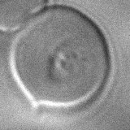
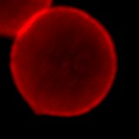

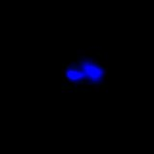
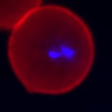
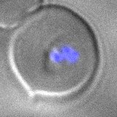
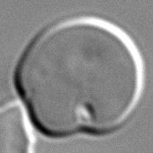
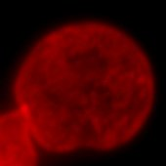
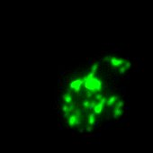
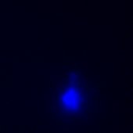
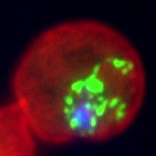
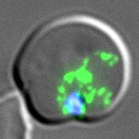
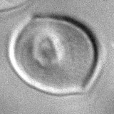
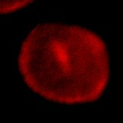

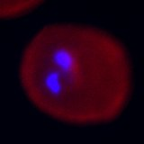
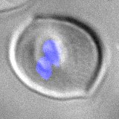
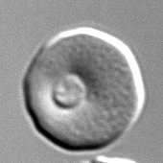
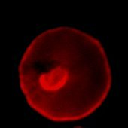
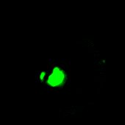
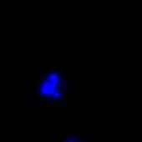
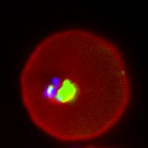
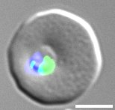
Figure S2
DIC
Band III
Alexa Fluor 488
DAPI
Merge
DIC/Merge
Pre-immune
sera
Anti-BdV234
Immune
sera
Pre-immune
sera
Anti-BdV38
Immune
sera
5 µm
Figure S2. Immunofluorescence assay for the detection of subcellular localization of B. duncani secreted proteins. Immunofluorescence staining of BdV234 and BdV38 proteins using rabbit polyclonal anti-BdV234 and BdV38 antibodies. Samples were subsequently, stained with an anti-rabbit secondary antibody conjugated with Alexa Fluor (AF)-488 (Green) in B. duncani -infected human RBCs. Anti–Band-III monoclonal antibody (Red) was used to label the human erythrocyte plasma membrane, and DAPI (Blue) was used to stain the parasite nucleus (DNA). The green fluorophore reveals both the localization and distribution of the parasite-secreted proteins within or outside the host red blood cell. Immune Sera: rabbit sera collected after injection of recombinant BdV234 and BdV38 recombinant proteins, and preimmune sera: same rabbit sera collected before injection of recombinant proteins. Differential Interference Contrast (DIC). Scale bars, 5µm.

Slide 3
Figure S3
A
B
BdV38 detection (in vitro)
OD at 450 nm
BdV38 detection (in vivo)
OD at 450 nm
C
D
BdV234 detection (in vitro)
OD at 450 nm
BdV234 detection (in vivo)
OD at 450 nm
Figure S3. Whole blood and hemolysate compression as a source of antigen. Graphs depict the comparative ELISA detection profiles of two different antigen sources, hemolysate, and whole blood, treated with various lysis buffers (1% saponin, 1% Triton X-100, and 1% saponin + Triton X-100). Panel (A) illustrates the comparable detection profiles of Bd38ACA between whole blood and hemolysate obtained from B. duncani in vitro cultures, while Panel (B) demonstrates a comparison between hemolysate and whole blood from B. duncani-infected mouse samples. Likewise, panel (C) shows the comparison of Bd234ACA detection between whole blood and hemolysate samples derived from cultured B. duncani parasites in human RBCs, and Panel (D) displays the comparison in B. duncani-infected mouse whole blood and hemolysate. Uninfected whole blood (u-WB) and uninfected hemolysate from human RBCs (uhRBCs) and mouse RBCs (umRBCs) served as controls. u-WB: uninfected whole blood, i-WB: infected whole blood, ihRBCs: infected human RBCs, imRBCs: infected mouse RBCs.

Slide 4
Figure S4
A
B
Figure S4. Detection of BdV234 antigen after Tafenoquine treatment of B. duncani cultures and in mice. (A) Untreated (UT) or Tafenoquine-treated (1x IC₅₀ and 2x IC₅₀ TQ) samples were collected over time and utilized as an antigen source in the Bd234ACA detection of BdV234 antigen in B. duncani in vitro culture hemolysate. (B) Vehicle-treated (PEG-400)/untreated or B. duncani 10⁶ infected mouse hemolysate was used as an antigen source to detect the BdV234 antigen in the untreated or tafenoquine-treated samples.

Slide 5
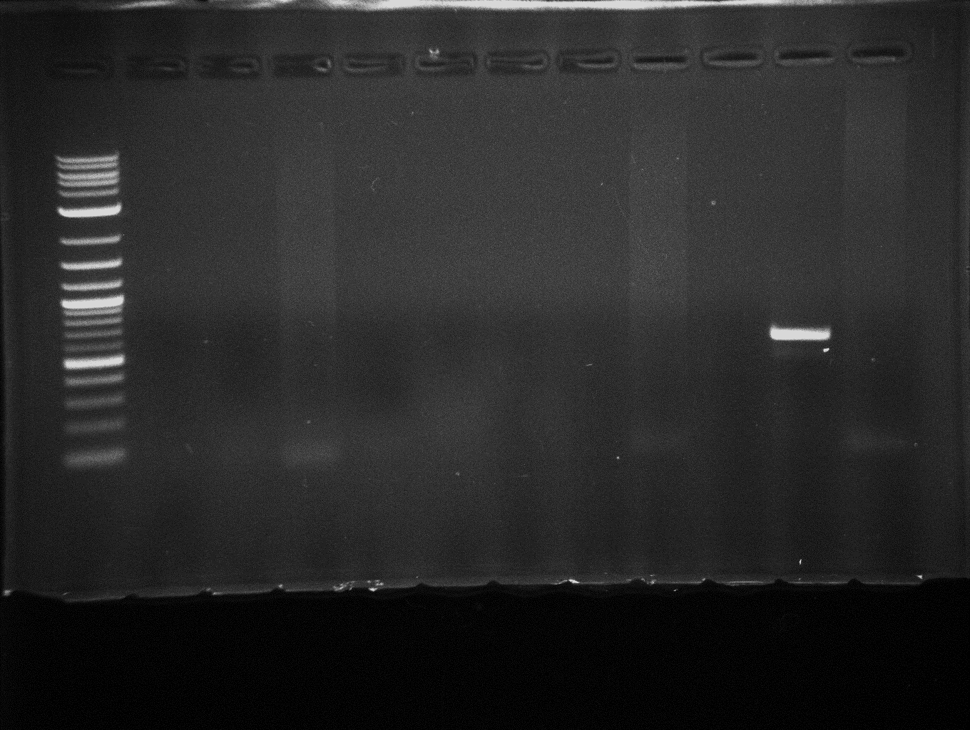
Figure S5
A
kb
M
L28
L85
L139
A30
F1
F6
F7
F8
F15
Bd⁺
R
3
1
0.5
0.1
B. duncani HSP70 primers (1000 bp)
B
kb
M
L28
L85
L139
A30
F1
F6
F7
F8
F15
Bd⁺
R
3
1
0.5
0.1
B. duncani CelTOS primers (500 bp)
C
kb
M
L28
L85
L139
A30
F1
F6
F7
F8
F15
Bd⁺
R
3
1
0.5
0.1
BdV38 primers (500 bp)
Figure S5. PCR detection of B. duncani-specific gene primer sets from selected human samples as well as from field mice samples. Agarose gel electrophoresis (1% agarose) images depict the PCR amplification of B. duncani specific (A) HSP-70 primers, (B) B. duncani CelTOS primer sets, (C) BdV38 primer set. The genomic DNA from B. duncani infected or uninfected human RBCs served as positive and negative control respectively. Lanes 1: M (marker) 1kb plus DNA size marker, 2: LDB 28, 3: LDB 85, 4: LDB139, 5: ARC30, 6: FM-1, 7: FM-6, 8: FM-7, 9: FM-8, 10: FM-15, 11: Bd⁺, 12: RBC. LDB-Lyme Disease Biobank, ARC-American Red Cross, FM-field mice, Bd-Babesia duncani, and RBC-Red Blood Cells.

Slide 6
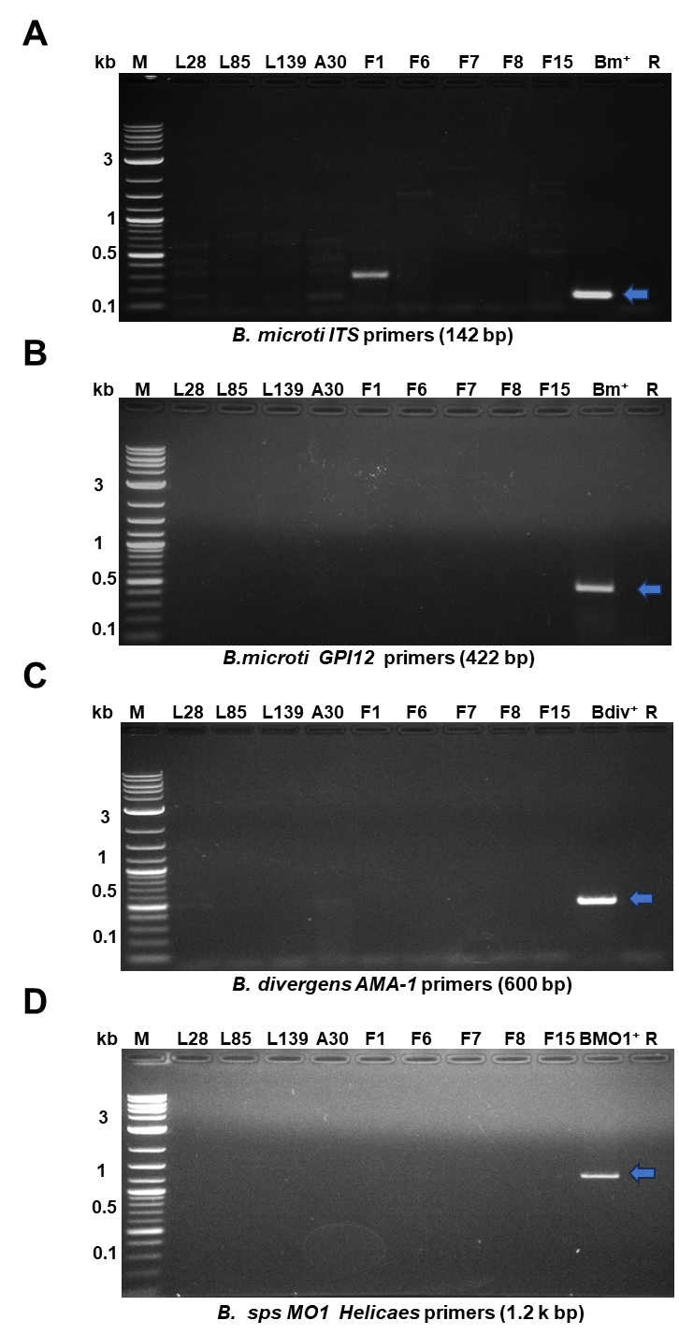
Figure S6
Figure S6. PCR amplification of various Babesia species from selected human samples as well as from field mice samples. The PCR assay utilized DNA extracted from chosen human patient samples and field mice samples to identify various Babesia species by using specific primer sets targeting different genes: (A) B. microti ITS1 gene primer sets, (B) B. microti GPI12 gene primer sets, (C) B. divergens AMA-1 gene primer sets, (D) B. MO1 helicase primer sets. The genomic DNA extracted from human red blood cells infected with B. duncani was used as a positive control, while DNA from uninfected human red blood cells served as a negative control. Lanes 1: M (marker) 1kb plus DNA size marker, 2: LDB 28, 3: LDB 85, 4: LDB139, 5: ARC30, 6: FM-1, 7: FM-6, 8: FM-7, 9: FM-8, 10: FM-15, 11: Bm+/Bdiv+/BMO1+, 12: R-RBC. LDB-Lyme Disease Biobank, ARC-American Red Cross, FM-field mice, Bm-Babesia microti, Bdiv- Babesia divergens (rouen87), BMO1- Babesia MO1, and RBC-Red Blood Cells.

Slide 7
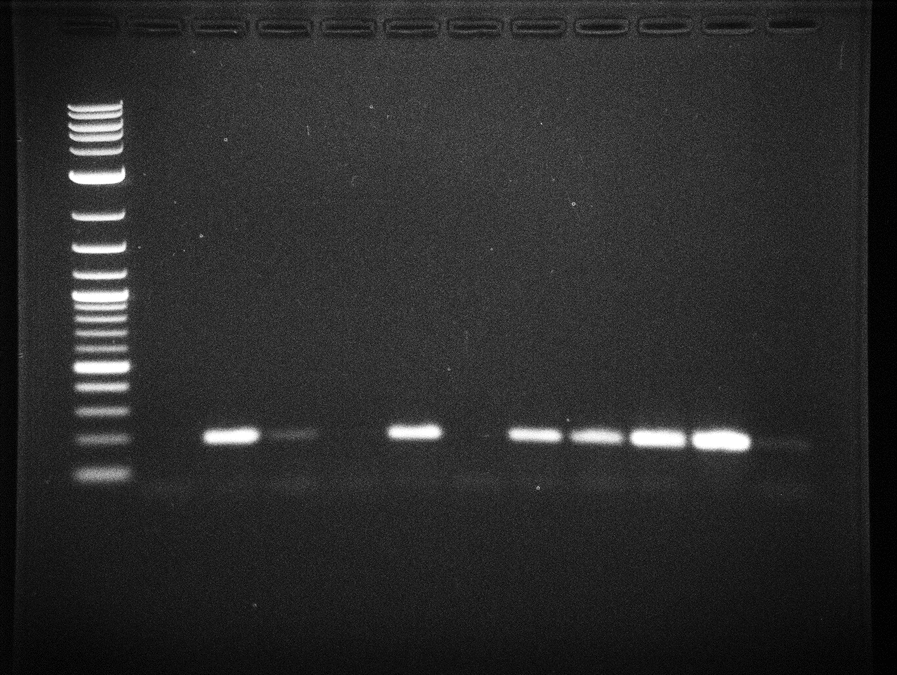
Figure S7
A
B
M
Bd
Bm
Bdiv
Bo
R
kb
M
L28
L85
L139
A30
F1
F6
F7
F8
F15
Bd⁺
R
3
3
1
1
0.5
0.5
0.1
0.1
B. common 18S rRNA primers (200 bp)
B. common 18S rRNA primers (200 bp)
C
D
kb
M
Bd
Bm
Bdiv
B.o
R
M
L28
L85
L139
A30
F1
F6
F7
F8
F15
Bd⁺
R
3
3
1
1
0.5
0.5
Babesia 18S rRNA primers (736 bp)
0.1
Babesia 18S rRNA primers (736 bp)
Figure S7. PCR amplification of Babesia conserved region of 18S rRNA gene fragments - Agarose gel electrophoresis images display the amplification of the conserved region of the Babesia 18S rRNA gene using two sets of primers. The first primer set, previously reported by Barbara et al., 2017, amplifies a 200-base pair fragment. Panel (A) shows the PCR products (200 bp) of the Babesia 18S rRNA gene were obtained from DNA isolated from various Babesia species: B. duncani (Bd), B. microti (Bm), B. divergens (Bdiv), B. odocoilei (Bo) while panel (B) shows the amplified 200 base pair Babesia 18S rRNA gene fragments from Lyme Disease Biobank (LDB85,139) and white-footed mice (FM-1, 7, 8, 15) samples. The second primer set, newly designed for the conserved region of the Babesia 18S rRNA gene amplifies a 736 bp fragment. (C) PCR amplification aimed at the conserved region of the Babesia 18S rRNA gene yielded a 736 bp fragment from DNA extracted from different Babesia species: B. duncani (Bd), B. microti (Bm), B. divergens (Bdiv), and B. odocoilei (Bo). Similarly, (D) PCR amplification targeted a conserved region of the Babesia 18S rRNA gene, resulting in the generation of a 736 bp fragment from DNA sourced from LDB, ARC, and white-footed mice blood. Notably, all five field mice displayed PCR amplification of the 18S rRNA gene, however no detection was found in LDB and ARC samples. The genomic DNA from B. duncani infected or uninfected human RBCs served as positive and negative control respectively. Lanes 1: M (marker) 1kb plus DNA size marker, 2: LDB 28, 3: LDB 85, 4: LDB139, 5: ARC30, 6: FM-1, 7: FM-6, 8: FM-7, 9: FM-8, 10: FM-15, 11: Bd⁺, 12: R-RBC. LDB-Lyme Disease Biobank, ARC-American Red Cross, FM-field mice, Bd-Babesia duncani, and RBCs-Red Blood Cells.

