Slide 1
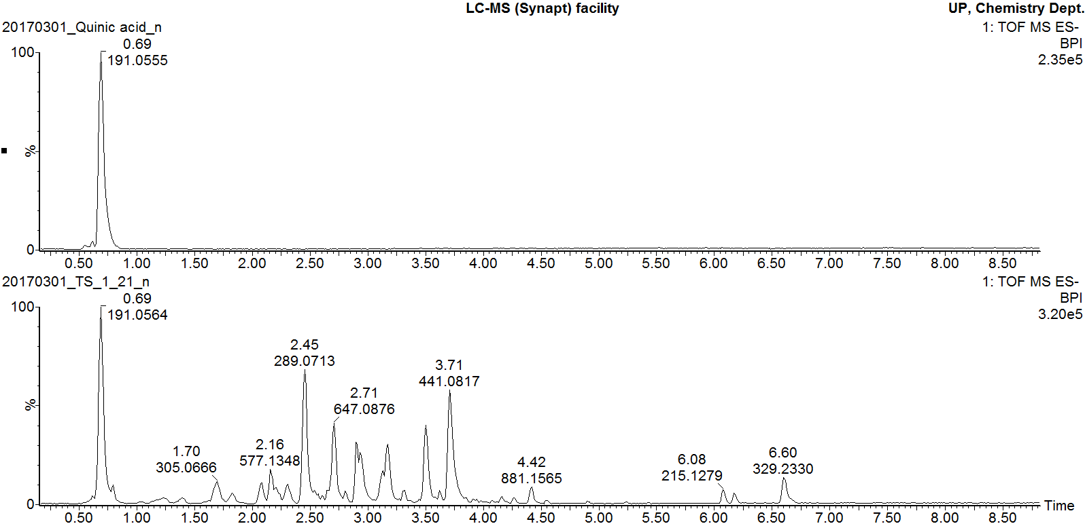
Quinic acid pure standard
Marula stem ethanol extract
Additional file 4
Negative mode BPI chromatogram of quinic acid pure standard overlaid with that of Marula stem ethanol extract

