Slide 1

Sentinel lymph node mapping and intraoperative assessment in a prospective, international, multicentre, observational trial of patients with cervical cancer: The SENTIX trial
David Cibula, Roman Kocian, Andrea Plaikner, Jiri Jarkovsky, Jaroslav Klat, Ignacio Zapardiel, Radovan Pilka, Aureli Torne, Borek Sehnal, Marcela Ostojich, Almerinda Petiz, Octavio A. Sanchez, Jiri Presl, Alessandro Buda, Francesco Raspagliesi, Peter Kascak, Luc van Lonkhuijzen, Marc Barahona, Lubos Minar, Pawel Blecharz, Maja Pakiz, Dariusz Wydra, Leon C. Snyman, Kamil Zalewski, Cristina Zorrero, Pavel Havelka, Mikulas Redecha, Alla Vinnytska, Ignace Vergote, Solveig Tingulstad, Martin Michal, Barbara Kipp, Jiri Slama, Simone Marnitz, Sylva Bajsova, Alicia Hernandez, Daniela Fischerova, Kristyna Nemejcova, Christhardt Kohler
European Journal of Cancer
Volume 137 Pages 69-80 (September 2020)
DOI: 10.1016/j.ejca.2020.06.034
Copyright © 2020 The Author(s) Terms and Conditions

Slide 2
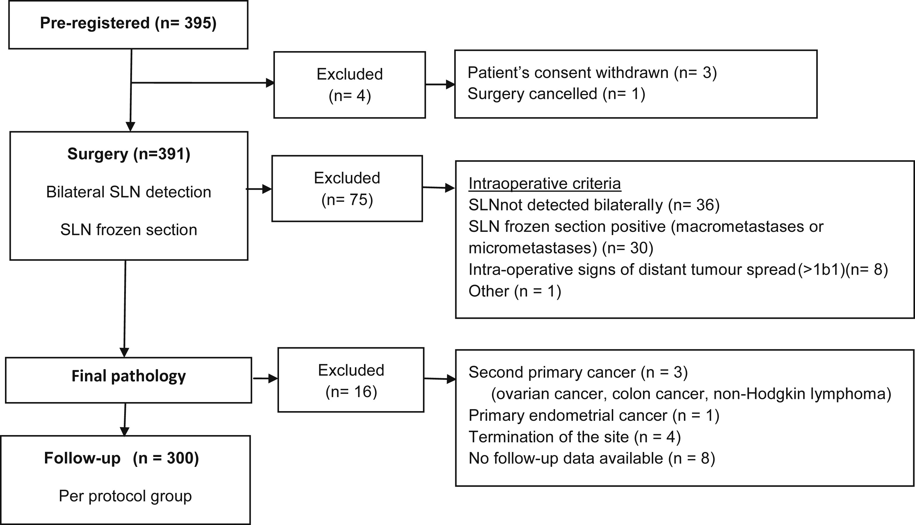
Fig. 1
European Journal of Cancer 2020 13769-80DOI: (10.1016/j.ejca.2020.06.034)
Copyright © 2020 The Author(s) Terms and Conditions
Notes:
Flow chart of patients registered in the SENTIX trial. SLN, sentinel lymph node.

Slide 3
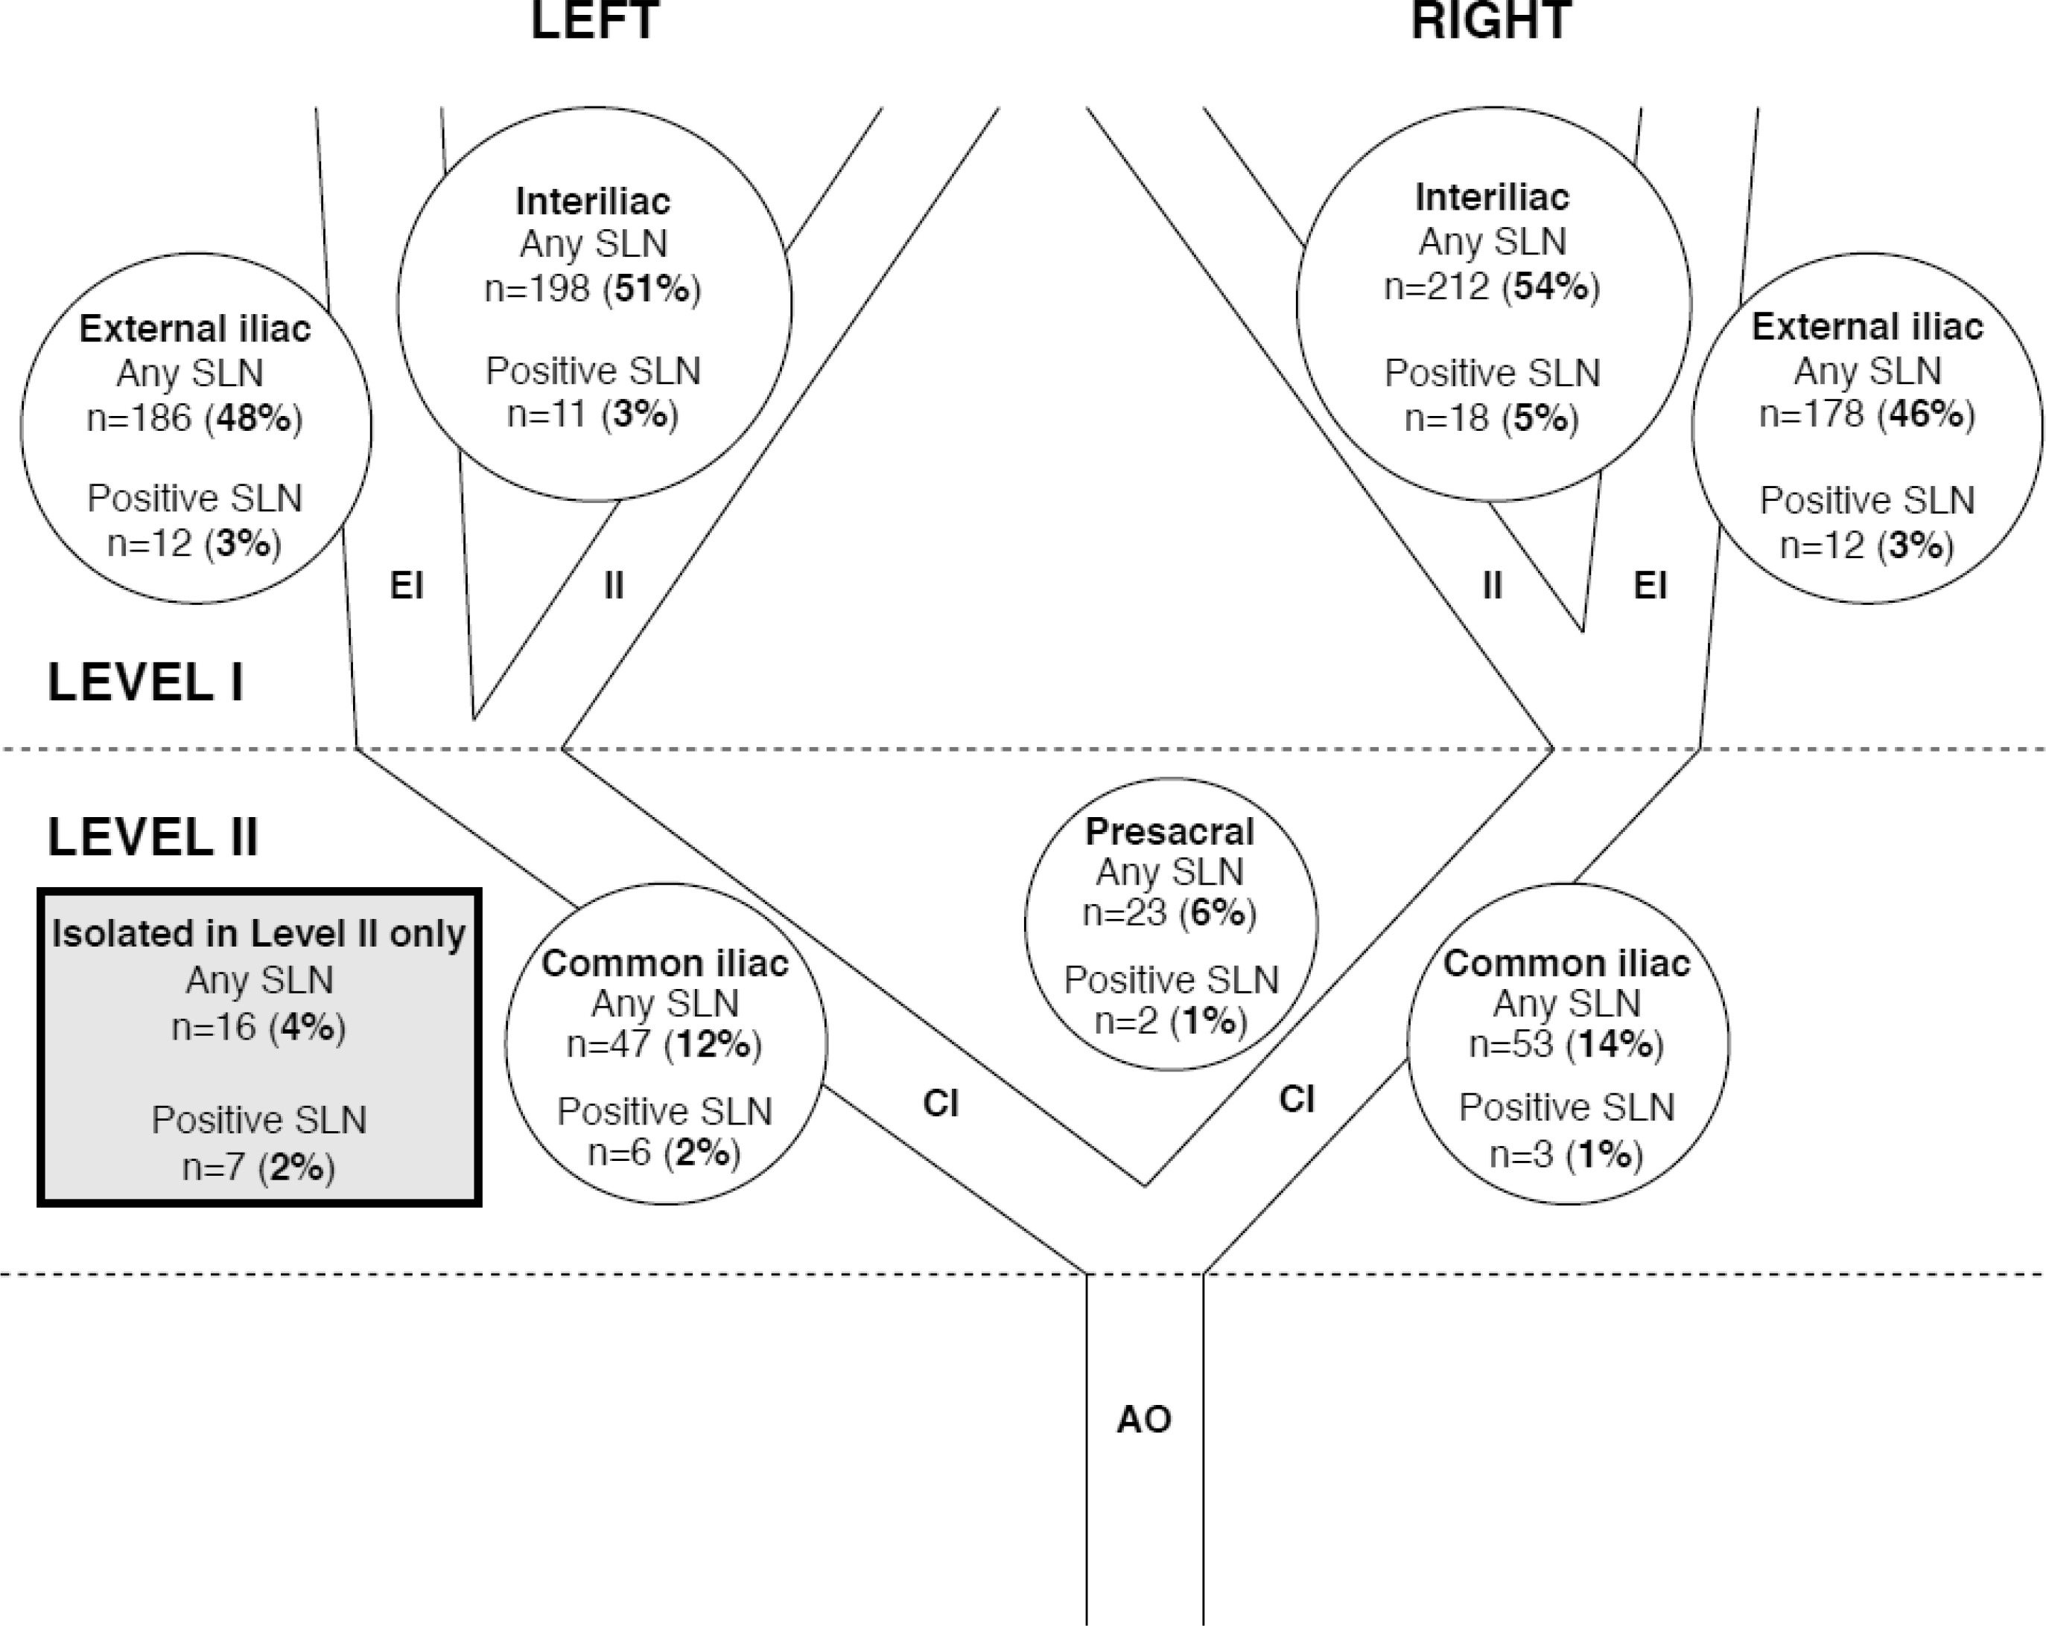
Fig. 2
European Journal of Cancer 2020 13769-80DOI: (10.1016/j.ejca.2020.06.034)
Copyright © 2020 The Author(s) Terms and Conditions
Notes:
Anatomical distribution of SLN in the pelvis. AO, aorta; CI, common iliac; EI, external iliac; II, internal iliac; SLN, sentinel lymph node.

