Slide 1
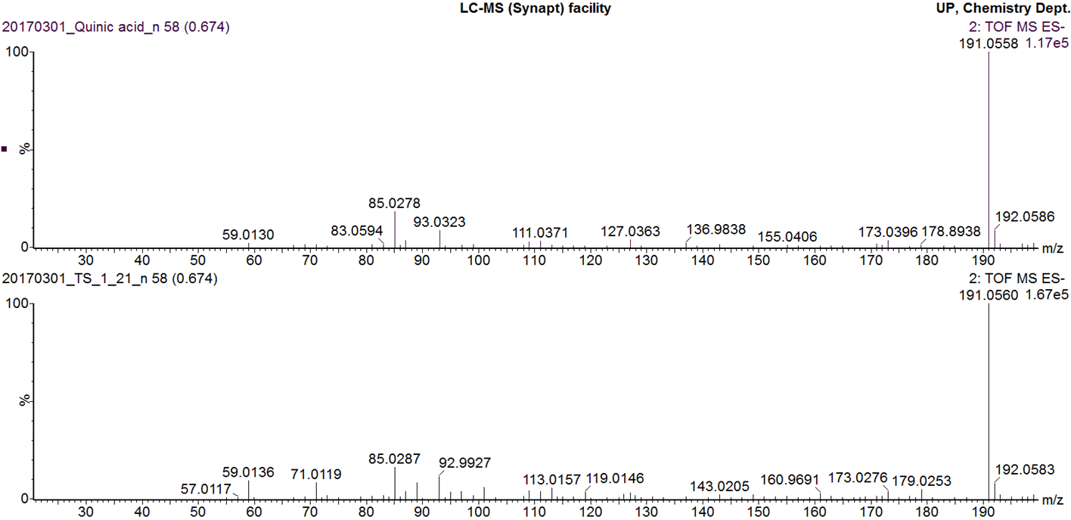
MS/MS fragmentation of quinic acid pure standard
MS/MS fragmentation pattern of peak 1
Additional file 3
MS/MS fragmentation pattern of quinic acid pure standard overlaid with MS/MS fragmentation of Peak 1

