Slide 1
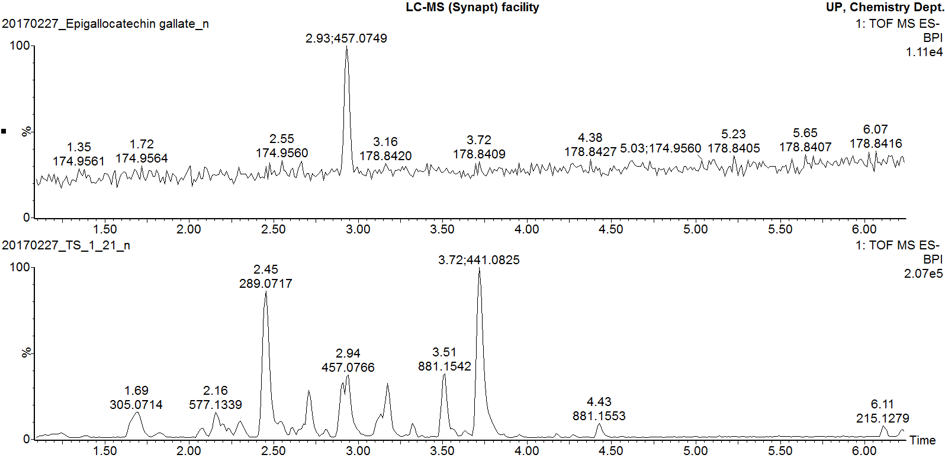
Epigallocatechin gallate pure standard
Marula stem ethanol extract
Additional file 8
Negative mode BPI chromatogram of epigallocatechin gallate pure standard overlaid with that of Marula stem ethanol extract

