Slide 1
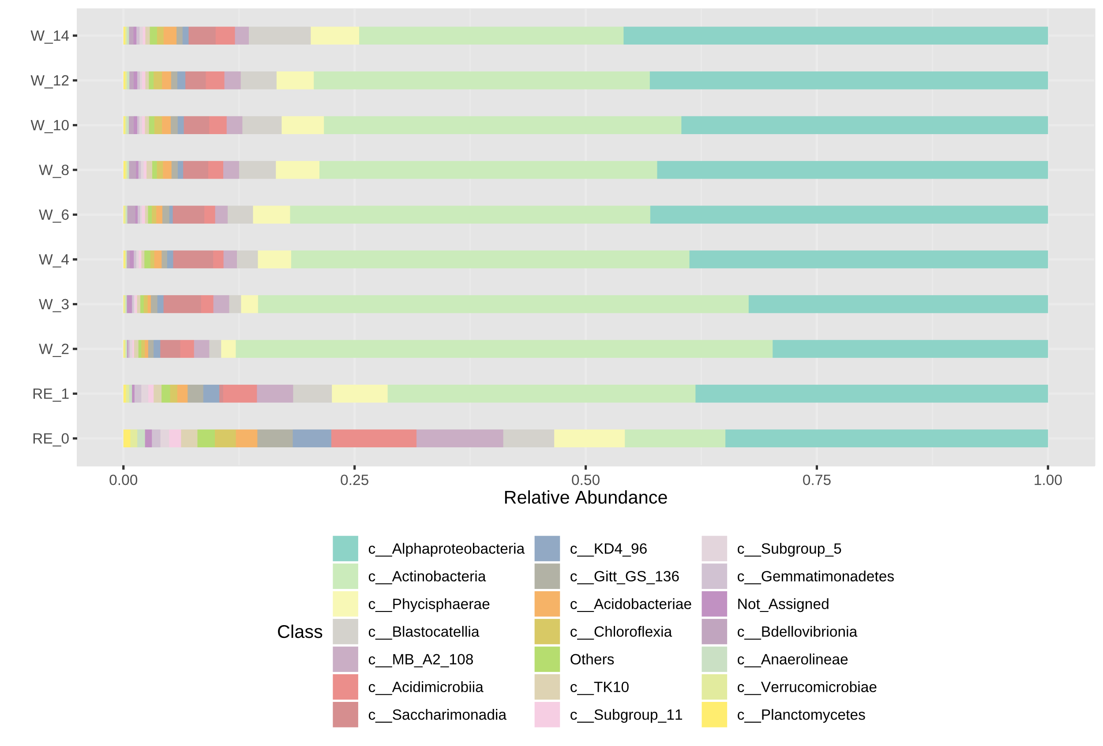
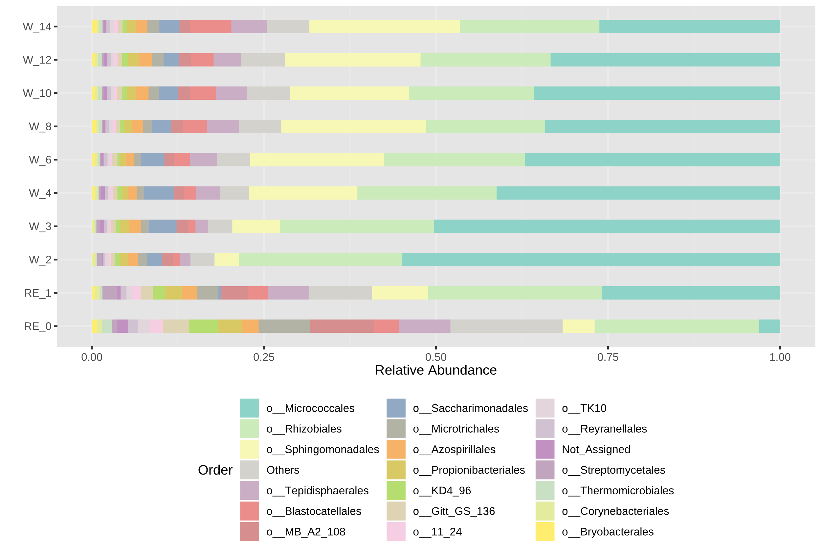
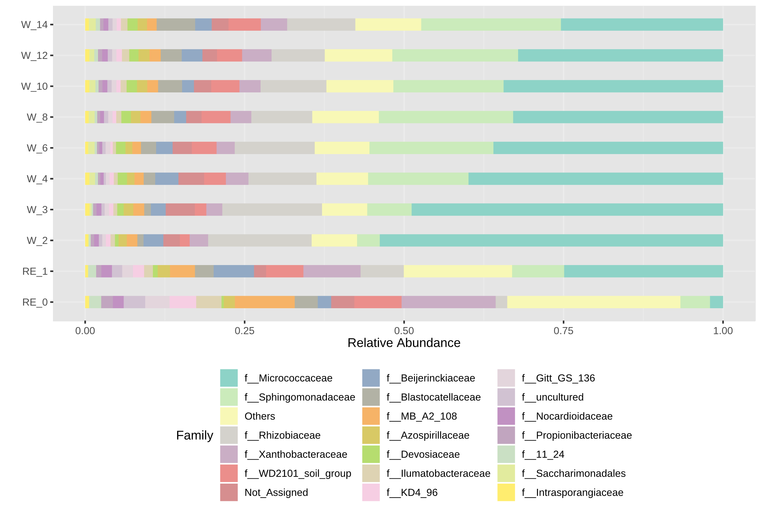
a)
14
12
10
8
6
Time (days)
4
3
2
1
0
0.00
0.25
0.50
0.75
1.00
Relative abundance of classes
b)
14
12
10
8
6
Time (days)
4
3
2
1
0
0.00
0.25
0.50
0.75
1.00
Relative abundance of orders
c)
14
12
10
8
6
Time (days)
4
3
2
1
0
0.00
0.25
0.50
0.75
1.00
Relative abundance of families

