Slide 1
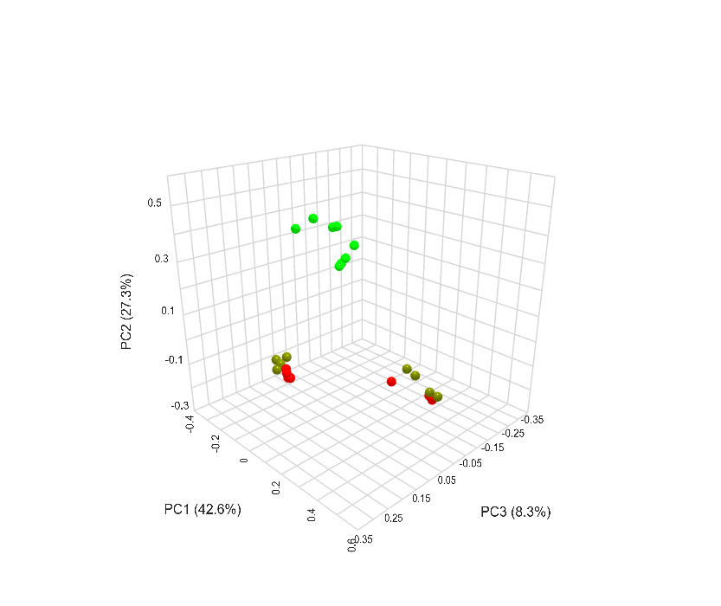
Bulk soil 5 pH 7.6
Rhizosphere 5, pH 7.6
Bulk soil 6, pH 8.1
PC2 (27.3%)
Rhizosphere 6, pH 8.1
Bulk soil 8, pH 5.5
Rhizosphere 8, pH 5.5
PC1 (42.6%)
PC3 (8.3%)
Figure S1: Principal component analysis of bulk soil and soybean rhizosphere communities from three sites.

