Slide 1

Supplementary Material
Author: Mano Mosalakgotla
Supervisor: Prof Mmantsae Diale

Slide 2
4.2. Optimization of processing parameters of dip-coated copper (II) oxide films for photoelectrochemical water-splitting

Slide 3
Figure 4.2.1 XRD patterns of CuO thin films (a) withdrawn from the precursor at different withdrawal speeds, (b) consisting of different number of film layers, and (c) annealed at various temperatures.

Slide 4
Processing parameters | Sample | 2 theta | FWHM | Crystal size (nm)
Withdrawal speed | 50 mm/min | 35.66 | 0.89 | 8.50
 | 100 mm/min | 35.62 | 0.63 | 12.01
 | 150 mm/min | 35.68 | 0.39 | 19.40
 | 200 mm/min | 35.80 | 0.41 | 18.45
Film thickness (150 mm/min) | 5 Layers | 35.68 | 0.39 | 19.04
 | 7 Layers | 36.08 | 0.38 | 19.89
 | 10 Layers | 35.76 | 0.37 | 20.44
Annealing temperature | 400°C | 35.89 | 0.76 | 9.96
(7 Layers) | 500°C | 35.93 | 0.49 | 15.43
 | 600°C | 36.08 | 0.38 | 19.89
 | 650°C | 35.84 | 0.36 | 21.01
Table 4.2.1 XRD analysis showing FWHM and crystal sizes of CuO thin films withdrawn from the precursor at different speeds, consisting of different number of film layers, and annealed at various temperatures.

Slide 5
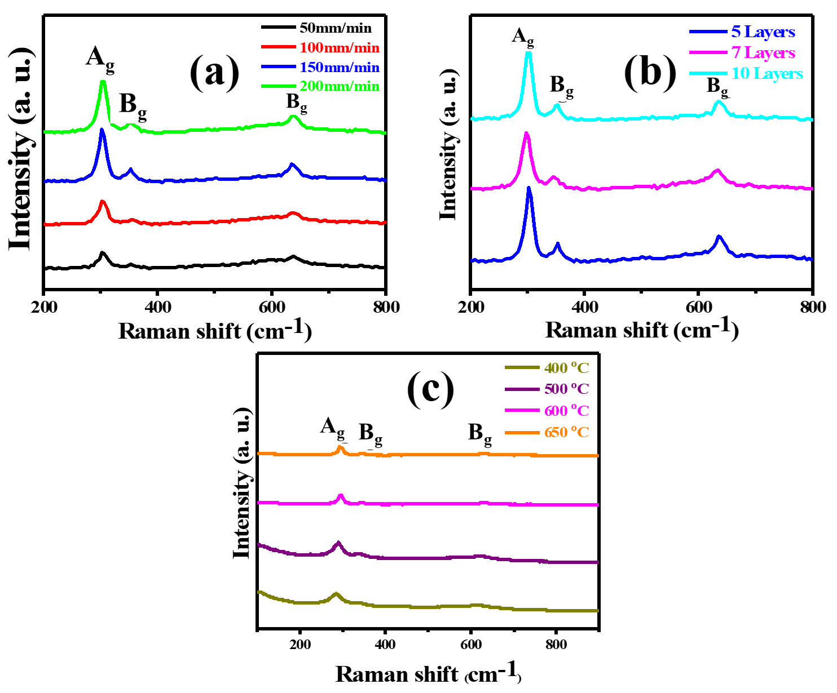
Figure 4.2.2 Raman spectra of CuO thin films (a) withdrawn from the precursor at different speeds (b) consisting of different number of film layers, and (c) annealed at different temperatures.

Slide 6
Figure 4.2.3 SEM micrographs of CuO thin films prepared at withdrawal speeds of (a) 50 mm/min (b) 100 mm/min (c) 150 mm/min (d) 200 mm/min: the corresponding histograms of the particle size distribution of the films are presented their insets.

Slide 7
Figure 4.2.4 SEM micrographs of thin films deposited with (a) 5 Layers (b) 7 Layers and (c) 10 Layers of CuO together with the corresponding histograms of their particle size distribution.

Slide 8
Figure 4.2.5 FE-SEM micrographs of CuO thin films prepared at withdrawal speeds of (a) 50 mm/min (b) 100 mm/min (c) 150 mm/min (d) 200 mm/min: the corresponding histograms of the particle size distribution of the films are presented in their insets.

Slide 9
Figure 4.2.6 FE-SEM cross-sectional views of CuO thin films prepared using withdrawal speeds of (a) 50 mm/min (b) 100 mm/min (c) 150 mm/min (d) 200 mm/min.

Slide 10
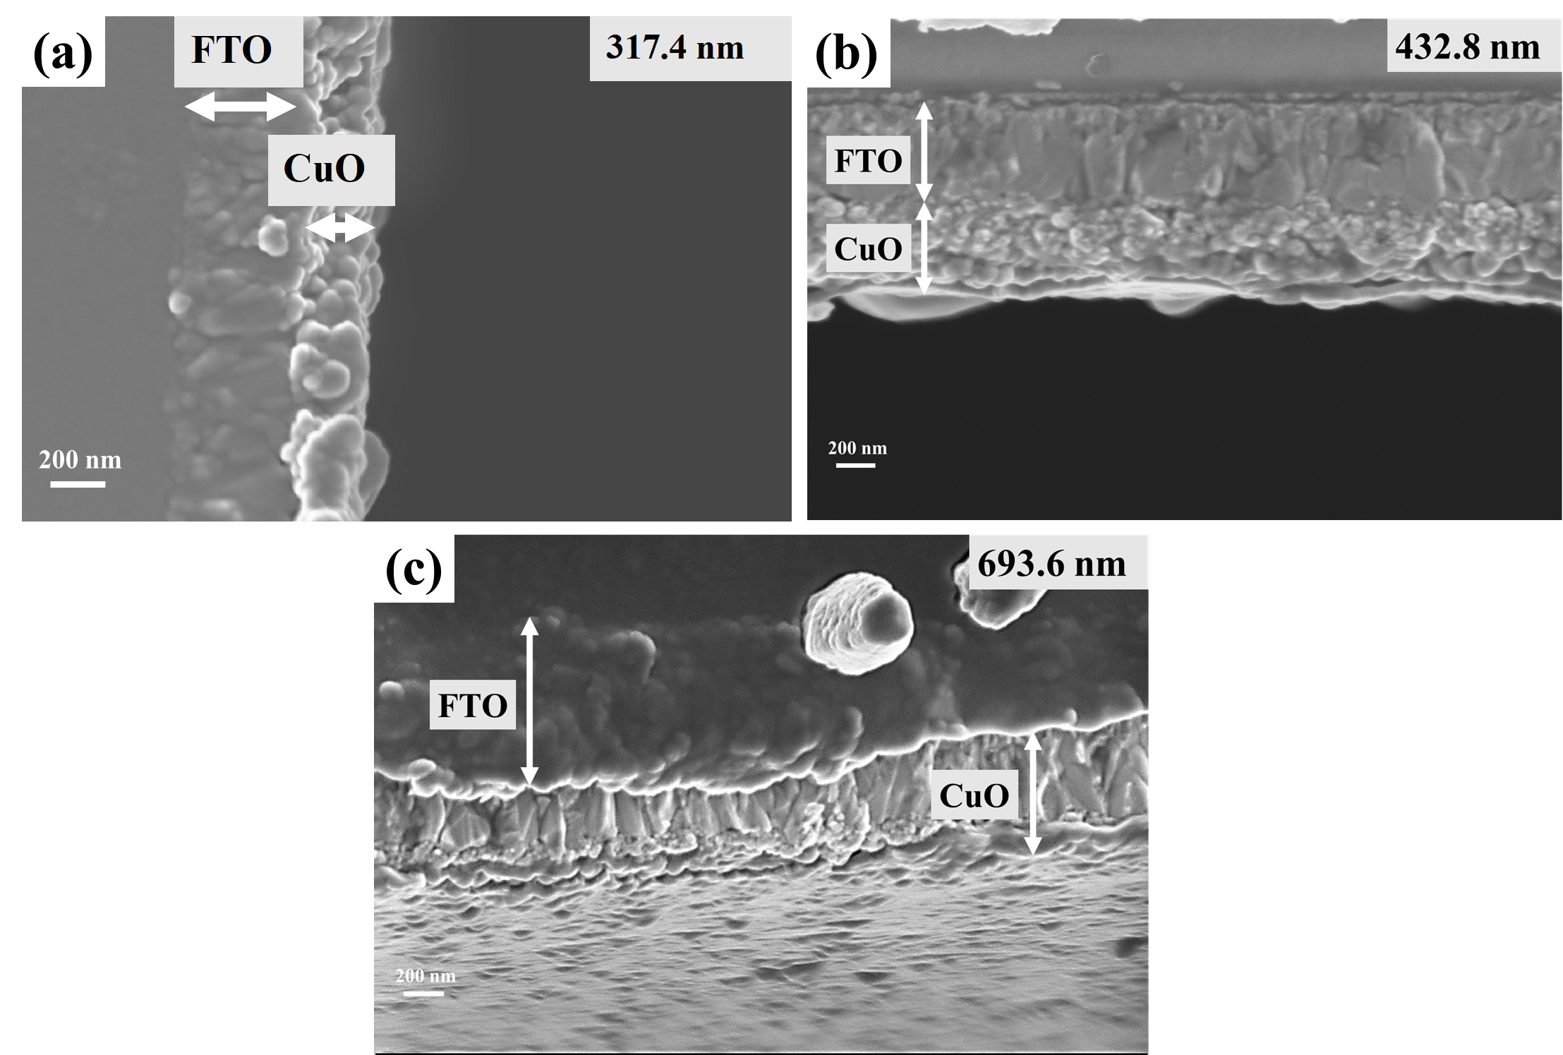
Figure 4.2.7 FE-SEM cross-sectional view of thin films deposited with (a) 5 (b) 7 and (c) 10 Layers of CuO.

Slide 11
Figure 4.2.8 EDS analysis of CuO thin films withdrawn from the precursor at the speeds of (a) 50 mm/min (b) 100 mm/min (c) 150 mm/min (d) 200 mm/min.

Slide 12
Figure 4.2.9 EDS analysis of the CuO thin films deposited to consist of (a) 5 Layers (b) 7 Layers and (c) 10 Layers.

Slide 13
Figure 4.2.10 EDS analysis of CuO thin films annealed at different temperatures of (a) 400°C (b) 500°C (c) 600°C and (d) 650°C.

Slide 14
Figure 4.2.11 UV–Vis absorption spectra of CuO thin films (a) withdrawn from the precursor at different speeds (b) consisting of different number of film layers, and (c) annealed at different temperatures, with the insets showing their transmittance measurements.

Slide 15
Figure 4.2.12 Tauc approximation for the indirect bandgaps of CuO thin films (a) withdrawn from the precursor at different speeds, (b) consisting of different number of film layers, and (c) annealed at different temperatures.

Slide 16
Figure 4.2.13 Photo-current density for CuO photocathodes: (a) withdrawn from the precursor at different speeds, (b) consisting of different number of film layers, and (c) annealed at different temperatures.

Slide 17
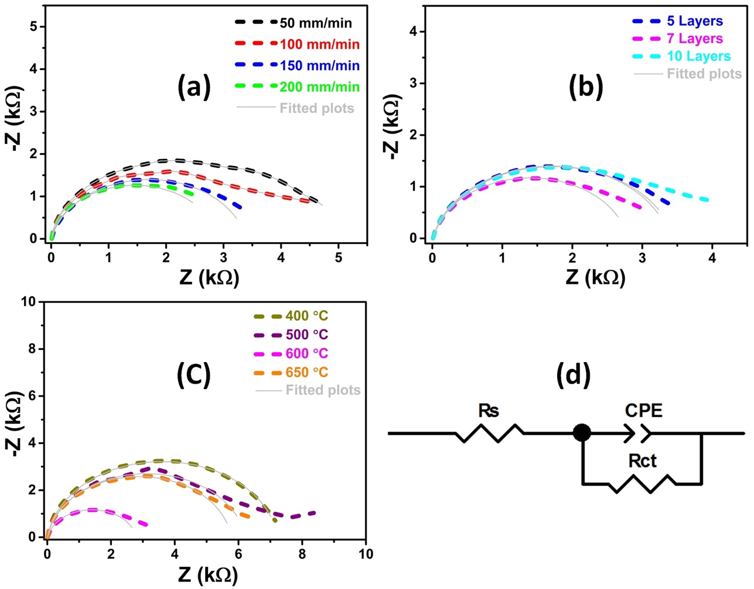
Figure 4.2.14 EIS of CuO photocathodes (a) withdrawn at different withdrawal speeds (b) consisting of different number of film layers, and (c) annealed at different temperature.

Slide 18
Processing parameter | Sample | Rs (Ω) | Rct kΩ | CPE (μF)
Withdrawal rates | 50 mm/min | 8.39 | 4.42 | 35.4
 | 100 mm/min | 9.16 | 3.74 | 40.4
 | 150 mm/min | 9.25 | 3.38 | 70.1
 | 200 mm/min | 9.02 | 2.89 | 36.1
Film layers (150 mm/min) | 5L | 9.25 | 3.38 | 70.1
 | 7L | 9.71 | 2.79 | 89.3
 | 10L | 9.68 | 3.45 | 79.3
Annealing temperature (7 Layers) | 400°C | 10.84 | 7.21 | 0.5
 | 500°C | 10.00 | 6.20 | 38.6
 | 600°C | 9.71 | 2.79 | 89.3
 | 650°C | 10.33 | 5.76 | 0.5
Table 4.2.2 The values obtained for the different elements after fitting the EIS data to the circuit model using ZView software.

Slide 19
Figure 4.2.15 Photo-stability measurements performed at 0.6 vs RHE on the CuO thin films prepared at the withdrawal rate of 150 mm/min, deposited with 7 layers, and annealed at 600 ℃.

Slide 20
4.3. CuO thin films decorated with protective layers of Activated Charcoal (AC) for PEC water-splitting

Slide 21
Figure 4.3.1 XRD patterns of pristine CuO, CuO/AC-1L, CuO/AC-3L and CuO/AC-5L thin films.

Slide 22
Sample | 2 theta | FWHM | Crystal size (nm)
Pristine CuO | 36.08 | 0.38 | 19.89
1 Layer CuO/AC | 35.71 | 0.36 | 21.02
3 Layers CuO/AC | 35.7 | 0.35 | 21.62
5 Layers CuO/AC | 35.68 | 0.6 | 12.61
Table 4.3.1 XRD analysis showing FWHM and crystal size of pristine CuO and CuO thin films coated with 1, 3, 5 layers of AC.

Slide 23
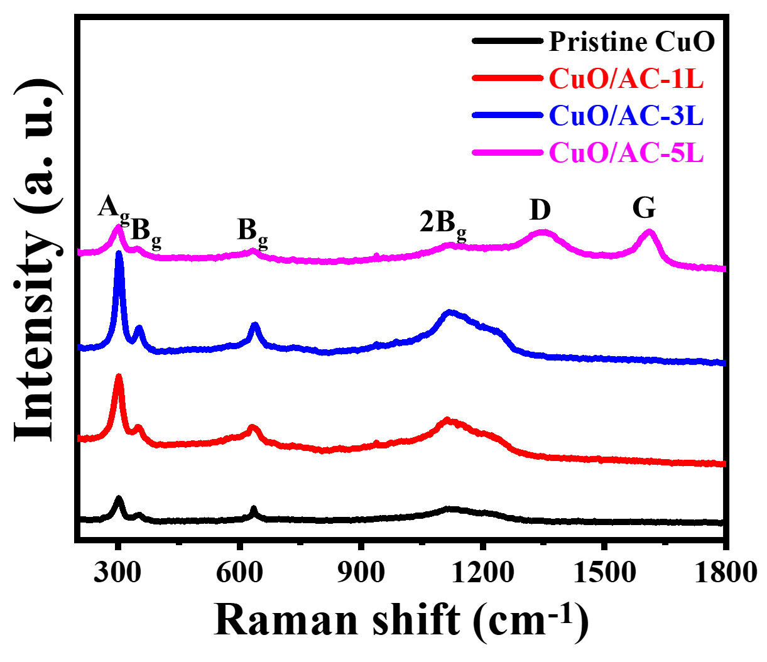
Figure 4.3.2 Raman spectra of pristine CuO and CuO/AC thin films deposited with 1, 3, 5 layers of AC.

Slide 24
Figure 4.3.3 FE-SEM images of (a) CuO/AC-1L (b) CuO/AC-3L (c) CuO/AC-5L thin films.

Slide 25
Figure 4.3.4 FE-SEM cross-sectional images of (a) CuO/AC-1L (b) CuO/AC-3L (c) CuO/AC-5L thin films.

Slide 26
Figure 4.3.5 EDS spectrum of (a) CuO/AC-1L (b) CuO/AC-3L (c) CuO/AC-5L thin films, respectively.

Slide 27
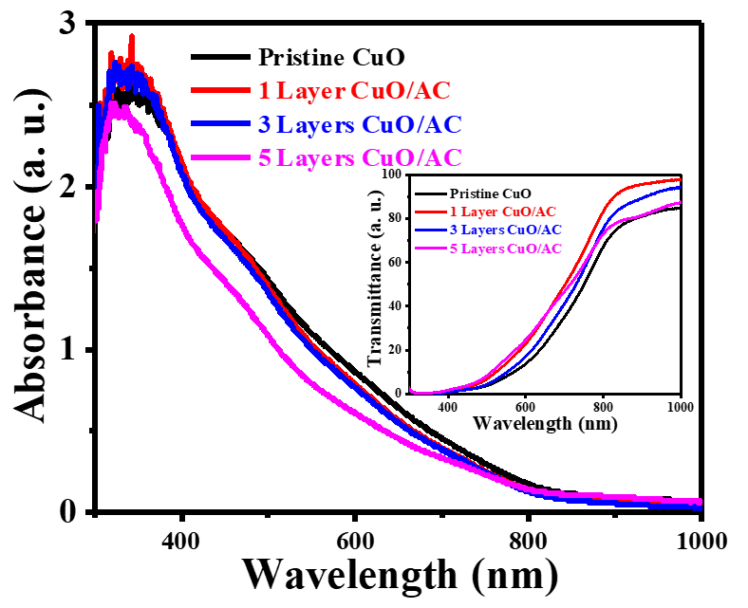
Figure 4.3.6 UV–Vis spectra of Pristine and CuO thin films coated with 1, 3, 5 layers of AC.

Slide 28
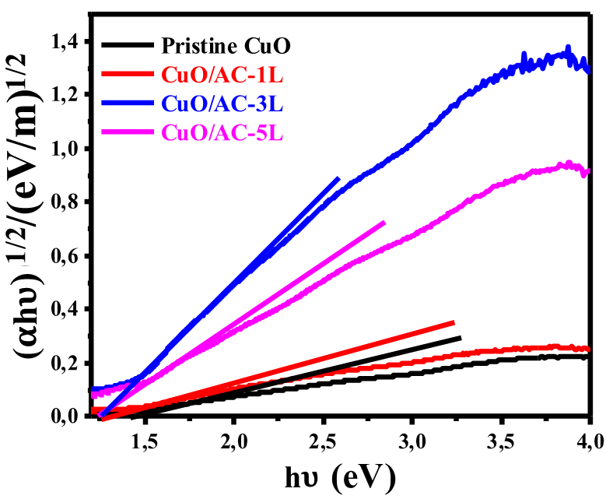
Figure 4.3.7 The Tauc approximation for the indirect bandgaps of pristine CuO, CuO/AC-1L, CuO/AC-3L and CuO/AC-5L thin films.

Slide 29
Figure 4.3.8 Current density measurements done under illumination conditions for pristine and CuO/AC photocathodes.

Slide 30
Figure 4.3.9 Electrochemical Impedance Spectra (EIS) of pristine CuO, CuO/AC-1L, CuO/AC-3L and CuO/AC-5L photocathodes.

Slide 31
Sample | Rs (Ω) | Rct (kΩ) | CPE (μF)
Pristine CuO | 9.29 | 1.24 | 128.8
CuO/AC-1L | 9.56 | 0.82 | 306.4
CuO/AC-3L | 8.52 | 0.89 | 150.8
CuO/AC-5L | 10.24 | 3.29 | 99.00
Table 4.3.2 The values obtained for the different elements after fitting the EIS data to the circuit model using ZView software.

Slide 32
Figure 4.3.10 MS plots of pristine CuO films and the ones consisting of 1, 3, 5 layers of AC.

Slide 33
Sample | V_{fb} vs RHE (V) | N_{D} * 10²⁰ (cm⁻³)
CuO Pristine | 1.049 | 0.9
CuO /AC-1L | 1.115 | 10.28
CuO/AC-3L | 1.137 | 5.31
CuO/AC-5L | 1.154 | 0.73
Table 4.3.3 Table showing Vfb and Nd estimated from the MS plots of pristine CuO films and the ones coated with 1, 3, and 5 layers of AC.

Slide 34
Figure 4.3.11 Photo-stability measurements performed at 0.6 V vs RHE on the CuO/AC-1L, CuO/AC-3L and CuO/AC-5L photocathodes.

Slide 35
4.4 CuO thin films modified with Ag nanoparticles for enhanced photo-stability during PEC reactions

Slide 36
Figure 4.4.1 XRD patterns of a pristine CuO and CuO/Ag thin films.

Slide 37
Sample | 2 theta | FWHM | Crystal size (nm)
Pristine CuO | 36.08 | 0.38 | 19.89
CuO/Ag-1L | 35.66 | 0.33 | 22.93
CuO/Ag-3L | 35.67 | 0.33 | 22.93
CuO/Ag-5L | 35.54 | 0.34 | 22.26
Table 4.4.1 XRD analysis showing FWHMs and crystal sizes of a pristine CuO thin film and CuO thin films coated with 1, 3, and 5 layers of Ag NPs.

Slide 38
Figure 4.4.2 Raman spectra of pristine CuO and CuO/Ag thin films.

Slide 39
Figure 4.4.3 FE-SEM images of CuO thin films coated with (a) one (b) three (c) five layers of Ag NPs.

Slide 40
Figure 4.4.4 Cross-sectional images of (a) CuO/Ag-1L (b) CuO/Ag-3L and (c) CuO/Ag-5L thin films

Slide 41
Figure 4.4.5 EDS spectrum of (a) a pristine CuO, and CuO thin films coated with (b) one (c) three (d) five layers of Ag NPs.

Slide 42
Figure 4.4.6 UV–Vis spectra of pristine and CuO thin films coated with 1, 3, 5 layers of Ag.

Slide 43
Figure 4.4.7 The Tauc approximation for indirect bandgaps of CuO/Ag-1L, CuO/Ag-3L and CuO/Ag-5L thin films.

Slide 44
Figure 4.4.8 photo-current densities pristine CuO and CuO/Ag photocathodes.

Slide 45
Figure 4.4.9 EIS Nyquist plots of pristine CuO, CuO/Ag-1L, CuO/Ag-3L, and CuO/Ag-5L photocathodes.

Slide 46
Sample | Rs (Ω) | Rct (kΩ) | CPE (μF)
CuO pristine | 9.29 | 1.24 | 128.8
CuO/Ag-1L | 8.73 | 0.37 | 743.5
CuO/Ag-3L | 6.51 | 0.38 | 601.0
CuO/Ag-5L | 8.12 | 0.93 | 860.6
Table 4.4.2 The values obtained for the different elements after fitting the EIS data to the equivalent circuit model using ZView software.

Slide 47
Figure 4.4.10 MS plots of pristine CuO/Ag-1L, CuO/Ag-3L and CuO/Ag-5L photocathodes.

Slide 48
Sample | V_{fb} vs RHE (V) | N_{D} * 10²⁰ (cm⁻³)
CuO Pristine | 1.049 | 0.90
CuO/Ag-1L | 0.959 | 40.02
CuO/Ag-3L | 0.844 | 36.01
Table 4.4.3 Table showing Vfb and Nd estimated from the MS plots of pristine CuO and CuO photocathodes coated with 1 and 3 layers of Ag NPs.

Slide 49
Figure 4.4.11 Photo-stability measurements performed at 0.5 V vs RHE on the CuO/Ag-1L, CuO/Ag-3L and CuO/Ag-5L photocathodes.

Slide 50
4.5 CuO thin films modified with Au nanoparticles for improved photo-stability in electrolyte

Slide 51
Figure 4.5.1 XRD patterns of a pristine CuO film, as well as CuO films coated with 1, 3, 5 layers of Au NPs.

Slide 52
Sample | 2 theta | FWHM | Crystal size (nm)
Pristine CuO | 36.08 | 0.38 | 19.89
CuO/Au-1L | 35.56 | 0.41 | 18.46
CuO/Au-3L | 35.50 | 0.37 | 20.46
CuO/Au-5L | 35.71 | 0.36 | 21.02
Table 4.5.1 XRD analysis showing the FWHM and crystal sizes of a the pristine CuO thin film and the ones coated with 1, 3, and 5 layers of Au NPs.

Slide 53
Figure 4.5.2 Raman spectra of a pristine CuO film, as well as CuO films coated with 1, 3, 5 layers of Au NPs.

Slide 54
Figure 4.5.3 SEM images of (a) CuO/Au-1L (b) CuO/Au-3L and (c) CuO/Au-5L thin films.

Slide 55
Figure 4.5.4 FE-SEM of cross-sectional images of (a) CuO/Au-1L (b) CuO/Au-3L and (c) CuO/Au-5L thin films.

Slide 56
Figure 4.5.5 EDS spectrum of (a) CuO/Au-1L, (b) CuO/Au-3L, and (c) CuO/Au-5L thin films.

Slide 57
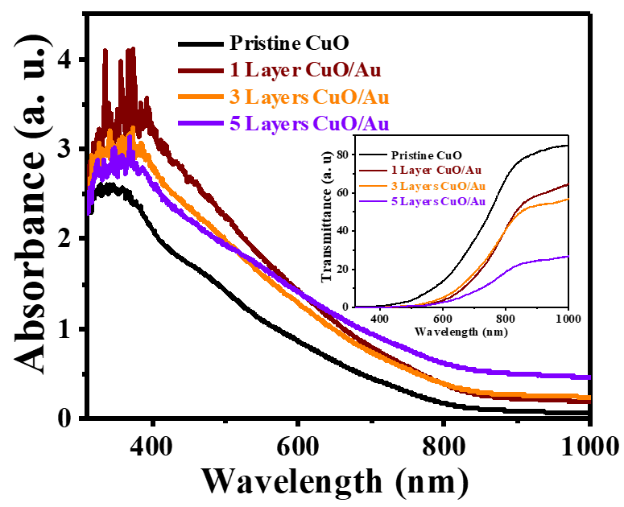
Figure 4.5.6 UV–Vis spectra of pristine CuO thin films and the ones coated with 1, 3, and 5 layers of AuNPs.

Slide 58
Figure 4.5.7 Tauc approximation for indirect bandgaps of CuO thin films coated with 1, 3, and 5 layers of Au.

Slide 59
Figure 4.5.8 Photo-current density of pristine CuO and CuO/Au photocathodes.

Slide 60
Figure 4.5.9 Electrochemical Impedance Spectra (EIS) of pristine CuO, CuO/Au-1L, CuO/Au-3L and CuO/Au-5L photocathodes.

Slide 61
Sample | Rs (Ω) | Rct (kΩ) | CPE (μF)
CuO pristine | 9.29 | 1.24 | 128.8
CuO/Au-1L | 11.62 | 0.43 | 320.1
CuO/Au-3L | 9.07 | 0.4 | 262.4
CuO/Au-5L | 8.04 | 0.32 | 1758.6
Table 4.5.2 The values obtained for the different elements after fitting the EIS data to the circuit model using ZView software.

Slide 62
Figure 4.5.10 MS plots of CuO/Au-1L, CuO/Au-3L and CuO/Au-5L photocathodes.

Slide 63
Sample | V_{fb} vs RHE (V) | N_{D} * 10²⁰ (cm⁻³)
CuO Pristine | 1.049 | 0.90
CuO /Au-1L | 1.031 | 6.75
CuO/Au-3L | 0.877 | 5.64
CuO/Au-5L | 0.940 | 6.38
Table 4.5.3 Table showing Vfb and Nd estimated from the MS plots of pristine CuO and CuO photocathodes coated with 1, 3, and 5 layers of Au NPs.

Slide 64
Figure 4.5.11 Photo-stability measurements performed at 0.5 V vs RHE on CuO/Au-1L, CuO/Au-3L and CuO/Au-5L photocathodes.

