Slide 1
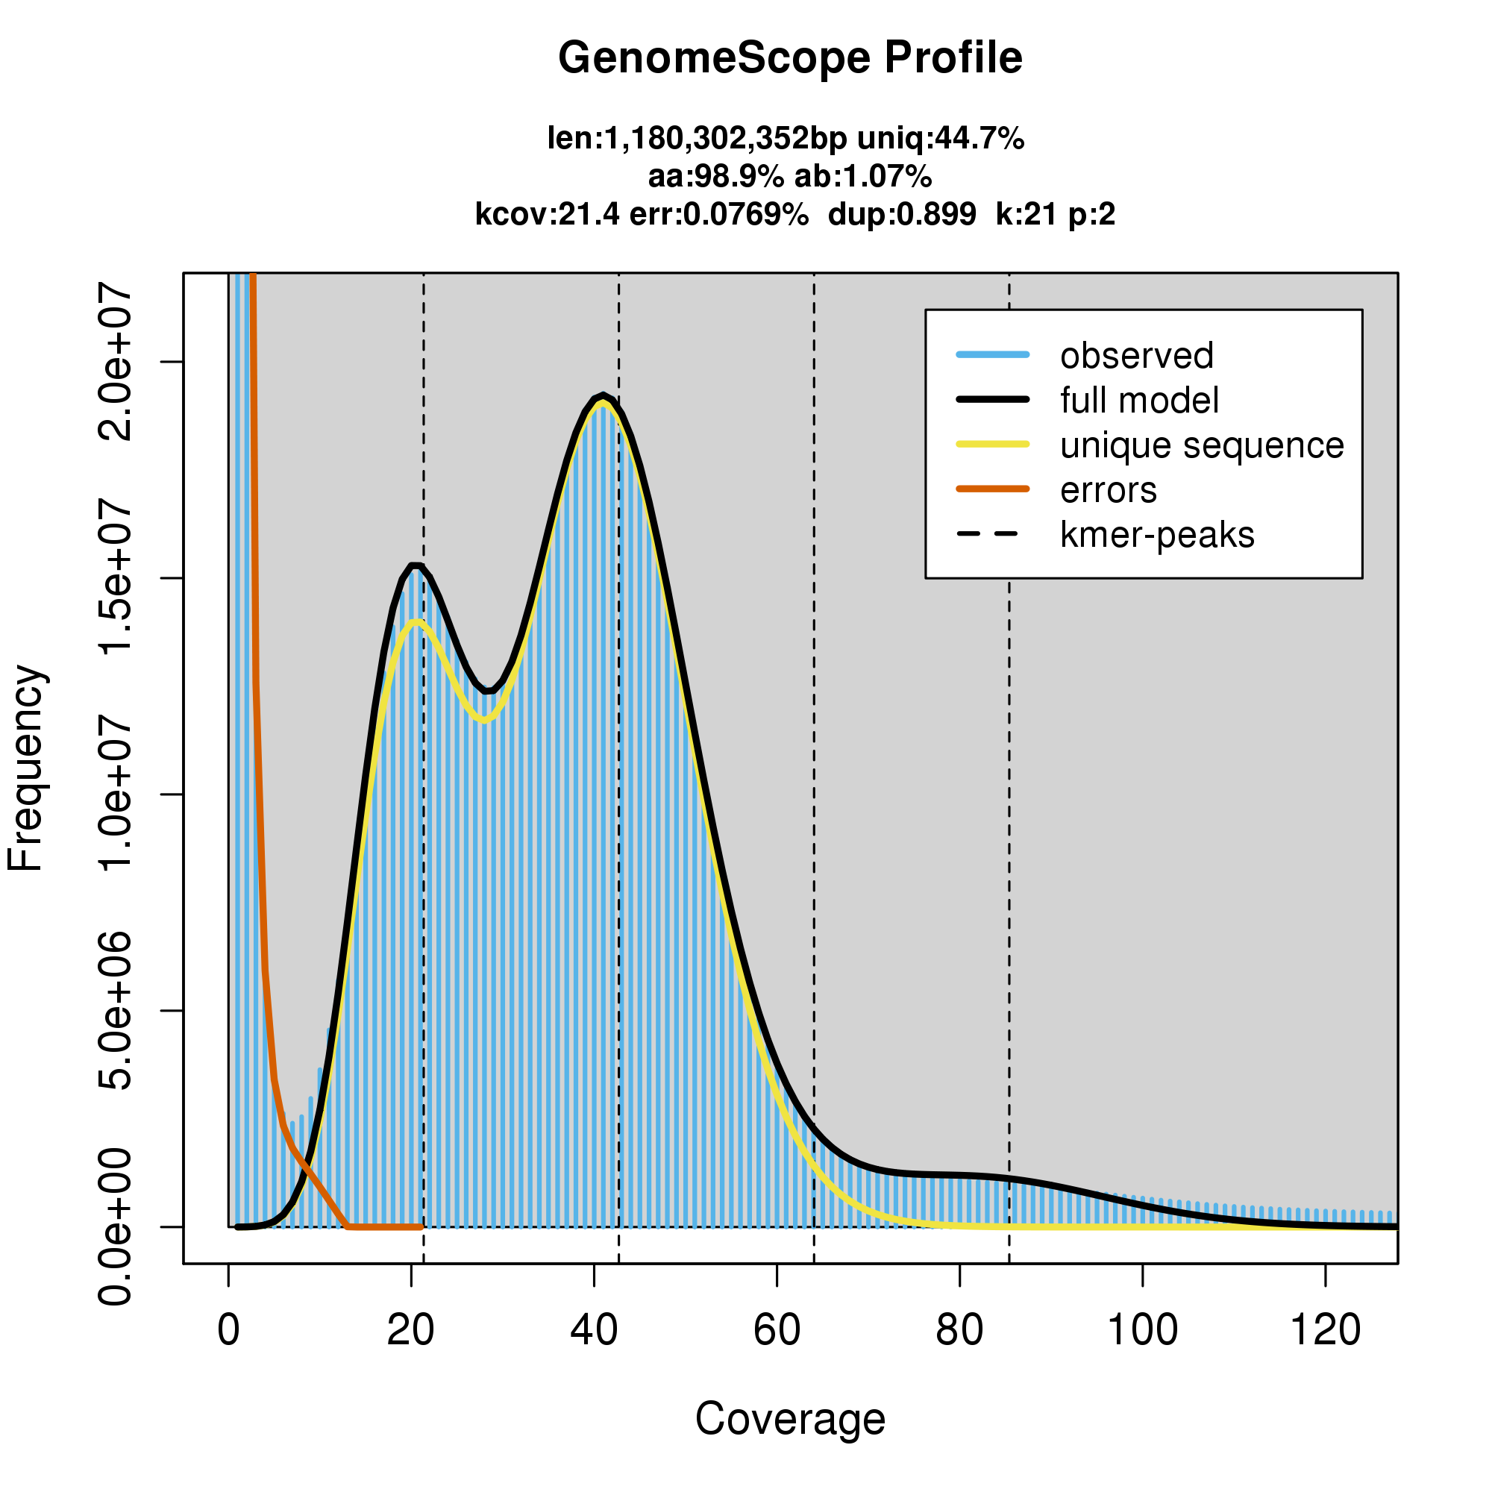
Supplemental Figure 1. Genome profiling with GenomeScope2 using Illumina short-read data. P. cynaroides is estimated to have a haploid genome size of 1.18 Gb with a 1.07 % genome-wide heterozygosity level.

