Slide 1
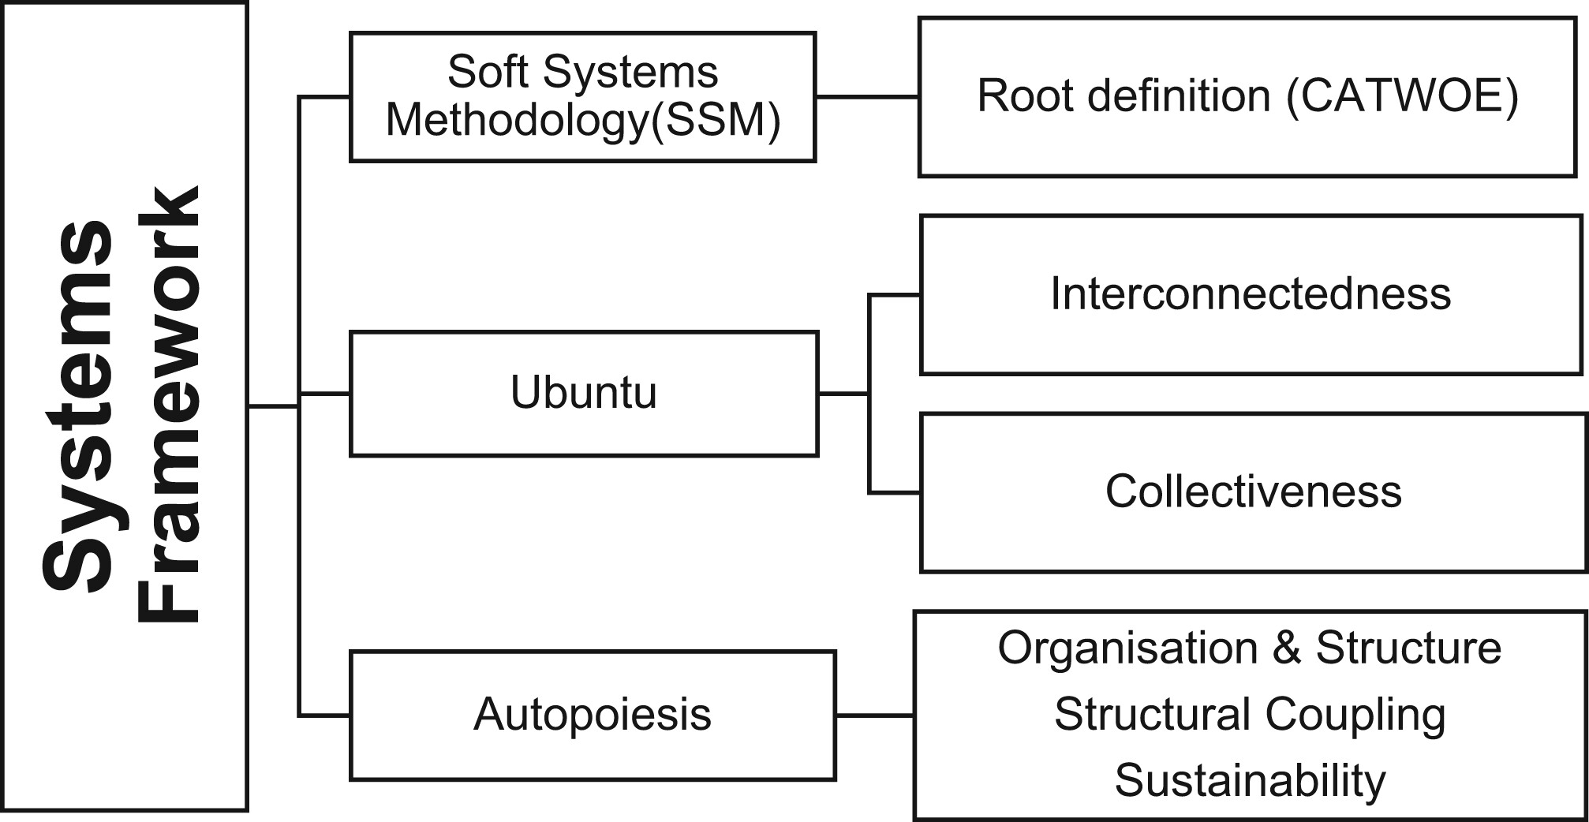
A systems framework to analyze the impact of corporate social investment projects with an information technology focus
E J Info Sys Dev Countries, Volume: 89, Issue: 5, First published: 07 April 2023, DOI: (10.1002/isd2.12273)
Notes:
Social Systems Framework.
IF THIS IMAGE HAS BEEN PROVIDED BY OR IS OWNED BY A THIRD PARTY, AS INDICATED IN THE CAPTION LINE, THEN FURTHER PERMISSION MAY BE NEEDED BEFORE ANY FURTHER USE. PLEASE CONTACT WILEY'S PERMISSIONS DEPARTMENT ON PERMISSIONS@WILEY.COM OR USE THE RIGHTSLINK SERVICE BY CLICKING ON THE 'REQUEST PERMISSIONS' LINK ACCOMPANYING THIS ARTICLE. WILEY OR AUTHOR OWNED IMAGES MAY BE USED FOR NON-COMMERCIAL PURPOSES, SUBJECT TO PROPER CITATION OF THE ARTICLE, AUTHOR, AND PUBLISHER.

