Slide 1
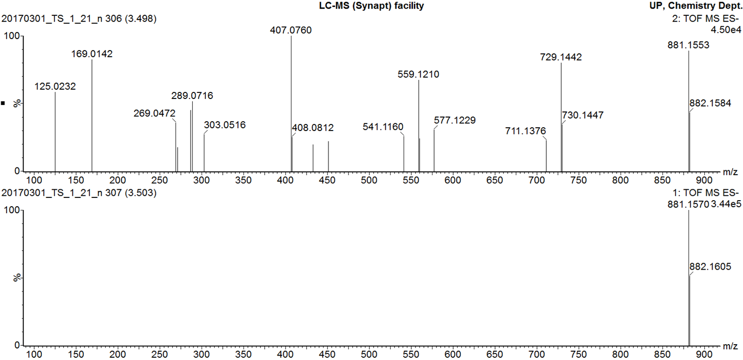
MS/MS fragmentation pattern of peak 6
MS fragmentation pattern of peak 6
Additional file 10
MS and MS/MS fragmentation pattern of peak 6

