Slide 1
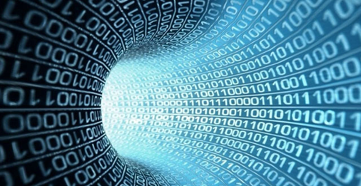
Digital Humanities and the
Role of University Libraries
https://www.flickr.com/photos/infocux/8450
DH
Presented by Johann van Wyk
University of Pretoria and Carnegie Corporation of New York Capstone Conference, held 25 March 2019 at the Kievits Kroon County Estate and Conference Centre, Pretoria, South Africa

Slide 2
Overview
What is meant by Digital Humanities Internationally?
Historical Development of Digital Humanities
National DH activities in South Africa
Digital Humanities Tools
What are academic libraries doing with regard to Digital Humanities?
Challenges
How does Digital Humanities Link-up with eResearch and Library Carpentry?

Slide 3
What is meant by Digital Humanities?
There are various definitions and viewpoints on what Digital Humanities is.
Digital Humanities originated from the field of Humanities Computing.
The field of Digital Humanities can be found at the intersection [computing] or digital technology and the disciplines of the humanities (Drucker, 2013, Wikipedia)
A distinctive characteristic of digital humanities is its nurturing of a two-way relationship between the humanities and the digital. Technology is used to do humanities research, but technology is also subjected to humanistic questioning and interrogation, often at the same time (Wikipedia)

Slide 4
What is meant by Digital Humanities?
DH entails activities beyond the process of digitisation (Roux, 2016):
creation and use of applicable software tools;
analysis and interpretation of digital data;
visual representation of digital data and results; and
predictions based on results (Roux, 2016).
DH combines the methodologies from traditional humanities disciplines with tools afforded by computing , e.g. data visualisation, data mining, text mining, digital mapping, digital publishing, data analytics, cultural analytics, humanities gaming, etc.

Slide 5
Historical Development of Digital Humanities
19th Century
Hypothesis that word frequency in a text might give clues about who wrote it – could not be tested
Late 1940s
1st initiatives - humanities engage with networks and computation (Burdick et al., 2012:8), e.g. concordance of the works of Thomas Aquinas – IBM – Index of every word used by Aquinas
1960s
Computer technology had progressed substantially – several digital concordance projects undertaken

Slide 6
Historical Development of Digital Humanities
1962
19th Century hypothesis about determining authorship by means of word frequency proven true through use of computers
Early 1970s
Archival projects inspired– e.g. Oxford University Text Archive . (Andrews, 2016: 2; Burdick et al., 2012: 8)
1980s
Advent of personal computer – marked increase in transcription and encoding of texts – launch of Text Encoding Initiative in 1988 – field of Humanities Computing

Slide 7
Historical Development of Digital Humanities
Late 1980s Development of DH starts gaining momentum, by developing, critiquing, and disseminating methods to structure humanities data that could interface effectively with computation (Burdick et al, 2012: 8).
1990s
Field dominated by electronic scholarly editions of texts (Andrews, 2016: 3)
End of 2002
The term ‘Humanities Computing’ found too limiting (Andrews, 2016: 3) – new name Digital Humanities
- shift from emphasis on computing as analysis, toward a focus on digital publication, digital media, and critical reflection on digital culture

Slide 8
Historical Development of Digital Humanities
2004: 1st Publication on DH: The Blackwell Companion to the Digital Humanities (1st use of the term Digital Humanities)
2006: ‘Digital Humanities Initiative’ launched in the USA (renamed ‘Office of Digital Humanities’ in 2008)
2004: Alliance of Digital Humanities Organizations (ADHO) officially established

Slide 9
Historical Development of Digital Humanities
2006: 1st Digital Humanities Conference (ADHO)- held yearly after that
2007: Digital Humanities Quarterly (Journal) launched
2009: DH mentioned as the “first next big thing in a long time” at the 2009 MLA Convention
2019: DH Conference, Utrecht, Netherlands, 9-12 July 2019

Slide 10
National DH activities in South Africa
Slow uptake in SA compared to international practice
2014:
1st local awareness campaign (with international guest) and a weekly discussion by Research Unit for Literature and Languages in SA context at NWU
2015:
1st DH Workshop SA
( 23-25 February)
NWU (Potchefstroom)
2016:
2nd DH Workshop SA
(4-8 April)
NWU (Potchefstroom) - Founding of Digital Humanities Association of Southern Africa (DHASA) as a forum – (http://digitalhumanities.org.za/ )
2017: Inaugural Conference of DHASA held 17-20 Jan 2017 at Stellenbosch University (http://dh2017.digitalhumanities.org.za/ )

Slide 11
National DH activities in South Africa
2018:
DHASA receives full Constituent Organisation Status with the Alliance of Digital Humanities Organizations (ADHO)
2018:
Digital Humanities: Pedagogy and Practices in the Library Environment Workshop, arranged by South African Centre for Digital Language Resources (SADiLaR)
2018:
Carpentry Connect – Johannesburg 2018 arranged by Rural Campuses Connection Project II and SADiLaR
2019:
2nd International Conference of the Digital Humanities Association of Southern Africa (DHASA) 25-29 March 2019 held at University of Pretoria.
http://dh2019.digitalhumanities.org.za/

Slide 12
DH related projects in South Africa
(From presentation by Justus Roux at Simposium: All about Me: digital humanities and representation of self, held on 17 June 2016 at University of Pretoria)
Various digitisation projects across many disciplines for many years: digital speech processing etc.
Beyers Naude (Theology) project: Stellenbosch University. (https://www.sun.ac.za/english/faculty/theology/Pages/BeyersNaud%C3%A9-Centre.aspx)
Digital Humanities and the Future of the Archive − WITS Institute for Social and Economic Research (2014)
(https://wiser.wits.ac.za/page/new-research-projects-11029)
Digital Innovation South Africa (DISA 1, 2) - University of KwaZulu- Natal (http://www.disa.ukzn.ac.za ) SA history, politics, gender, literature, economics, human rights, urban struggles
Digitisation, history and the making of a post-colonial archive: University of the Western Cape
(https://www.uwc.ac.za/UWCInsight/Pages/CHR1.aspx)

Slide 13

Historical Papers - WITS (http://www.historicalpapers.wits.ac.za )
Largest non-state archive in South Africa
International Library of African Music (ILAM)
  Rhodes University, Grahamstown (http://www.ru.ac.za )
The Jonathan Edwards Centre Africa 2009 – strategic partnership of Yale University, Jonathan Edwards Center and the University of the Free State
(https://edwardseducationblog.wordpress.com/about/) - Missionary Archives
from Lesotho, 1832-2006
Race and the Digital Humanities in South Africa - Hector Peterson Museum (Angel Nieves), New York (http://ssrn.com/abstract=2250565 )
Soweto Historical GIS Project (http://www.dhinitiative.org/projects )
Language Resource Management Agency – NWU
(http://www.rma.nwu.ac.za )

Slide 14
Digital Humanities Tools
For a detailed list of DH tools visit: DH Resources for Project Building http://dhresourcesforprojectbuilding.pbworks.com/w/page/69244319/Digital
Types of tools:
Animation & Storyboarding tools
Audio tools
Authoring/Annotation/Editing/Publishing platforms & tools
Code versioning tools
Command Line tools
Content Management Systems
Crowdsourcing tools
Exhibition/Collection/Editing Platforms & Tools
Internet Research tools (tools for studying the Internet or parts of the Internet
Mapping Tools & Platforms
Mind-mapping tools
Network Analysis / Social Network Analysis tools

Slide 15
Digital Humanities Tools
Types of tools:
Programming Languages tools & resources (e.g. Python, R)
Simulation tools & platforms (e.g. Second Life)
Text Analysis tools
Text Collation tools
Text Encoding tools
Text Preparation for Digital Work (Harvesting, scraping, cleaning, classifying)
Topic Modelling tools
Video tools
Video & Film Analysis tools
Visualisation tools (e.g. General or Multiple Purpose Viz tools; Diagramming & Graphic tools; Image Tools; Infographic Tools; Network Visualisation Tools; Text Visualisation Tools; Time Line Tools; Twitter Visualisation Tools)

Slide 16
What are academic libraries doing with regard to DH?
DH Centres or Programmes
A number of libraries have dedicated DH Centres or programmes – many of these in different developmental stages. Staffing of these centres are often confined to a digital scholarship librarian (who fulfils other roles) and a few IT professionals (many working on contract or grant funded projects , or have other responsibilities beyond DH programmes)
Typical DH Services
Digitisation – providing wide access to cultural information /materials
Digital Exhibitions on a visualisation wall
Manipulation of data flowing from cultural information
Offer a website focusing on DH

Slide 17
What are academic libraries doing with regard to DH?
Typical DH Services (Continued)
Develop tools for preserving and archiving of digitally-born artifacts of recent and contemporary cultural heritage
Support curation and publication of data that contributes to improved methodologies for the organisation and stewardship of humanities research
Create frameworks to enable the development of new methods and tools for exploration and visualisation of digital materials and data
Text analysis and electronic text encoding, as well as image analytics for cultural heritage collections
Provision of text-mining tools
Provision of 3D environments (e.g. Virtual Reality & Augmented Reality)
Provision of Online Exhibitions
Use social media technologies

Slide 18
What are academic libraries doing with regard to DH?
Typical DH Services (Continued)
Provision of creative environment (space that encourages innovation and testing – where researchers can create, develop and test)
Some DH Centres have makerspaces incorporated in them, e.g. scholarslab
Provision of a tool for adding layers of meaning to a map (GIS)
Training on various software and hardware tools (e.g. Data, Software and Library Carpentry)

Slide 19
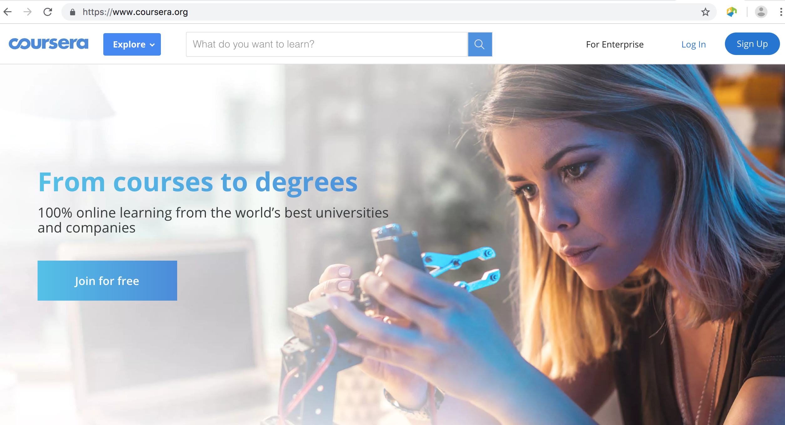
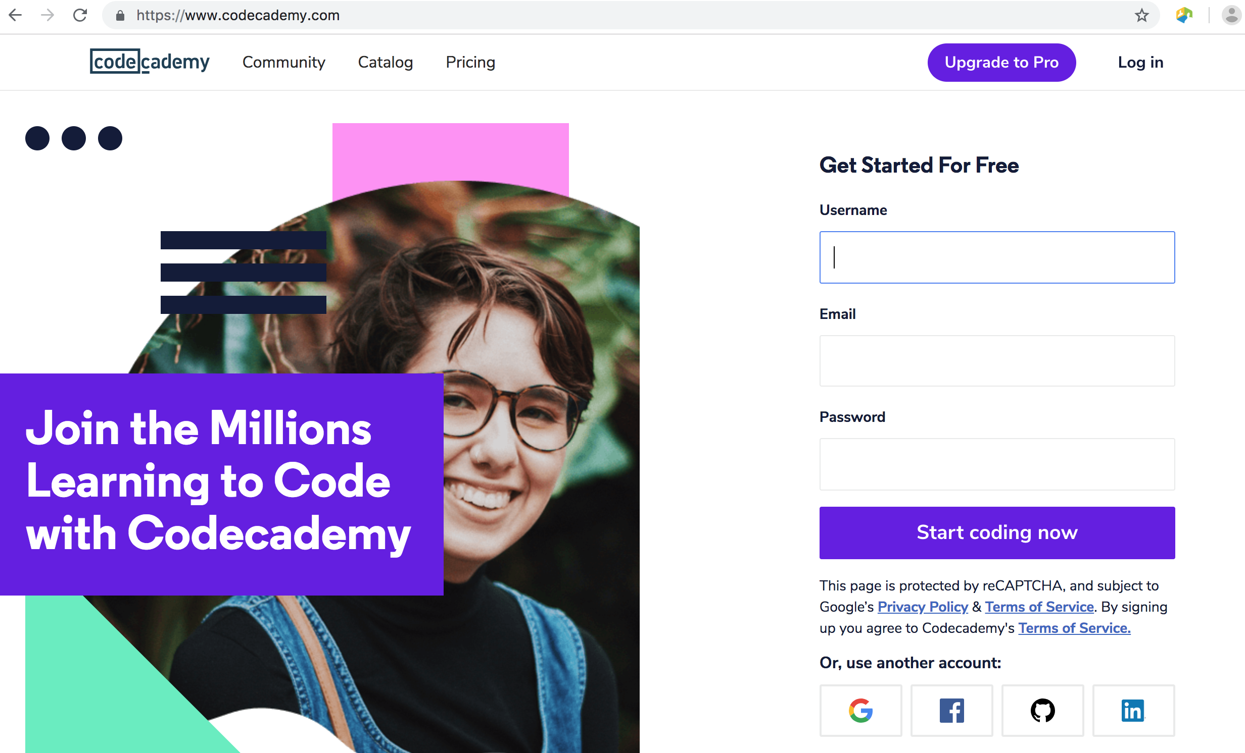
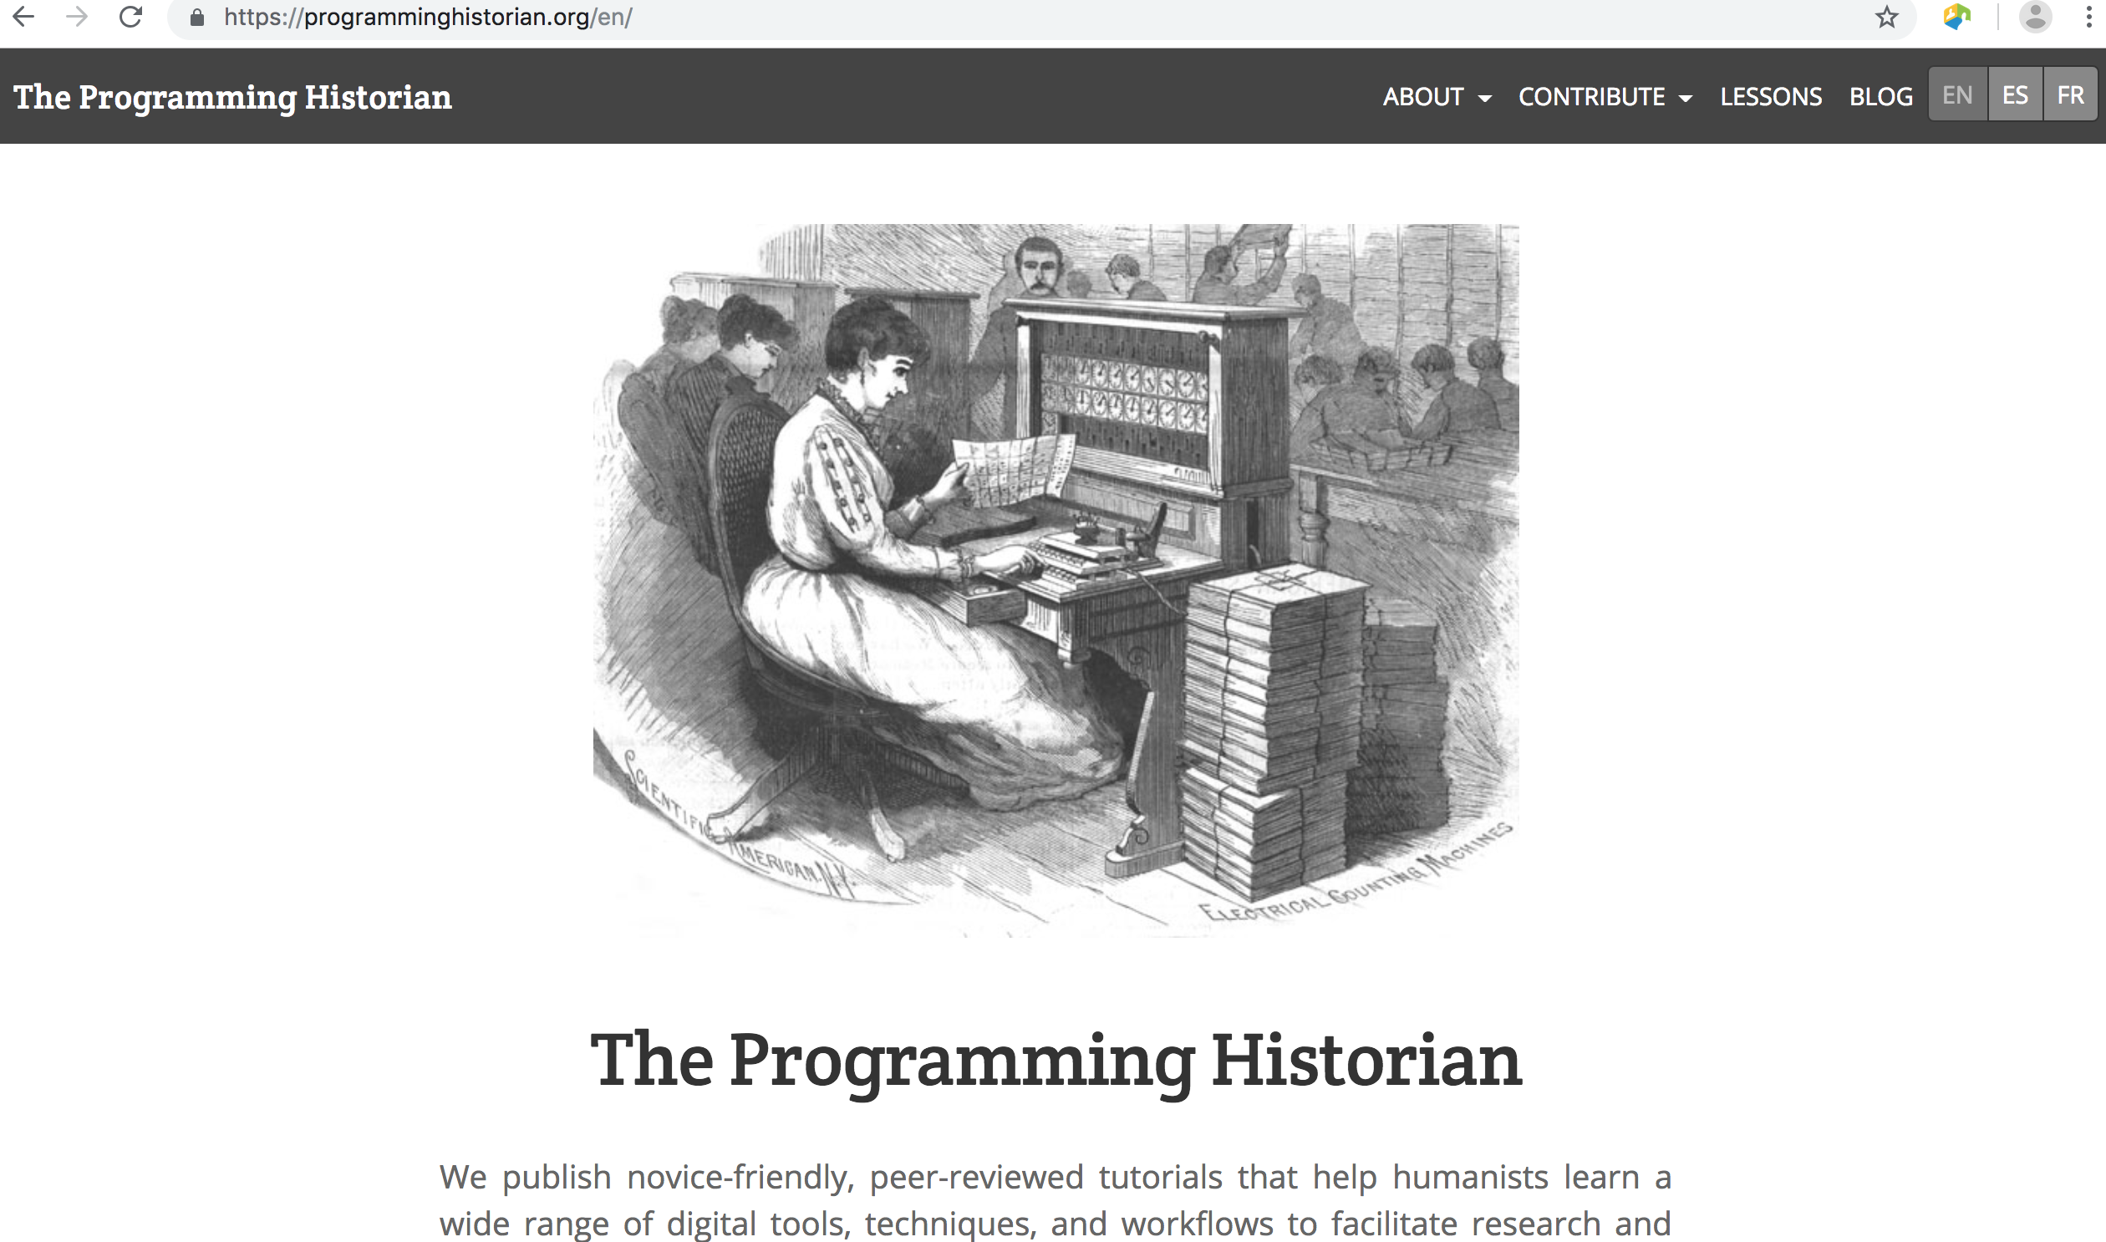
What are academic libraries doing with regard to DH?
Skills development for librarians in DH
Online sources:
Coursera (https://www.coursera.org/ )
Codeacademy (https://www.codecademy.com/ )
Programming Historian (http://programminghistorian.org/ ) – Software
Carpentry for Digital Humanities

Slide 20
How does Digital Humanities link-up with eResearch and Library Carpentry
There is a natural overlap between DH and Library Carpentry and eResearch. This can be seen in the number of Library/Software Carpentry workshops that are geared towards training of library staff and researchers in coding skills for DH
Examples of Library/Software Carpentry workshops for DH:
Using Git, Github
Cleaning data with OpenRefine,
Getting started with Markdown
Editing audio with Audacity
Counting and mining data with Unix
R basics with tabular data
For more examples see http://programminghistorian.org/lessons/

Slide 21
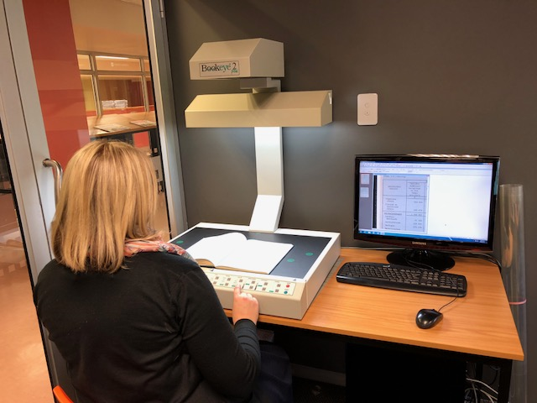
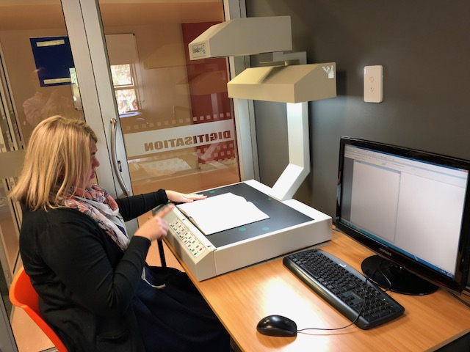
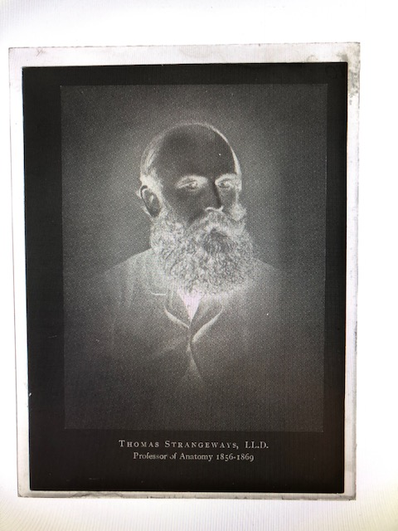
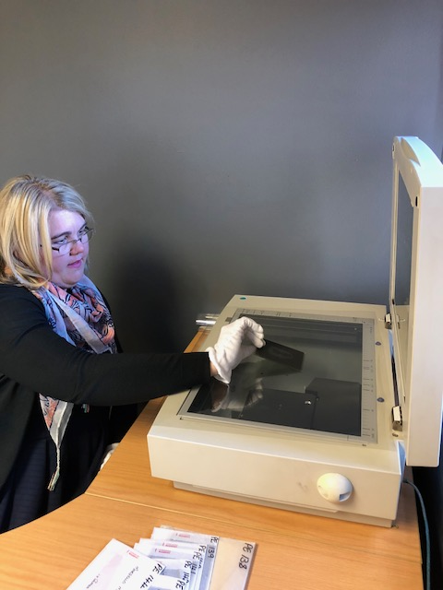
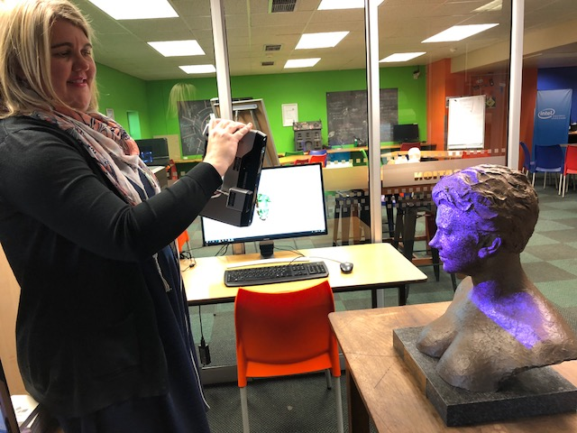
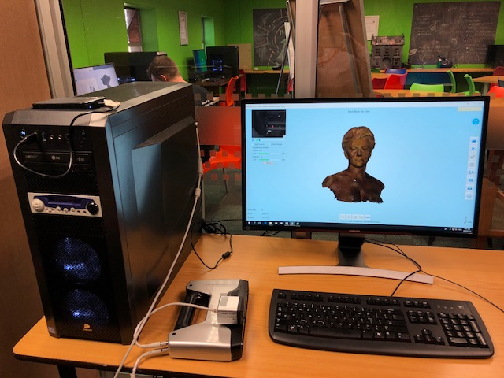
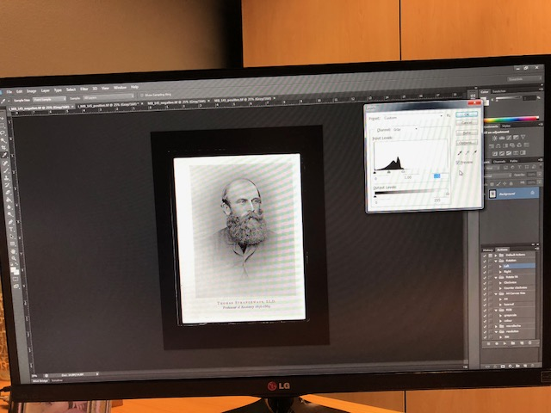
Examples: Digitisation

Slide 22
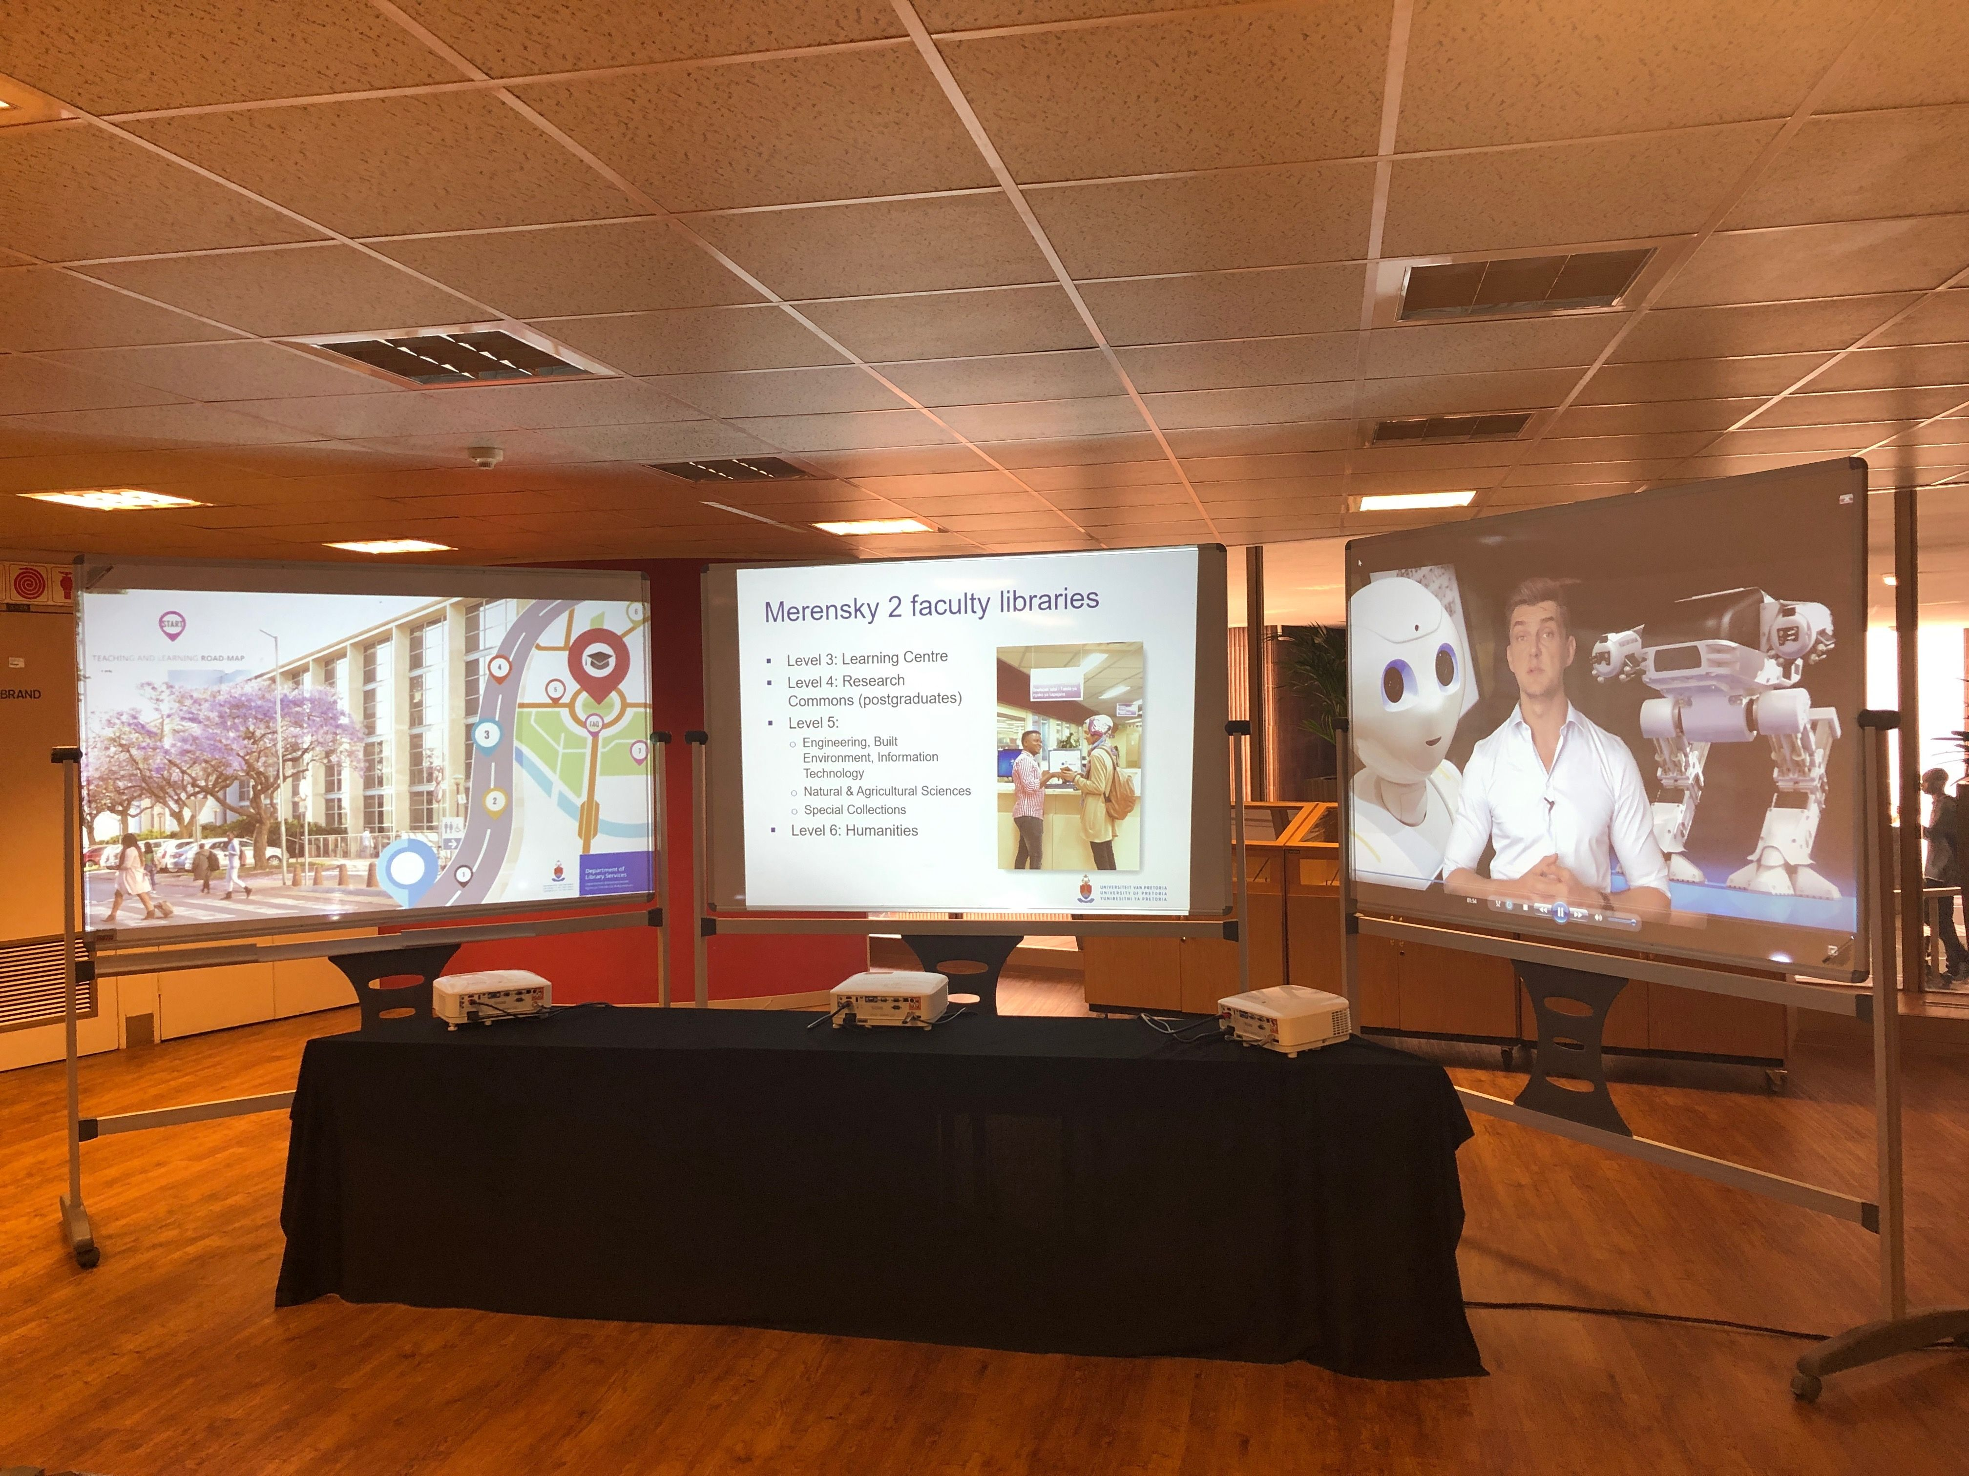
Example: Virtual Exhibitions
Creation of virtual (digital) collections, showcased on the Library Service’s mobile visualisation unit.

Slide 23
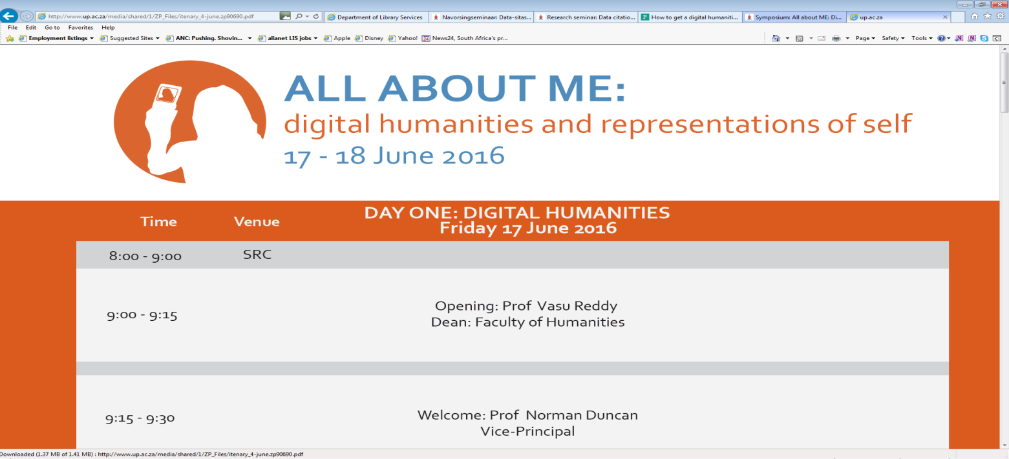
Examples amongst UP Academics
Seminar: All about me: Digital Humanities and Representations of Self, held 17-18 June 2016, University of Pretoria – focussed on Cell Phone Selfies
http://www.up.ac.za/media/shared/1/ZP_Files/itenary_4-june.zp90690.pdf

Slide 24
Examples amongst UP Academics
African Languages Department:
Digitisation of African Languages sources that are in print, sound, microfilm and microfiche format for the SADiLaR-projek (https://www.sadilar.org/)

Slide 25
Challenges
Insufficient formal training opportunities
Lack of support for library-conceived initiatives
Lack of time
Lack of authority to marshall appropriate resources
Inflexible infrastructure
Lack of incentive
Complexity of collaboration with academics
Lack of institutional commitment
Diffusion of effort
Overcautiousness
Challenges

Slide 26
Sources on DH
Journals:
DSH: Digital Scholarship in the Humanities
DHQ: Digital Humanities Quarterly
Digital Studies / Le champ numérique
Digital Literary Studies
DH Commons
Journal of Digital Humanities
Journal of Digital and Media Literacy
Journal of the Text Encoding Initiative
Computers in the Humanities Working Papers
Text Technology
Digital Humanities Now (Informal, Aggregator of scholarship
Books:
Blackwell’s Companion to Digital Literary Studies
Blackwell’s Companion to Digital Humanities
The Digital Humanities: a primer for students and scholars / Eileen Gardiner and Ronald G Musto
The emergence of the Digital Humanities / Steven E. Jones
Big Digital Humanities: imagining a meeting place for the Humanities and the Digital / Patrik Svensson

Slide 27
Bibliography
ANDREWS, T. 2016. Digital Humanities: introduction. (Living Books About History) [Online] available at https://livingbooksabouthistory.ch/uploads/media/pdf/en/digital-humanities.pdf (Accessed 22 March 2019)
BURDICK, A. et al. 2012. Digital Humanities. Cambridge, MA: MIT Press.
DRUCKER, J. 2013. Intro to Digital Humanities: Introduction. UCLA Center for Digital Humanities. [Online] available at http://dh101.humanities.ucla.edu/?page_id=13 (Accessed 22 March 2019).
ROUX, J.C. 2016. Promoting Digital Humanities in South Africa. Presented at ‘All About Me Symposium’, held at University of Pretoria, Pretoria, 17-18 June 2015.
Wikipedia contributors. 2019. ‘Digital humanities’. In Wikipedia, The Free Encyclopedia. [Online] available at from https://en.wikipedia.org/w/index.php?title=Digital_humanities&oldid=888613947 (Accessed 22 March 2019)

