Slide 1

CLUSTER 1
CLUSTER 2
Q 1
Q 2
Q 3
Q 4
Q 5
Q 6
Q 7
Q 8
Q 9
Q 10
Q 11
Q 12
Figure S2. Cluster image generated by Java TreeView (Saldanha, 2004) of the protein obtained after LC-ESI-MS/MS analysis of total protein isolated from BIG8-1 before (Day 0), and after induction of water stress (Days 7 and 14), and after recovery and regrowth (Day 21). Red bands show up-regulated proteins, whereas green bands show down-regulated proteins.

Slide 2
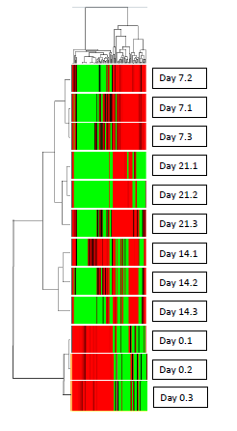






CLUSTER 1
CLUSTER 2
Cluster 1
Cluster 2
Q 1
Q 2
Q 3
Q 4
Q 5
Q 6
Q 7
Q 8
Q 9
Q 10
Q 11
Q 12
Cluster 1
Cluster 2
Fig. S1
Fig. S2

Slide 3










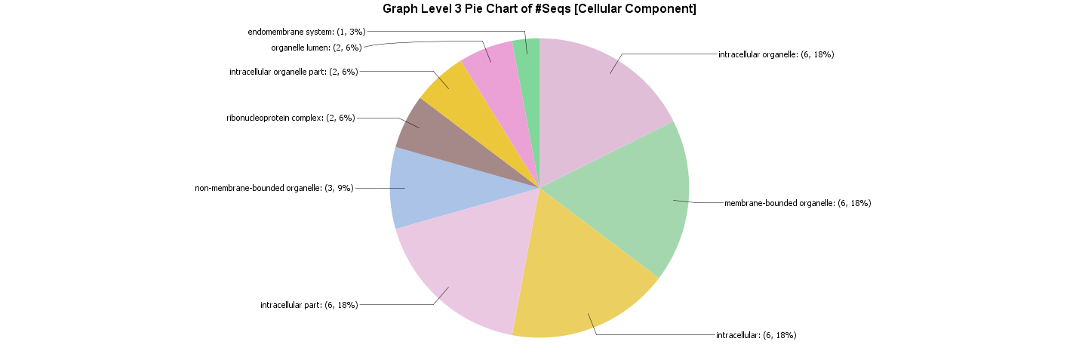

Q1
Q2
Q3
Q4
Fig. S2 (Cont.)

Slide 4












Q9
Q10
Q11
Q12
Fig. S2 (Cont.)

Slide 5









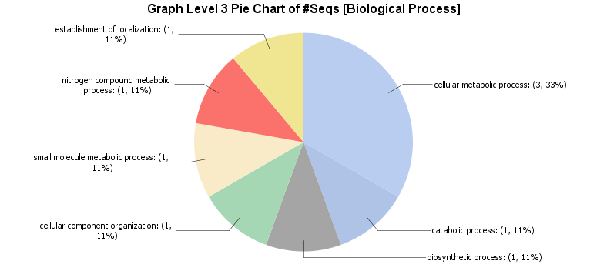
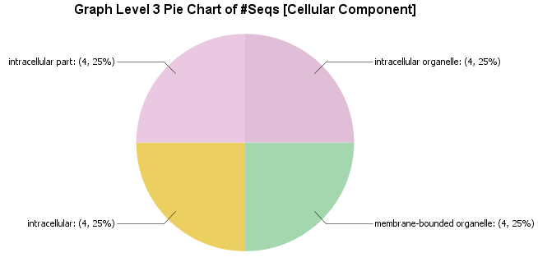
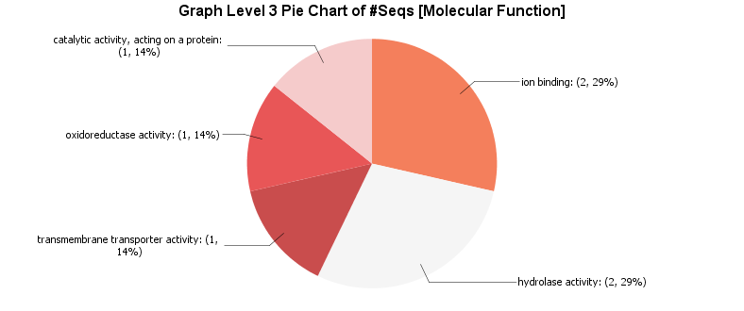
Q5
Q6
Q7
Q8
Fig. S2 (Cont.)

