Slide 1
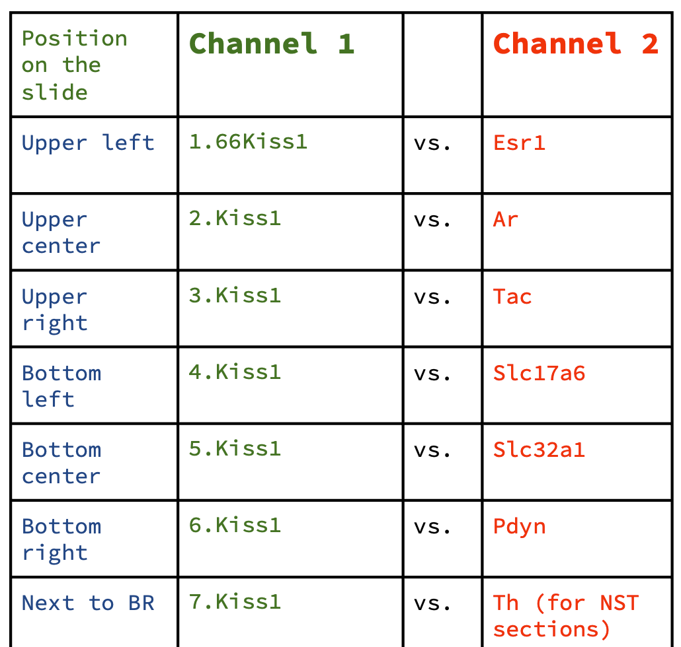
A. Sample collection and SISH (Brown kit) experimental design
The collection was repeated for 16 mouse brains: 16 = 4 (n) x 2 (treatments) x 2 (sexes)
A1
1
5
9
A2
25
A3
A4
A5
13
17
21
…
B1
2
6
10
B2
26
B3
B4
B5
14
18
22
…
C
1
3
7
11
C2
27
C3
C4
C5
15
19
23
…
D1
4
8
12
D2
28
D3
D4
D5
16
20
24
…
Notations for panel A:
Section Thickness: Each section was 12 µm thick.
Series Composition: Each of the four series (A, B, C, and D) includes 5-6 slides with 6 sections per slide. One series which covers approximately 1.8 cm linear dimension (rostro-caudal or medio-lateral), with 36-42 sections, was processed for SISH per subject (i.e., 1 in 4 sections).
Distance Between Sections: There was a linear distance of about 48–84 µm between two adjacent sections on a given slide. Typically, 1-3 sections per slide were not suitable for mounting due to section rolling or breakage during the unrolling process.
Design Rationale: By reacting one series out of four, we could comprehensively observe the spatial spans of the Kiss1-expressing cell populations. However, approximately 80% of the brain volume intercalated between contiguous sections within the series, per subject, was missing from the reaction.
In light of the heterogeneity in anatomical distribution, we believe that using statistical extrapolation to estimate the total cell number may not be the most accurate approach.
B. Sample collection and DISH experimental design for ROIs of hypothalamus
This design is repeated for 8 wild-type intact mouse brains: 8 = 4 (n) x 2 (sexes)
A
1
2
3
G
1
2
3
MAP
Nissl
A7
B7
C7
4
5
6
4
5
6
D7
E7
F7
B
1
2
3
H
1
2
3
MAP
Nissl
G7
H7
I7
4
5
6
4
5
6
J7
K7
L7
C
1
2
3
I
1
2
3
Probe combination
4
5
6
4
5
6
D
1
2
3
J
1
2
3
1
1. Kiss1
4
5
6
4
5
6
2
E
1
2
3
K
1
2
3
3
4
5
6
4
5
6
4
F
1
2
3
L
1
2
3
5
4
5
6
4
5
6
6
Notations for Panel B:
Section Thickness: Each section was 12 µm thick.
Section Distribution: Sequential sections from each mouse brain were mounted on 12 slides (A L). Six sequential sections were mounted in the slide A and a seventh slice (A7) was mounted on a separate slide for Nissl staining for anatomical reference. This same rule was applied to the subsequent slides (B L).
Series Composition: Six series corresponding to the 6 probe combinations were created, with twelve sections per series distributed across 12 sequential slides (A L). For each probe combination, there is approximately 100 µm between adjacent sections (e.g., from A1 to B1 for probe combination 1, Kiss1 vs. Esr1). The “missing” 6 sections were utilized for other combinations to ensure comparable observations. Each slide featured six probe combinations.

Slide 2
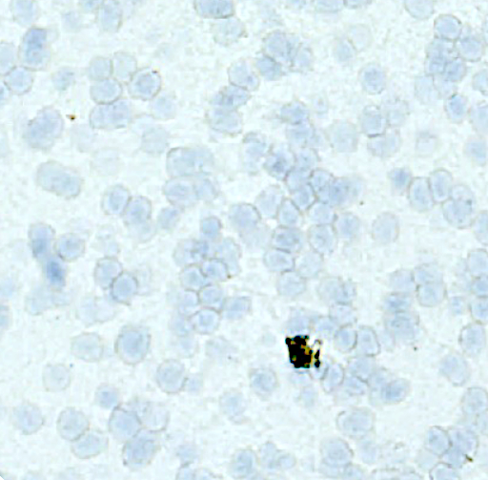
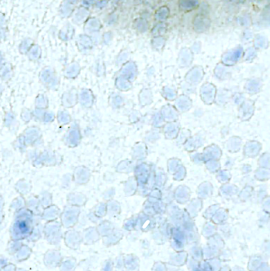
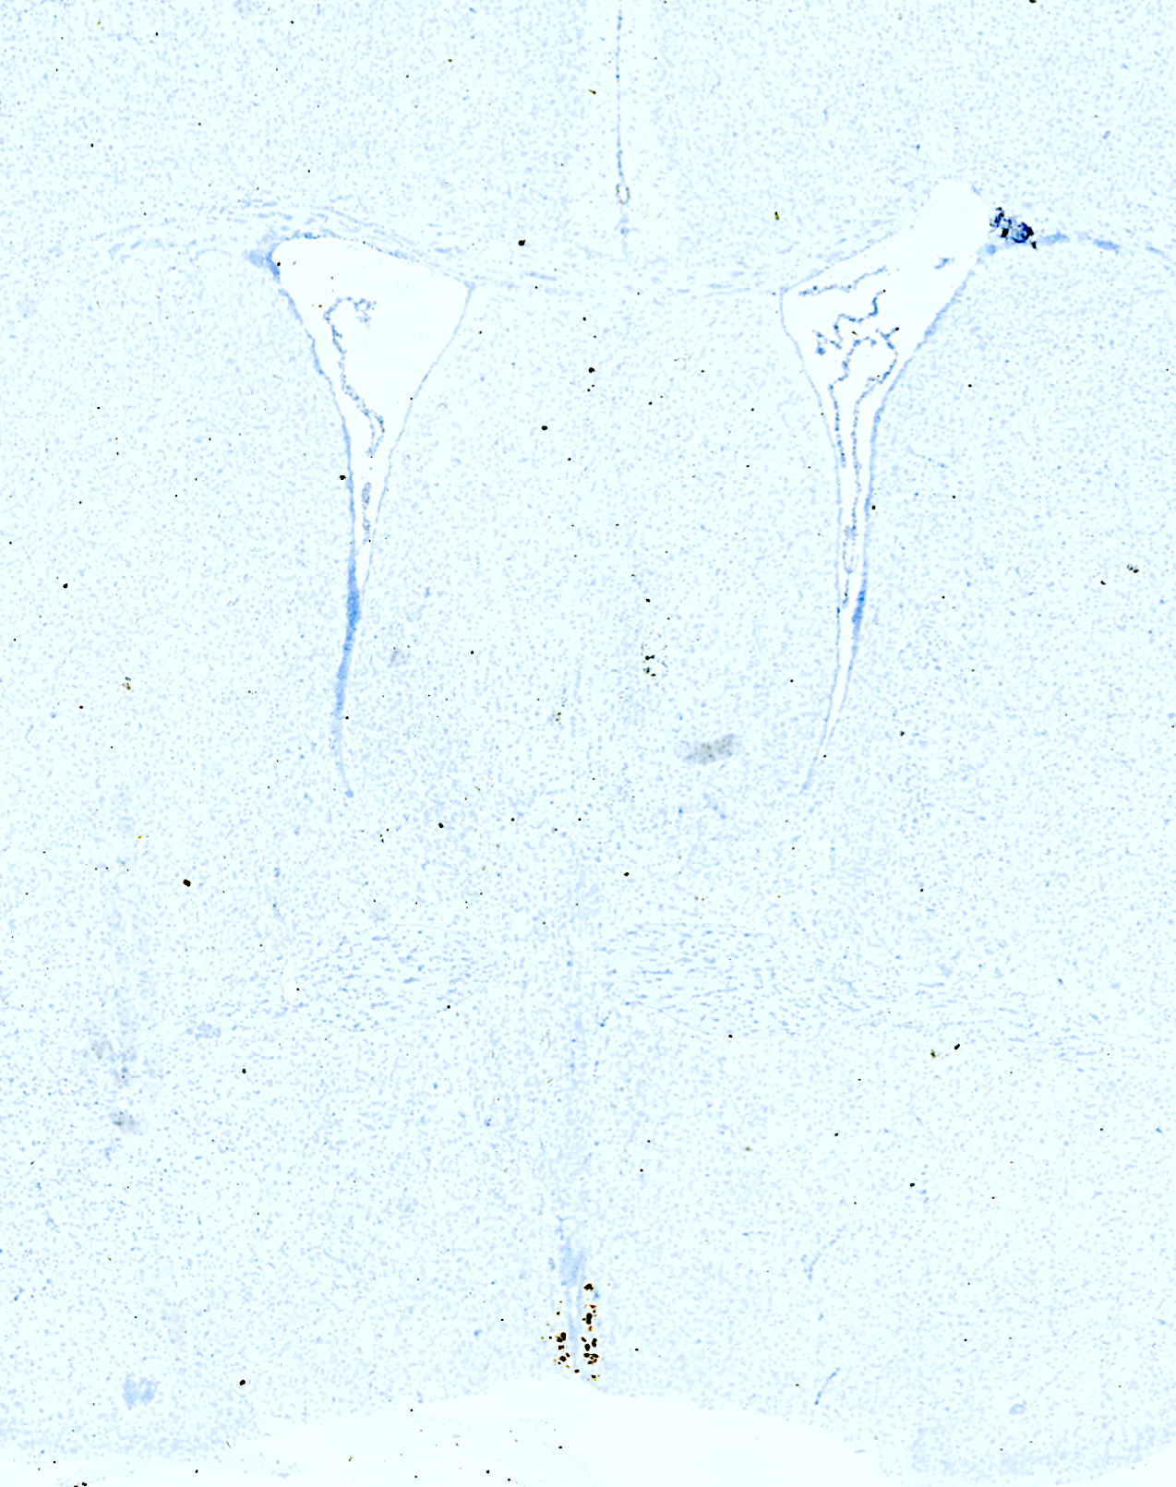
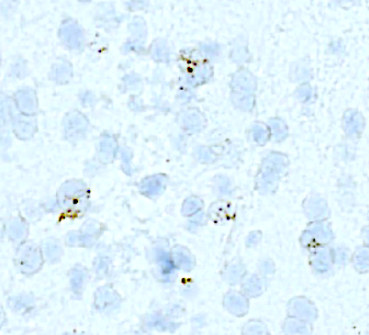
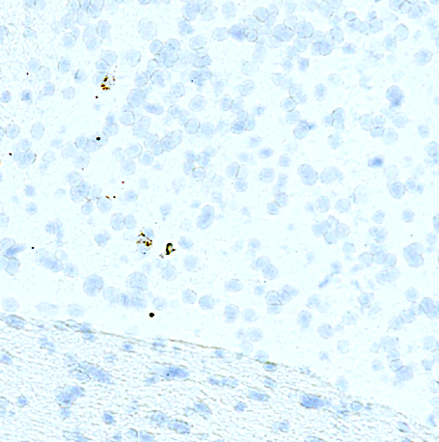
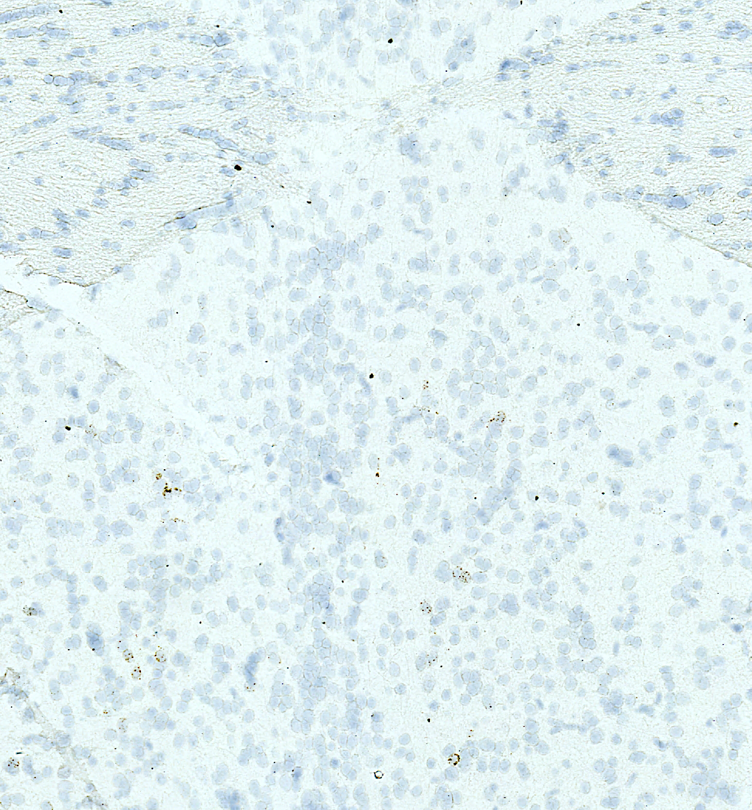
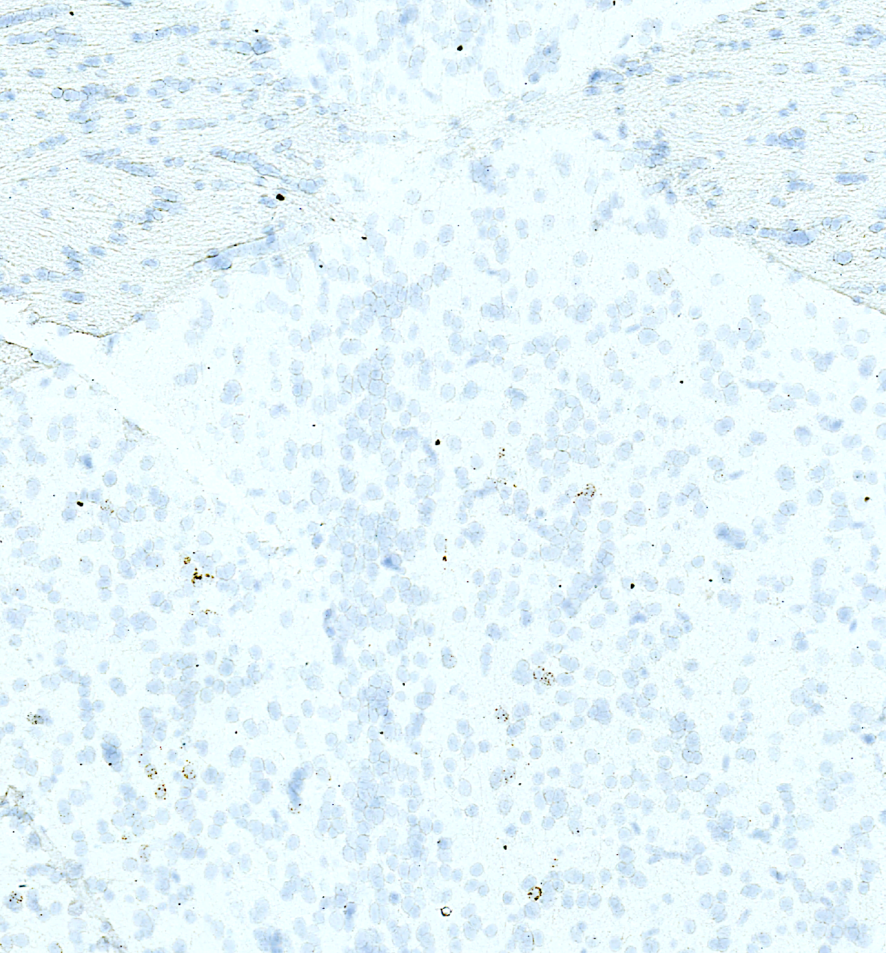
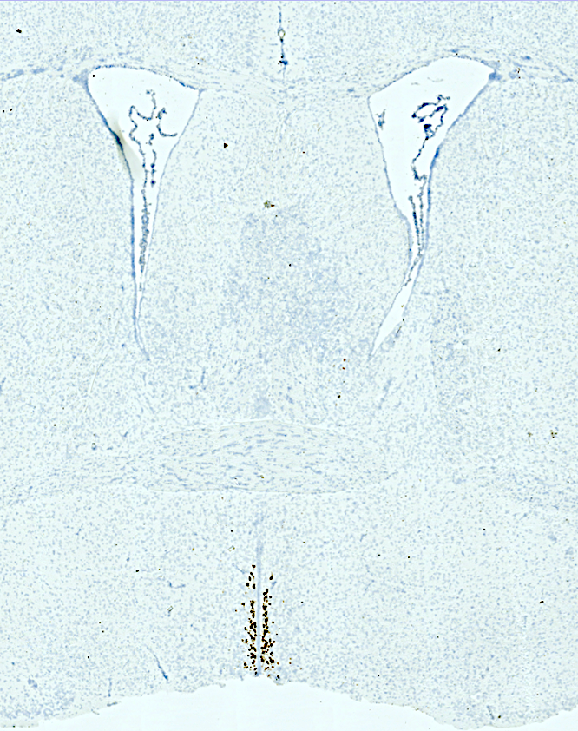
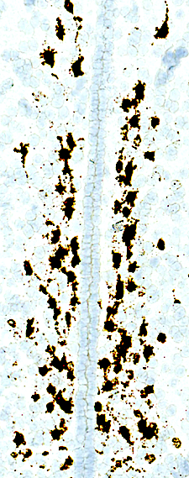
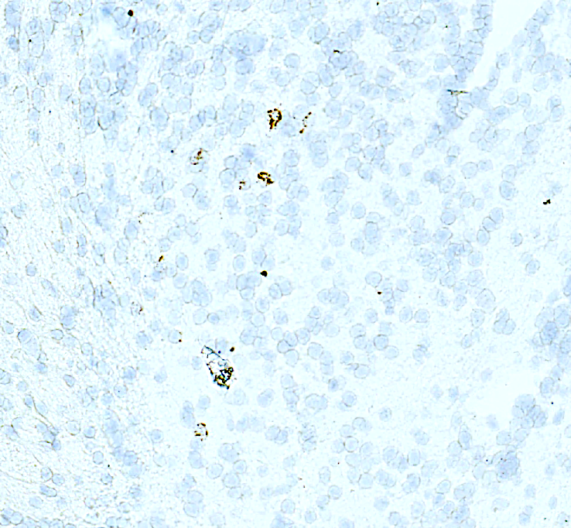
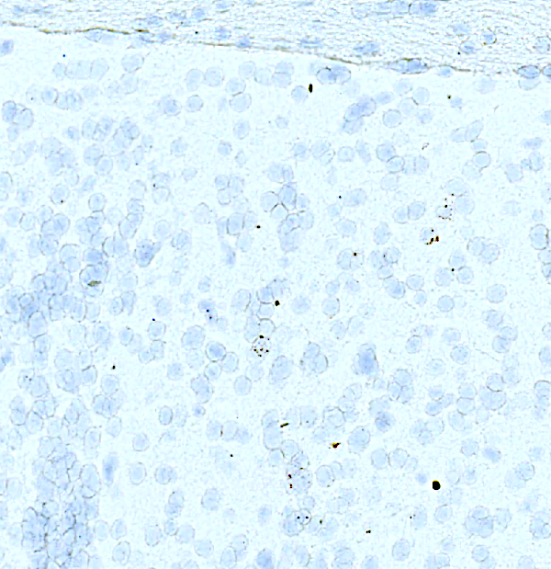
A1
A2
A
LSV
50 µm
LSV
50 µm
A3
A4
LSV
LSV
BSTov
1
3
BSTov
BSTam
2
4
BSTam
SHy
BSTam
ac
5
ac
50 µm
ac
50 µm
SHy
6
SHy
A5
ac
A6
ADP
ADP
MnPO
OVLT
MnPo
AVPe
AVPe
BSTav
Bregma 0.38 mm
500 µm
SHy
ADP
50 µm
MnPo
ADP
50 µm
B
B3
B1
LSV
LV
3V
RP3V
st
LV
f
BSTam
LSV
LSV
st
50 µm
f
f
B2
ac
ac
1
2
ADP
3V
3
RP3v
3V
50 µm
500 µm
ADP
Bregma 0.02 mm
50 µm

