Slide 1
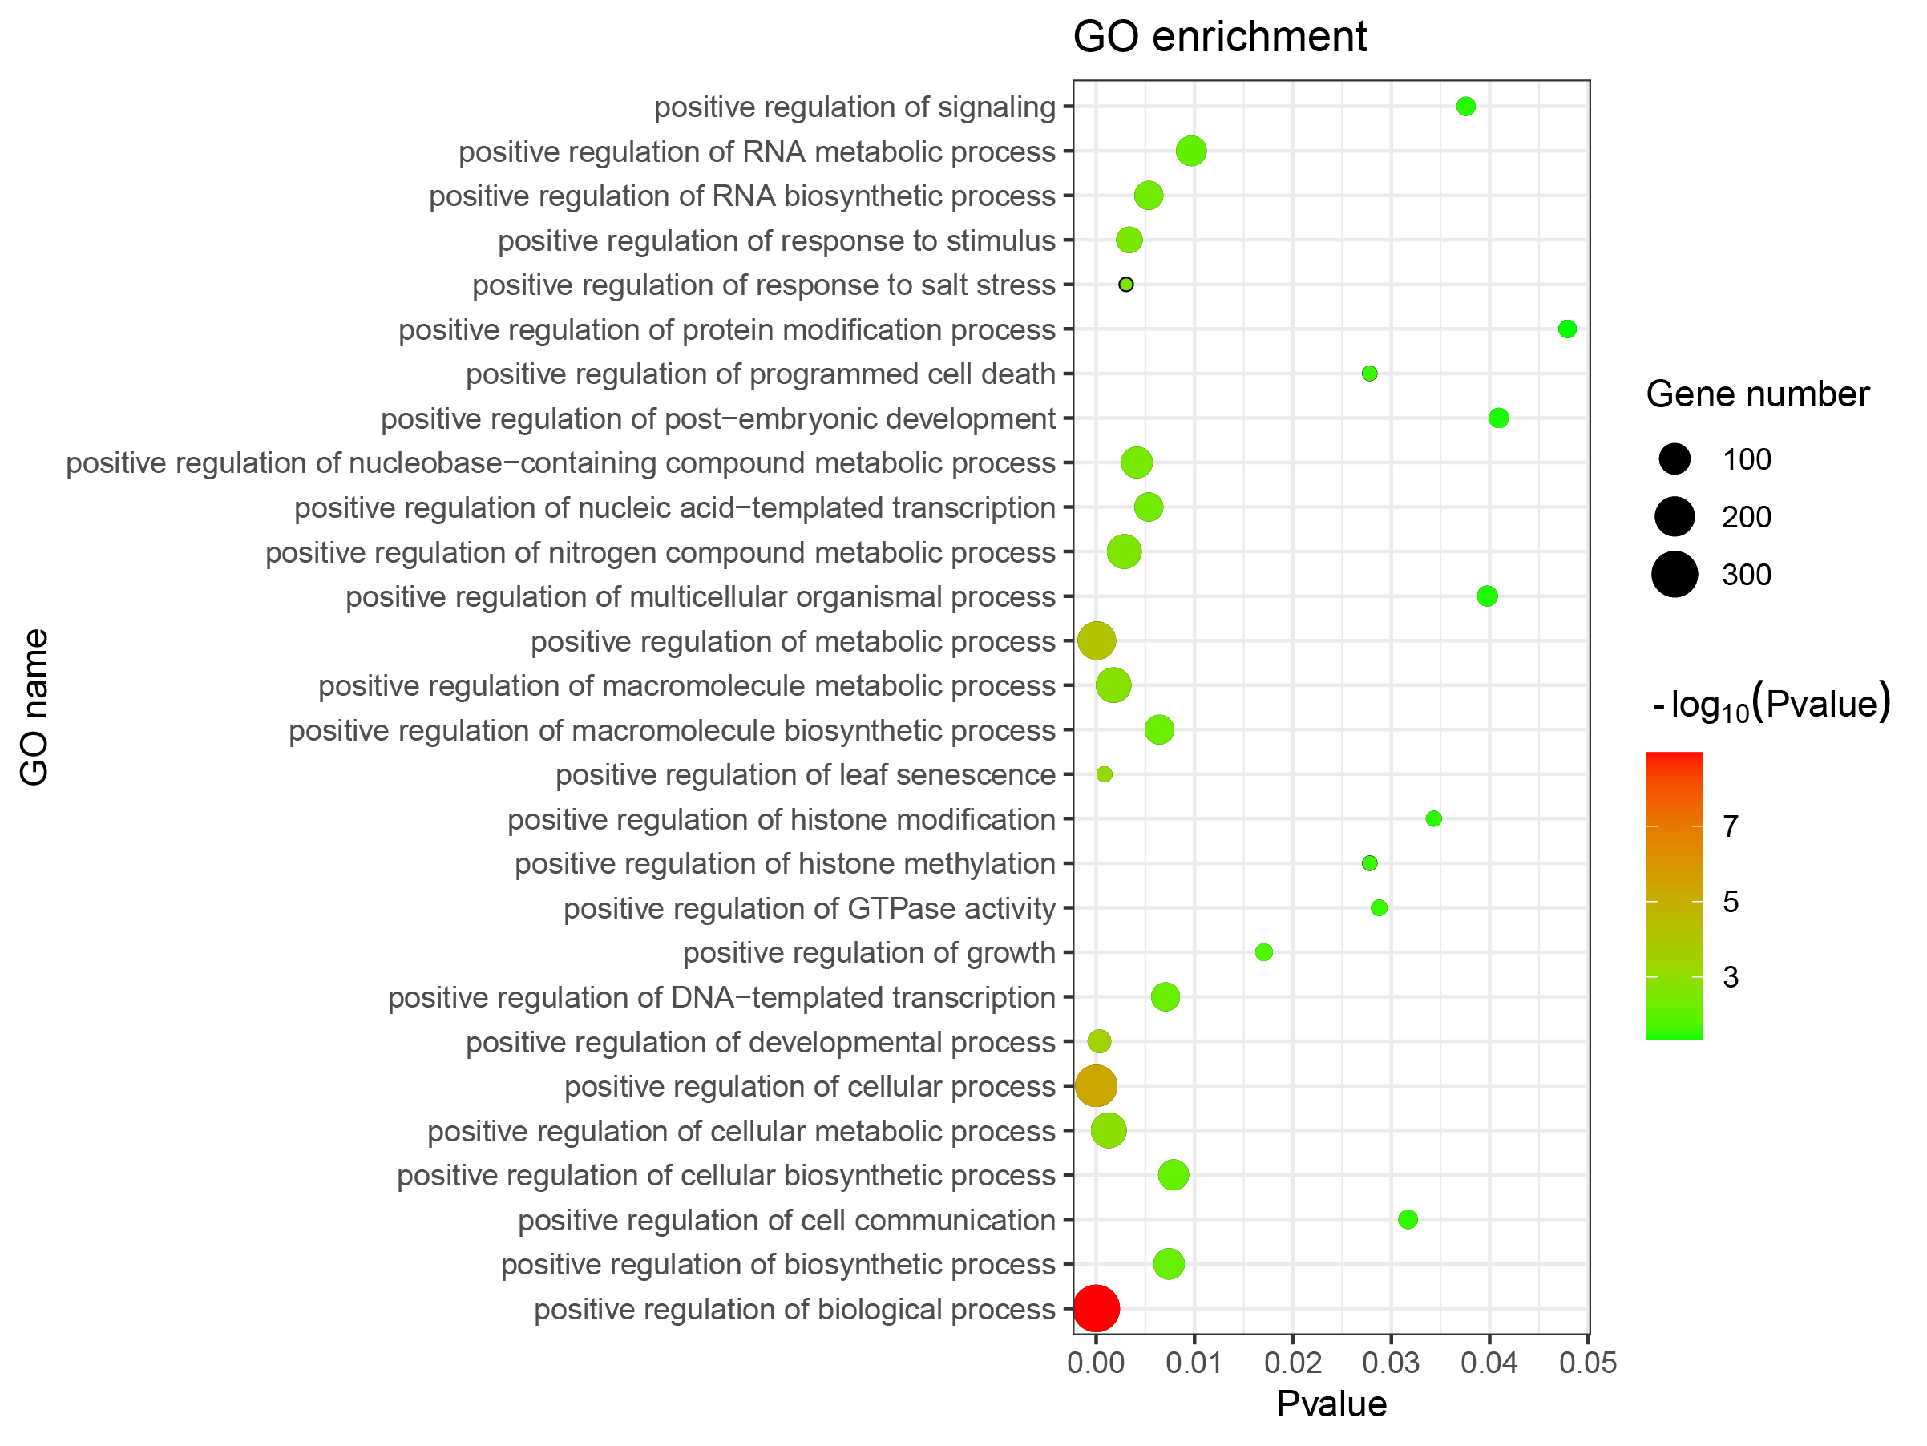
Supplemental Figure 12. GO enrichment of retained genes after whole genome duplication.

