Slide 1
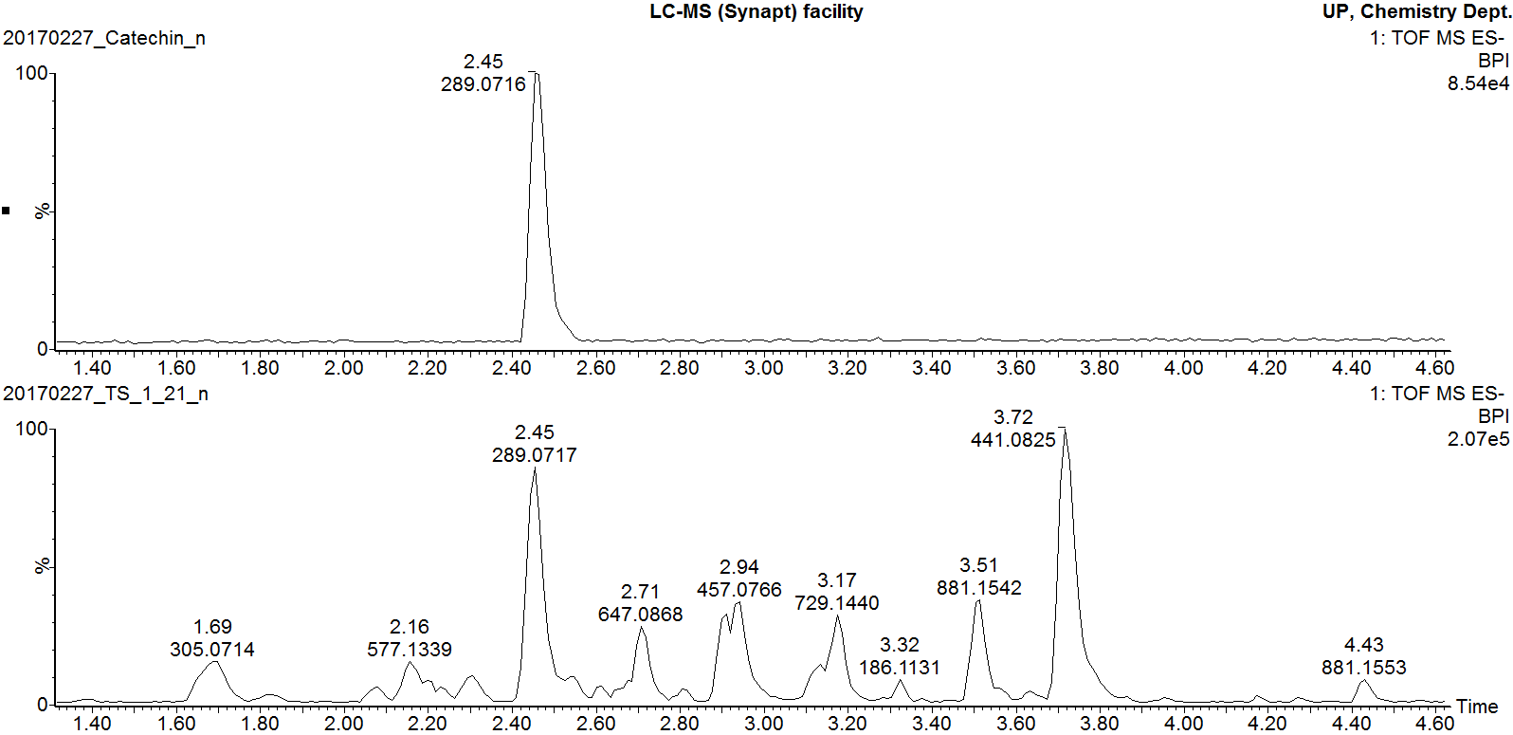
Catechin pure standard
Marula stem ethanol extract
Additional file 6
Negative mode BPI chromatogram of catechin pure standard overlaid with that of Marula stem ethanol extract

