Slide 1
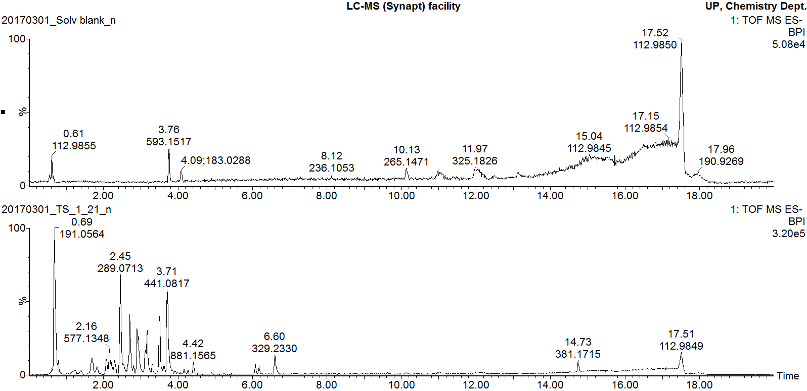
Solvent Blank
Marula stem ethanol extract
Additional file 2
Negative mode BPI chromatogram of Marula stem ethanol extract

