Slide 1
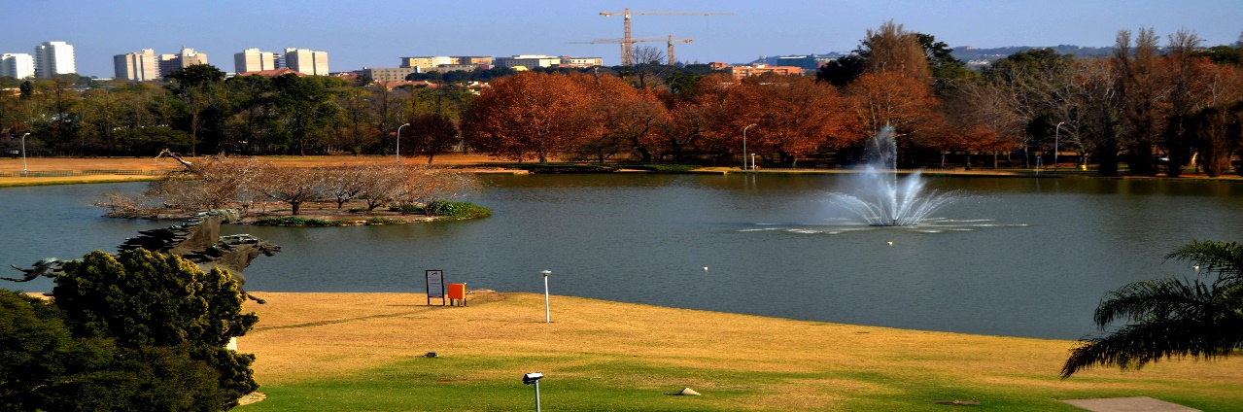
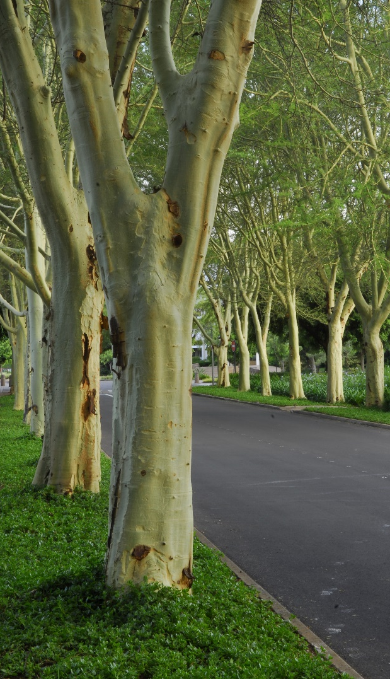
Count every drop….
Presented by Prof Susan Adendorff
Director Facilities Management
University of Pretoria
4 May 2017

Slide 2
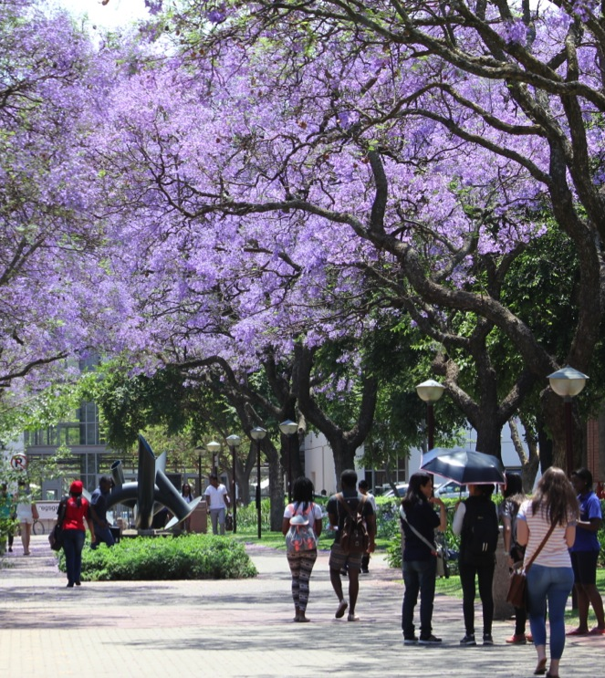
Water facts about South Africa
World average rainfall 800 – 850 mm per annum
World average water use per person per day is 65% of that of South Africans
South Africa classified as semi arid country
30st driest country in the world
South Africa’s rainfall of 480 – 500 mm
South Africa exploits 98% of its water resources
Let’s talk water

Slide 3
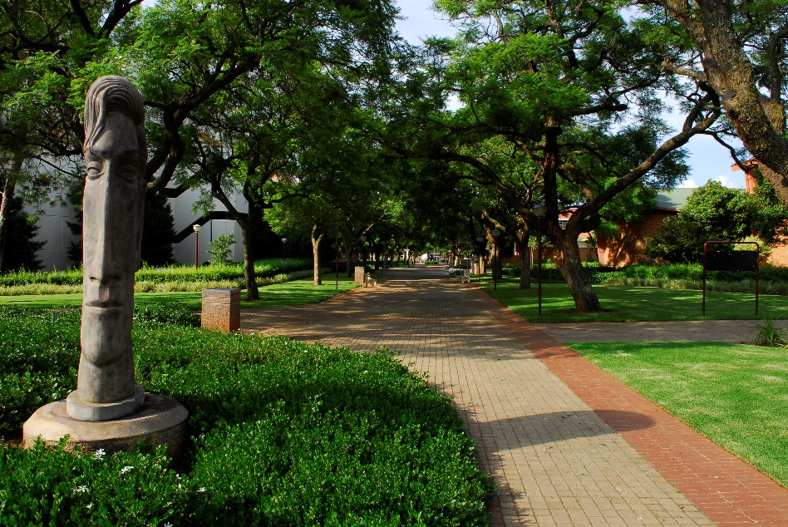
Water use in South Africa
Sector | %
Irrigation | 59.0%
Urban use | 25.1%
Mining and Bulk Industrial use | 5.7%
Rural use | 4.3%
Afforestation | 3.7%
Power Generation | 2.2%
Let’s talk water

Slide 4
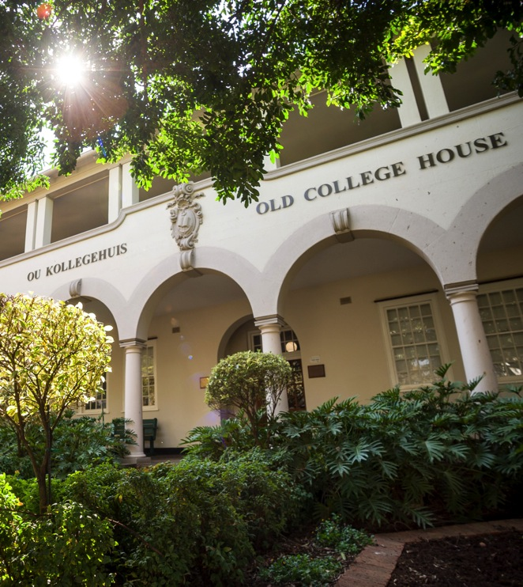
Domestic uses of water
UP has almost 2 500 toilets
UP has more than 800 urinals
Domestic Use | Rural | Urban
Toilets | 73% | 37%
Bath and Shower | 19% | 32%
Washing Machine | N/A | 17%
Other (Cooking, Cleaning, Washing Dishes, Drinking, etc) | 8% | 14%
Let’s talk water

Slide 5
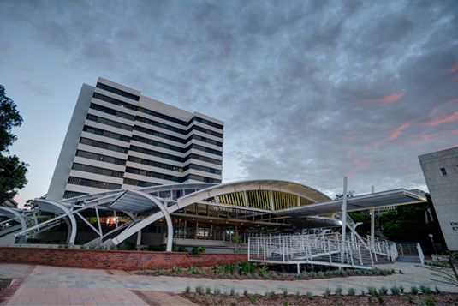
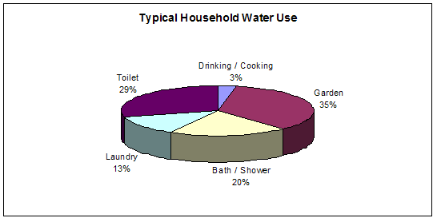
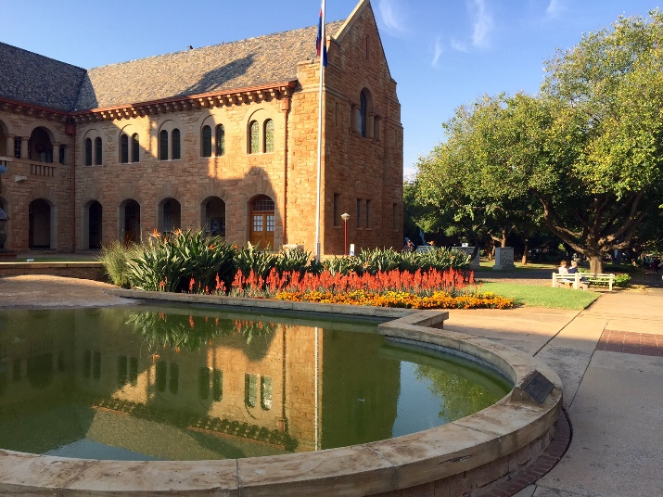
There are almost 900 buildings on the UP campuses
UP has 404 ha of land – sports fields and gardens included
All 31 residences have laundries
UP has a food services division in the Department of Residence Affairs & Accommodation
Numerous food service providers on all campuses
Let’s talk water

Slide 6

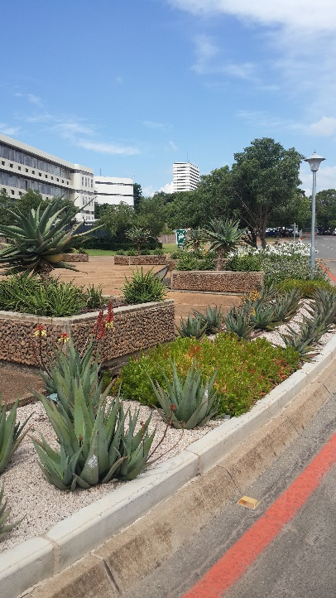
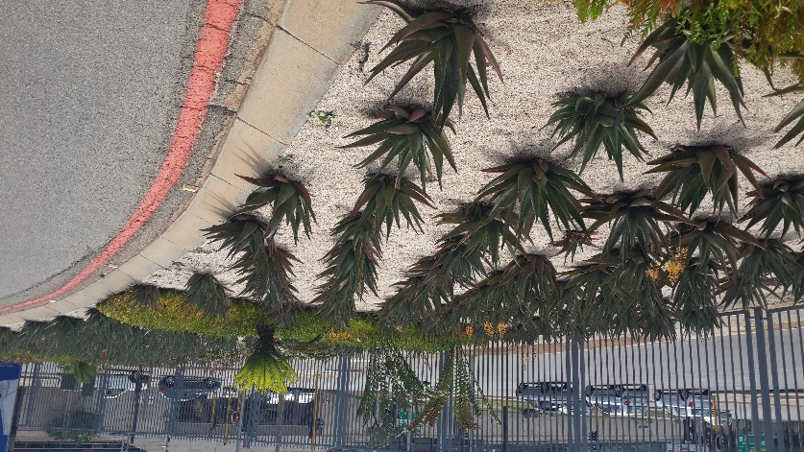
Climate
Nature of economy (irrigated
agriculture, industrialization)
Standard of living
Population growth
Economic growth
For UP
Student/staff growth
Expansion of the UP facilities
Let’s talk water

Slide 7
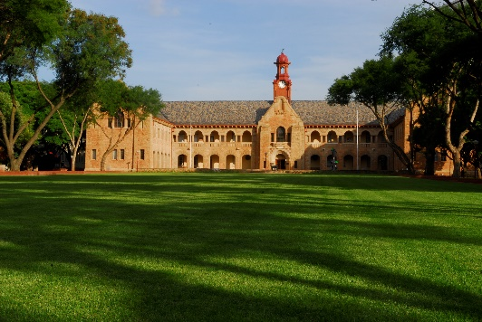
Water use UP
Water approximately 15% of UP’s annual utility budget
Water uses:
  Energy production
  Laboratory and research
  Dining services
  Rest rooms
  Grounds maintenance (404 ha)
On average approximately 640 000kL per annum
  Norms applied to use – kL per gfa; for UP below norm (0.86<0.97)
Let’s talk water

Slide 8
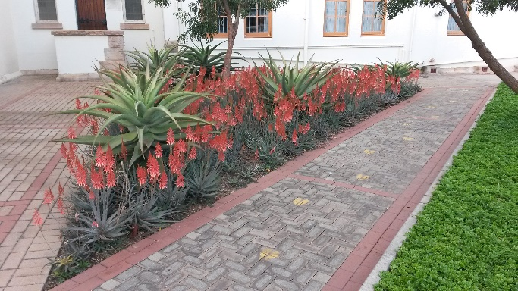
Water management @ UP
Water management policy approved by the UP Executive – part of sustainability approach
2017 awareness campaign
Design of new buildings and refurbishment of existing buildings
  Reduce water use through high efficiency plumbing
Measures to stop water flow into buildings after hours and holidays
Leakage detection and repairs
Preventive maintenance
Water wise gardening
Use of water efficient irrigation system
Let’s talk water

Slide 9
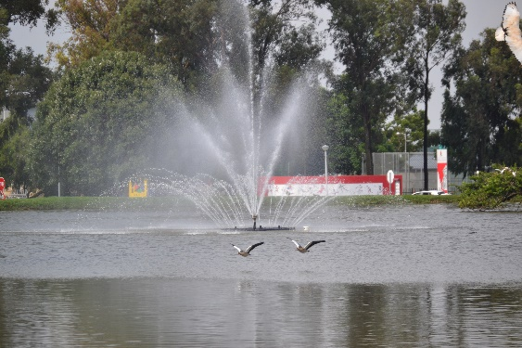

Use of reclaimed water
Rainwater harvesting and storage
Use of storage tanks/reservoirs for borehole water
Water use monitoring
  Pogo:
    Collects, displays and logs soil moisture
    Prevents over watering
Water test and analysis on regular basis to monitor quality
Let’s talk water

Slide 10
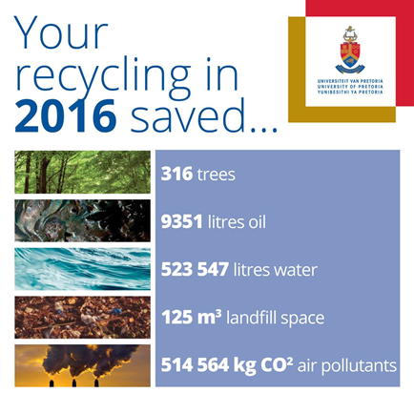
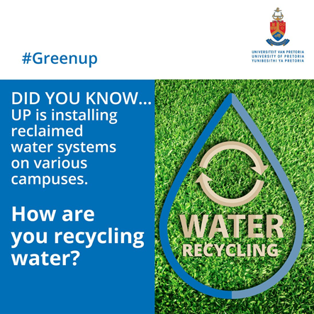
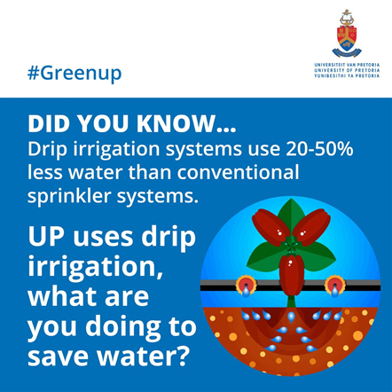
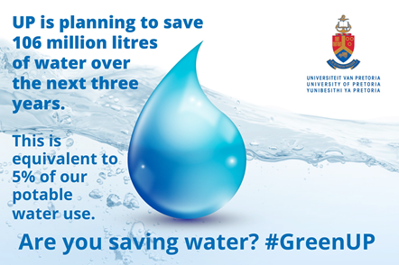

2017 Social media campaign
Let’s talk water

Slide 11
Water Management and sustainability
Let’s talk water

Slide 12
Case study: Hillcrest Campus
Let’s talk water

Slide 13
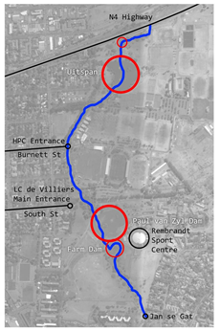
Case study: Hillcrest Campus
Let’s talk water

Slide 14

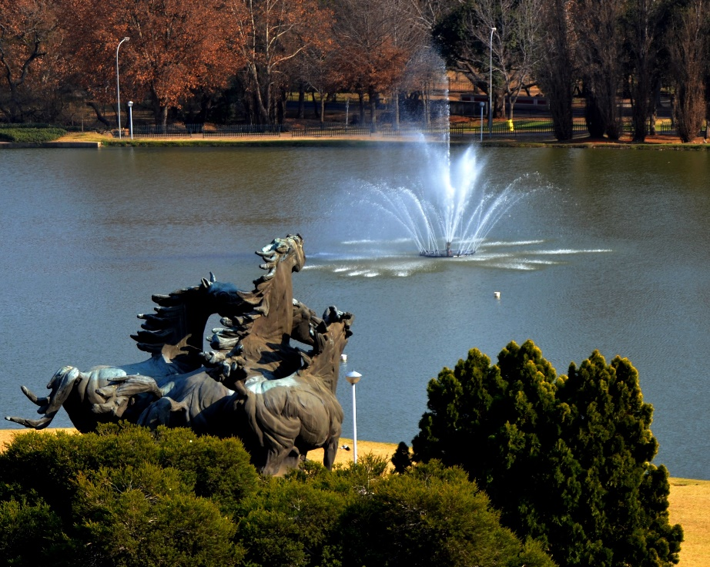
Count every drop, because……

Slide 15
Thank You

