Slide 1
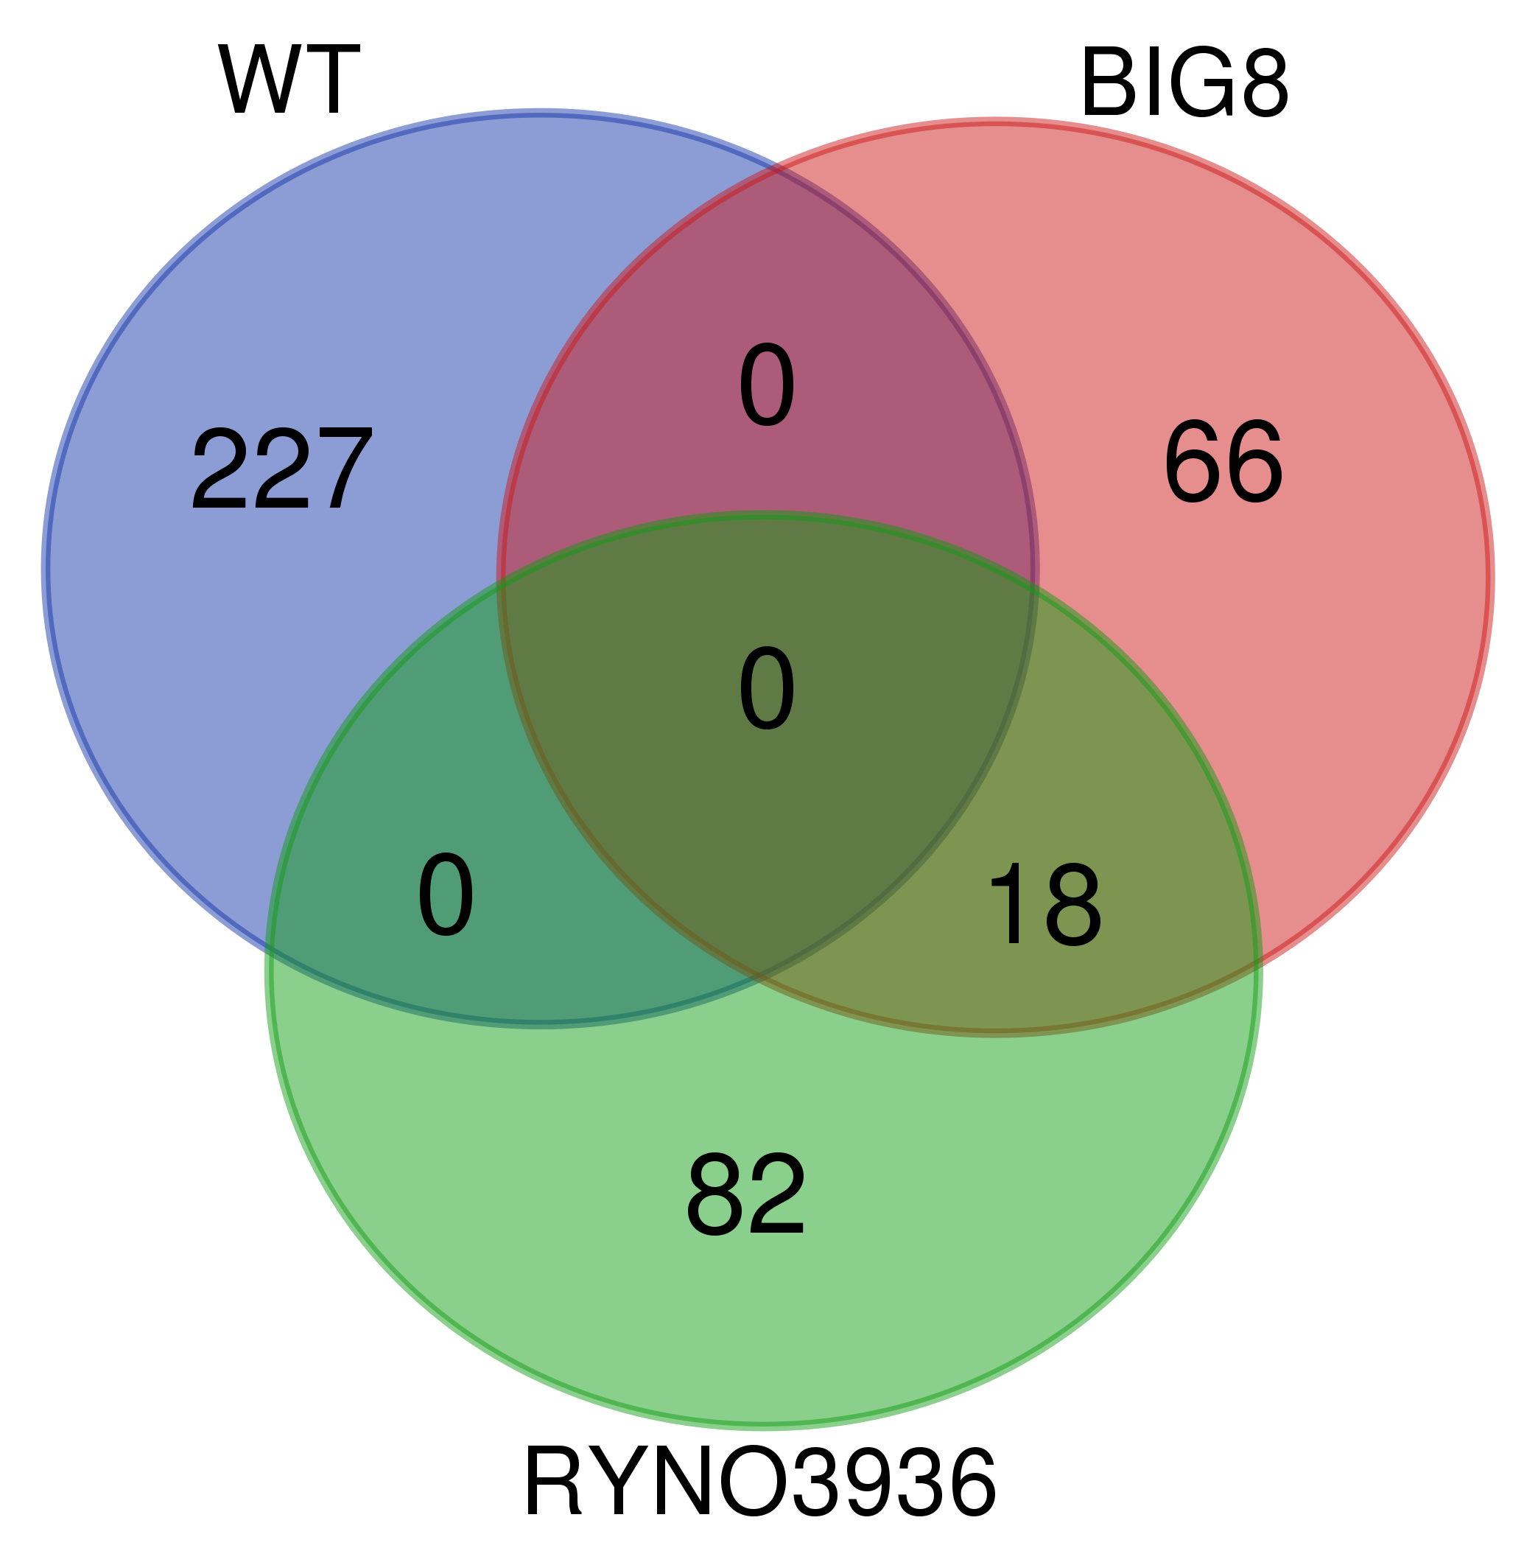
Figure S3 Venn-diagram of the shared and unique proteins present in wildtype TugelaDN, and mutants BIG8-1 and RYNO3936 plants before (Day 0) exposure to water deficit stress.

