Slide 1
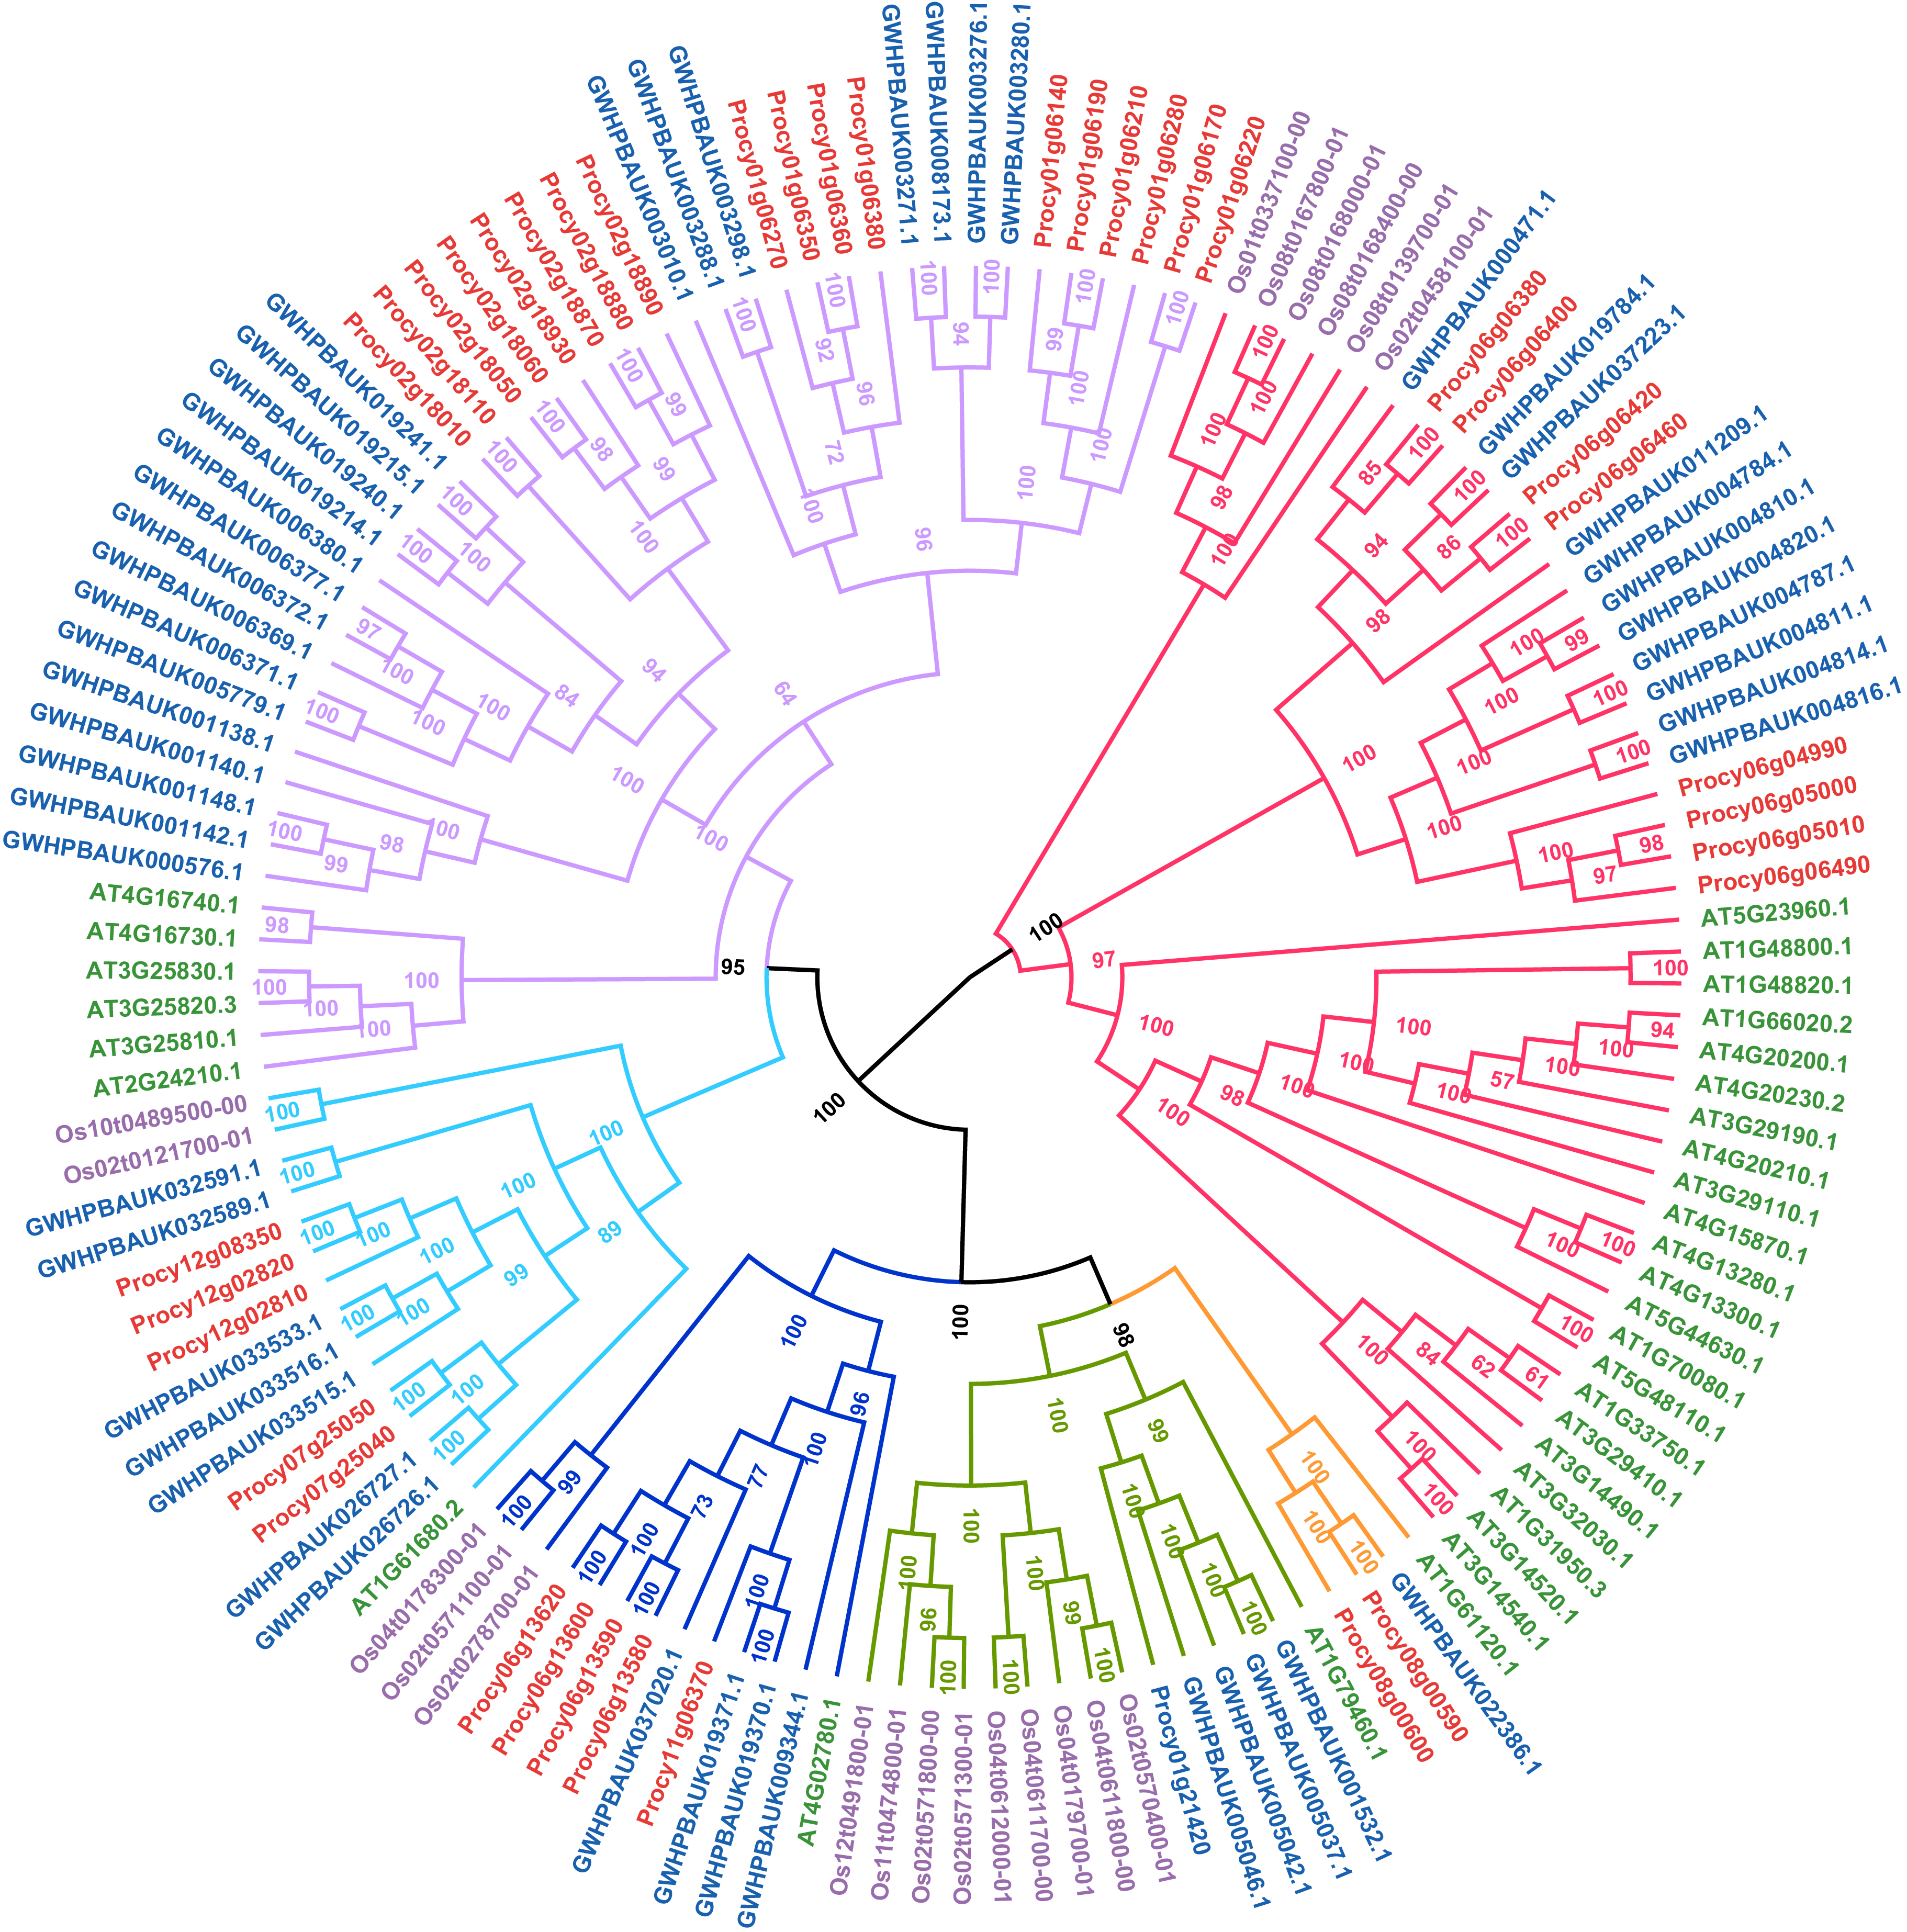
Supplemental Figure 10. The phylogenetic tree of TPS genes in P. cynaroides, M. integrifolia, A. thaliana and O. sativa.

