Slide 1

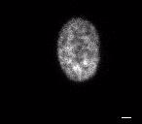
A
B
Video S1: Time-lapse imaging of HeLa Kyoto cells exposed to DMSO as a vehicle control and 0.4 µM ESE-16. Videos illustrate cell division in DMSO exposed samples (time-lapse: 50 minutes) (A) and the induction of a metaphase block in ESE-16 treated cells (time-lapse: 680 minutes) (B).

