Slide 1
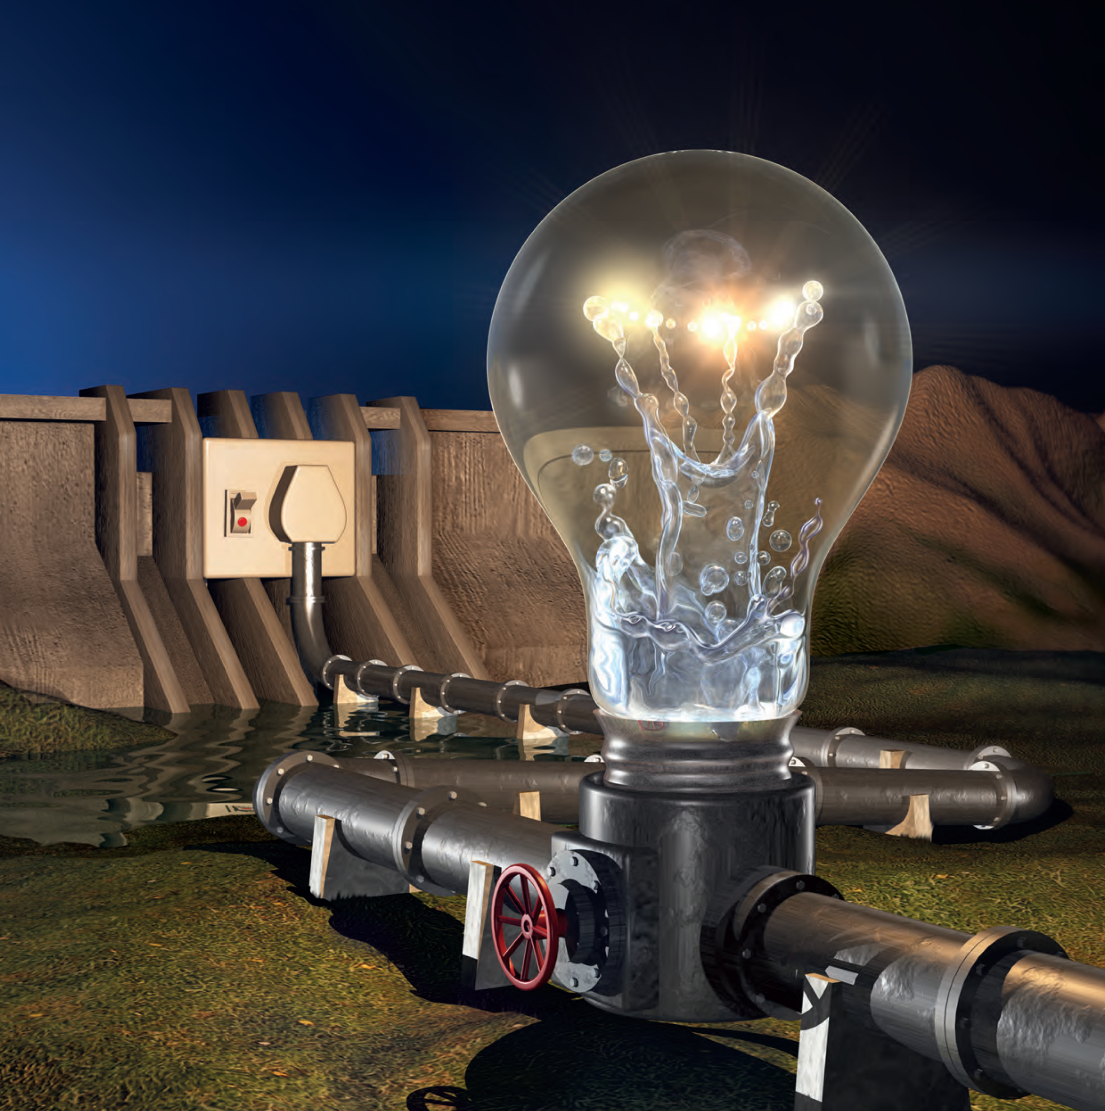
CONDUIT HYDROPOWER
Marco van Dijk
Department of Civil Engineering
4 May 2017

Slide 2
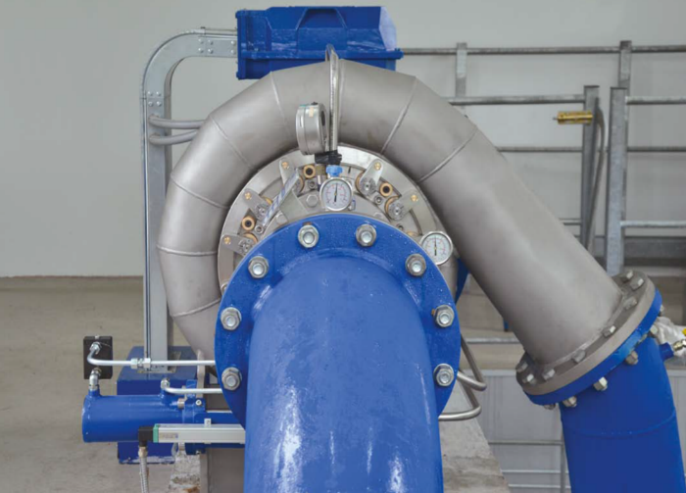
Will be answering:
What is conduit hydropower?
What opportunities do we have in South Africa for conduit hydropower?
Feasibility of conduit hydropower – It is a really sustainable and profitable investment

Slide 3
Outline of the Presentation
Introduction
What is conduit hydropower?
Where would you find conduit hydropower opportunities?
Example of opportunities in City of Tshwane
Summary

Slide 4
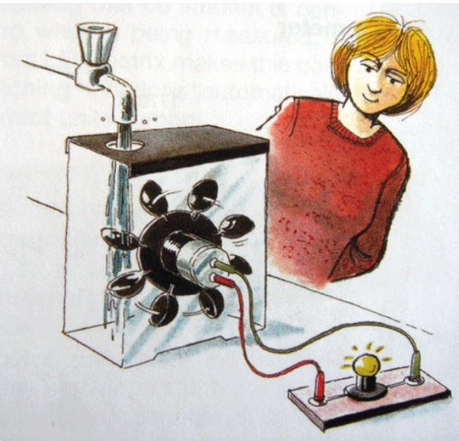
Introduction
“Low hanging fruit”
Easy renewable to develop
In US FERC – adopted legislation which provides exemption
Fits into SA being a water scarce country

Slide 5
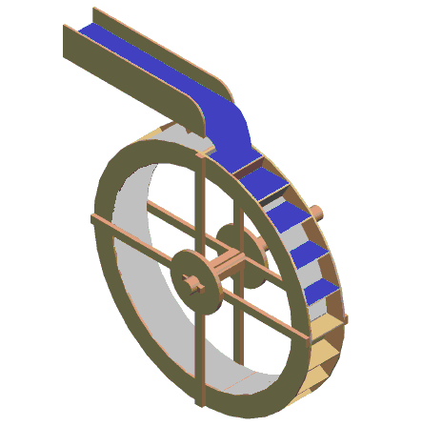
What is Hydropower?
Hydropower is often referred to as water power. The simplest definition of hydropower would be the power that derives from the force of energy of the moving water.

Slide 6

What is Hydropower?

Slide 7
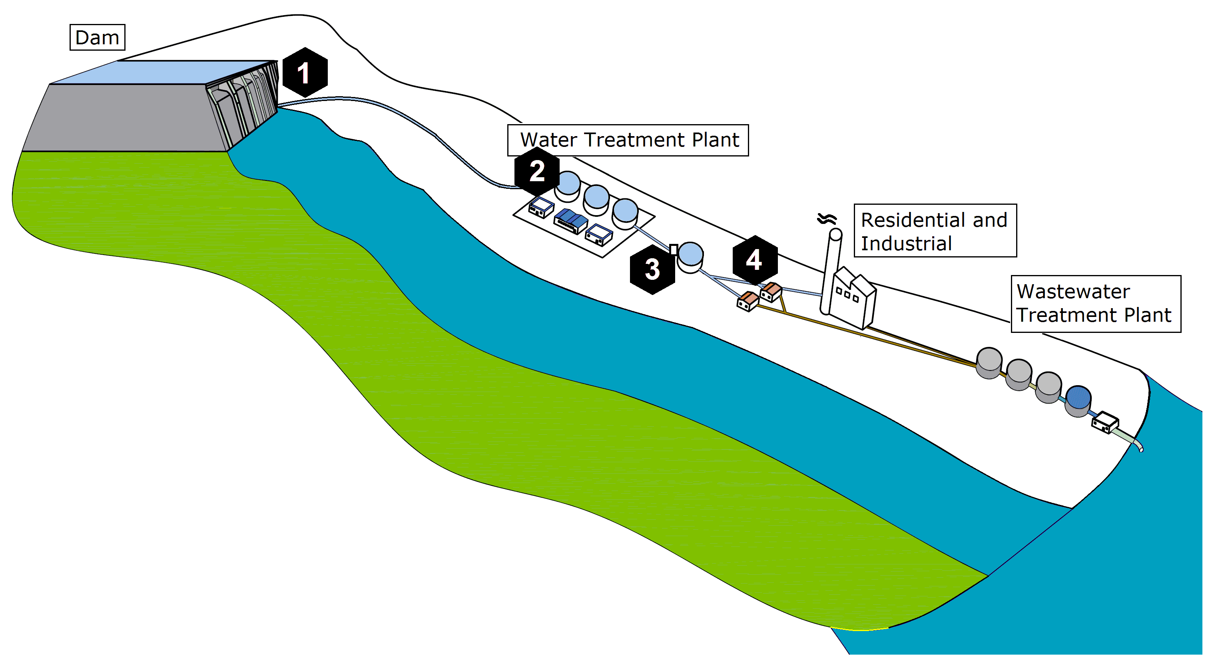
What is Conduit Hydropower?
“Conduit hydropower” – energy generated from pressurised conduits

Slide 8

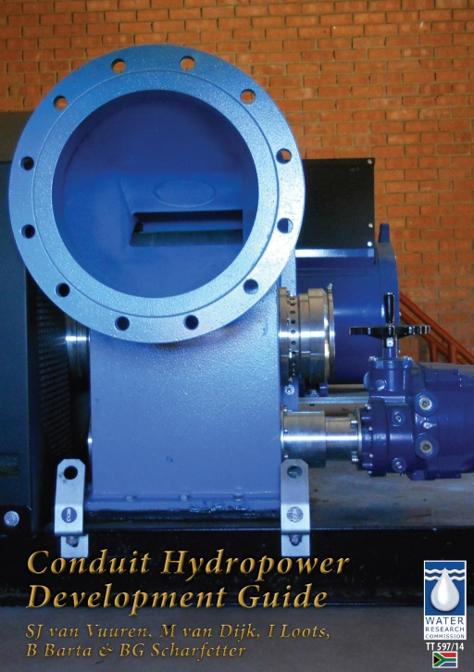
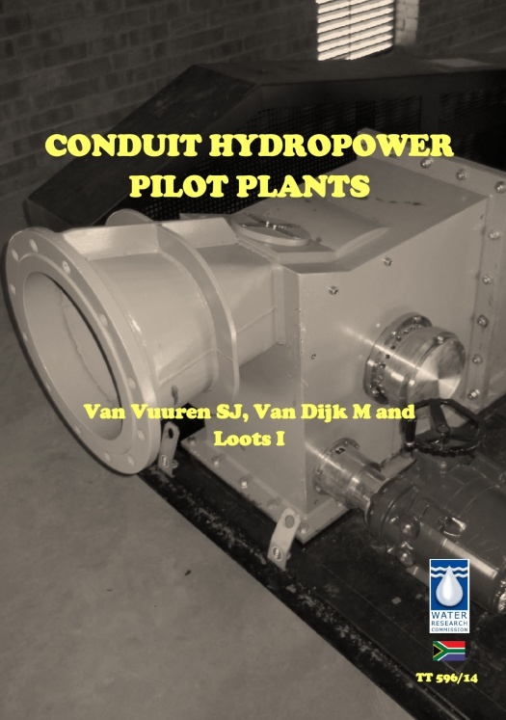
What is Conduit Hydropower?
Available WRC studies
KV238/10 - A High Level Scoping Investigation into the Potential of Energy Saving and Production/Generation in the Supply of Water Through Pressurized Conduits
TT596/14 - Conduit Hydropower Pilot Plants
TT597/14 - Conduit Hydropower Development Guide
www.wrc.org.za

Slide 9
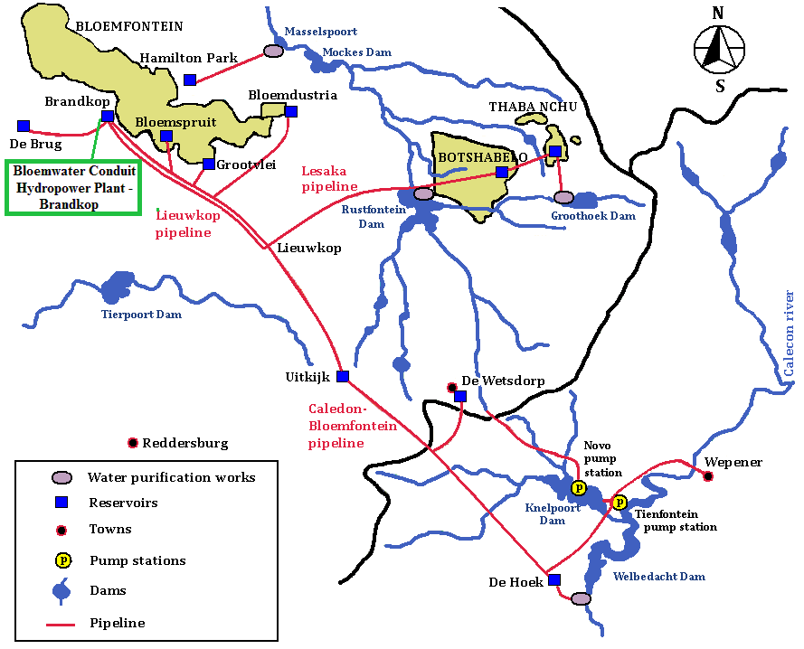
Caledon – Bloemfontein water supply system
Pipeline Distance | 105 km
Pipeline Diameter | 1170 mm
Avg. Pressure Head | 46.5 m
Avg. Flow rate | 1.05 m³/s
What is Conduit Hydropower?

Slide 10
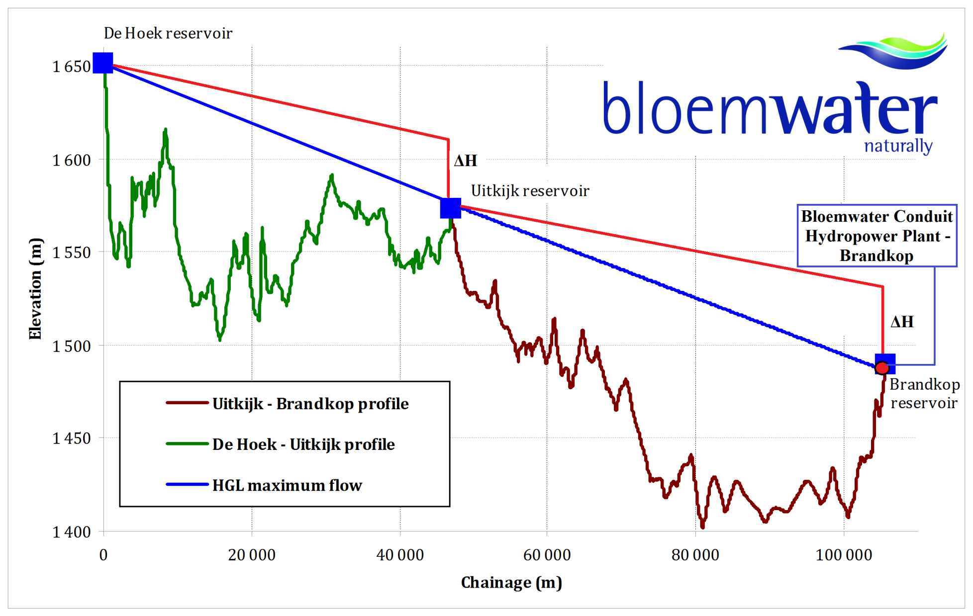
What is Conduit Hydropower?
Pipelines are usually controlled at the downstream end

Slide 11
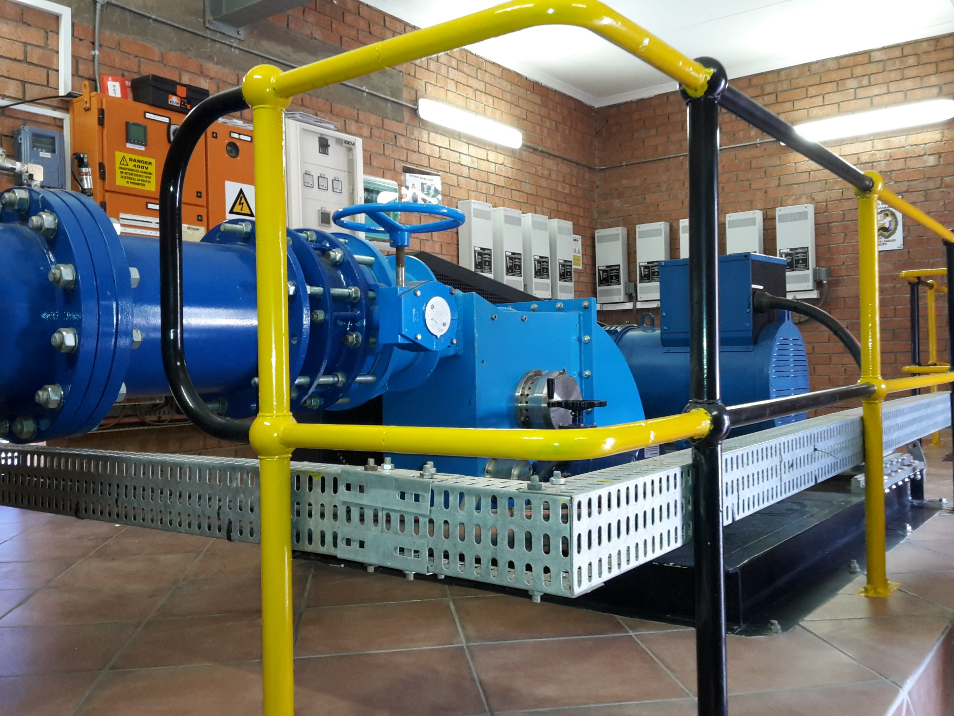
What is Conduit Hydropower?
96 kW

Slide 12
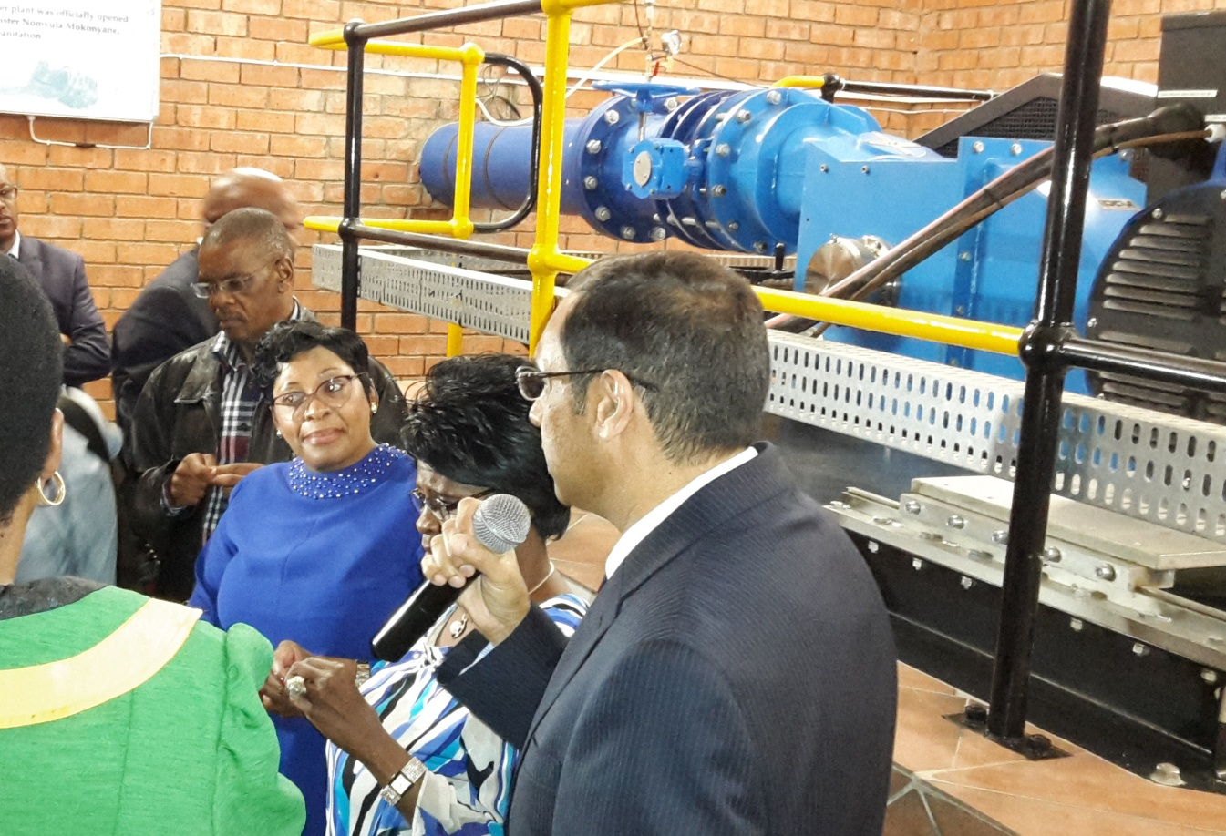
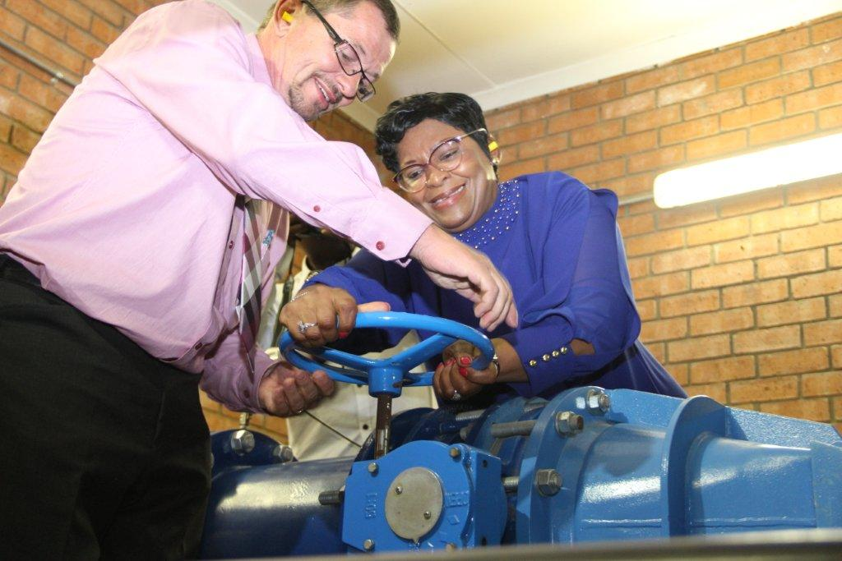
What is Conduit Hydropower?
Launched plant - 31 March 2015
Supplies the entire Bloemwater head office

Slide 13
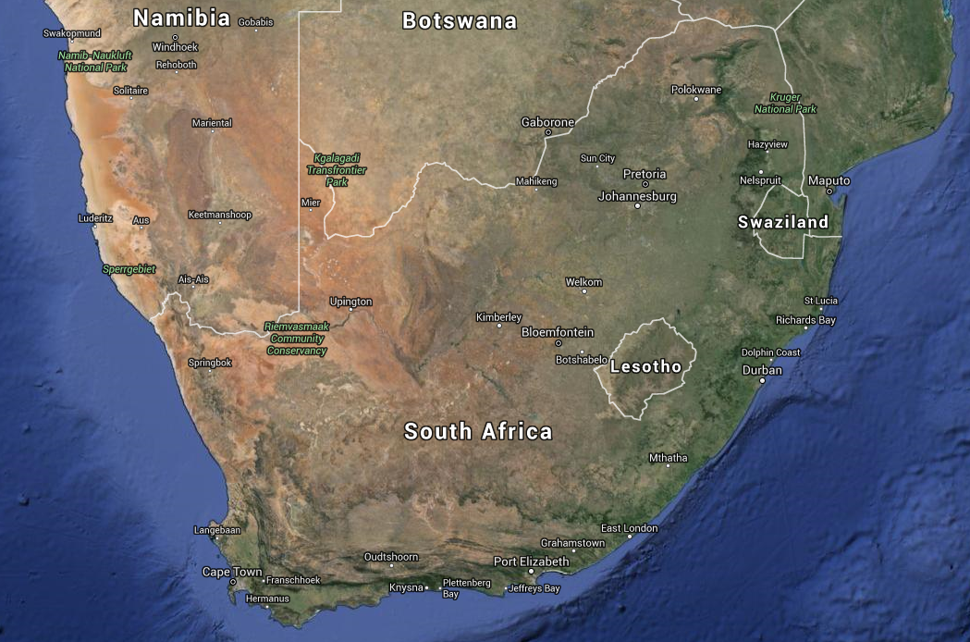
Finding sites

Slide 14
Finding sites
Operational category | Type | Purpose
Conveyance | Open channel | Convey fluid from one point to another
 | Tunnel / conduit
 | Aqueduct
 | Drops (vertical and chutes)
 | Culverts
 | Water distribution systems
 | Bulk sewer lines
Regulatory and diversions | Sluice gates | Control water level upstream side of structure. Navigation, Storage, Hydro.
 | Weirs
 | Barrages
Flow measurement | Parshall flume | Measure flow
 | Crump weir
 | Broad crested weir
 | Sharp crested weir
Dams | Outlet works | Reserve flow releases, domestic or irrigation releases, spill/overtopping flows
Water treatment works | Inlet works | Treatment facility with specific opportunities at both in- and outlet
 | Outlet works
Waste water treatment works | Inlet works | Treatment facility with specific opportunities at both in- and outlet
 | Outlet works
Energy dissipation | Drop structure | Dissipate energy associated with big elevation change, or velocity head
 | Kinetic structure
Industrial flows | Conduits and channels | Water utilized in industrial activities/processes
Rivers/channels | Kinetic | Convey fluid from one point to another

Slide 15
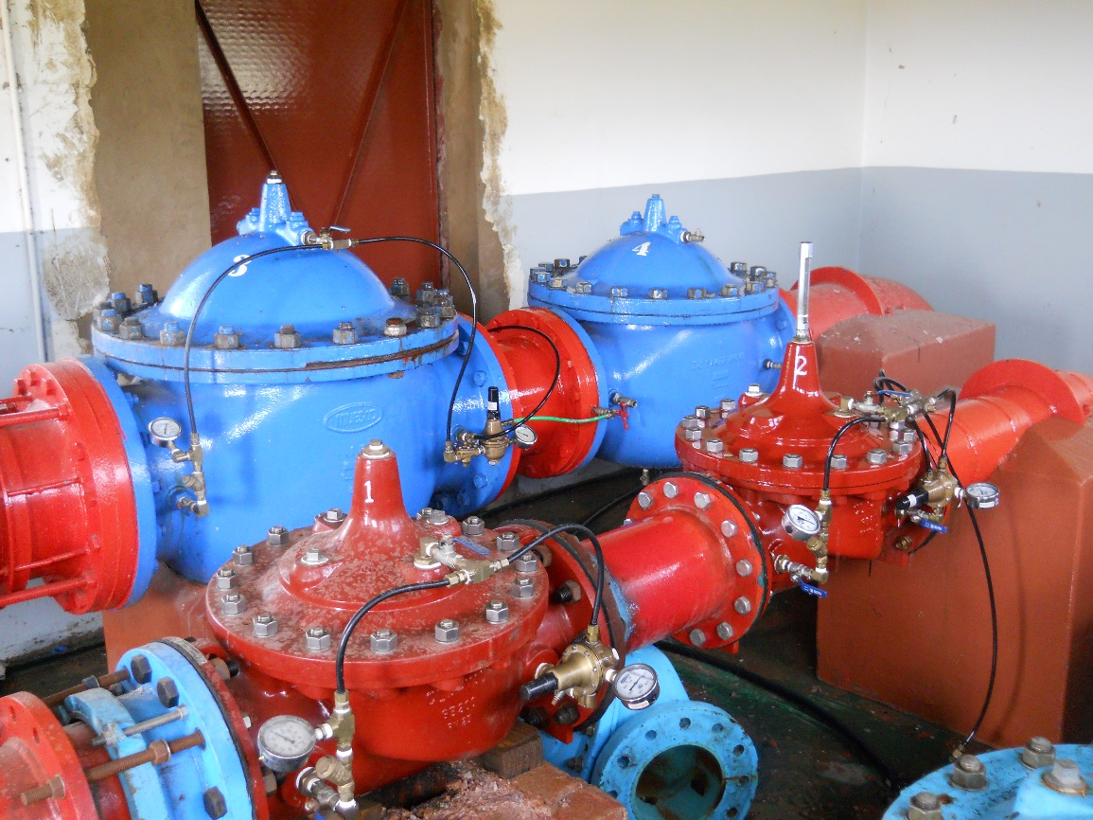
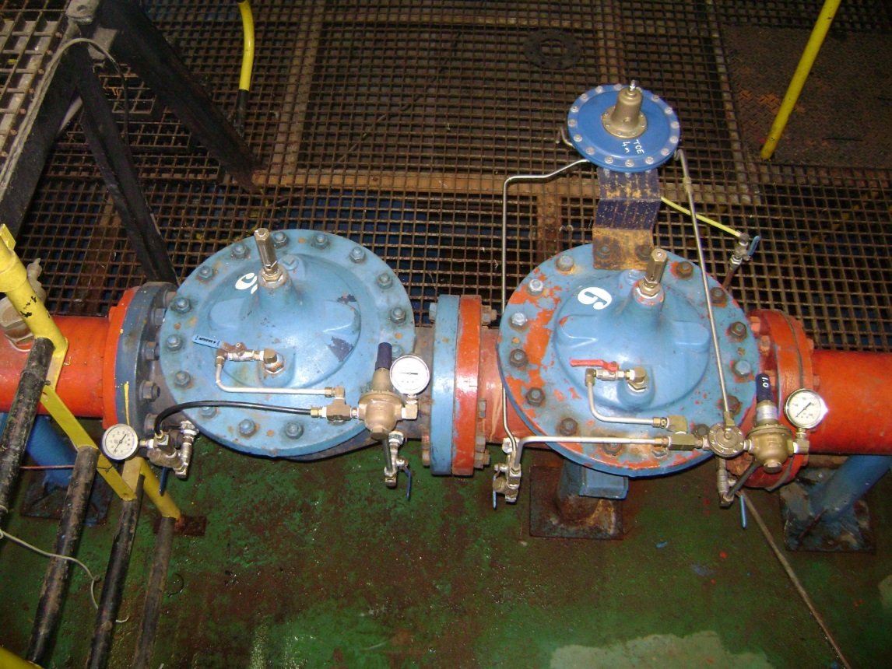
Finding sites
Pressure Reducing Stations

Slide 16
Example of opportunities in City of Tshwane Executive summary
Yes there is exploitable conduit hydropower opportunities (±2.3 MW) (☺)
Yes it is feasible (IRR = ☺, c/kwh = ☺)
Total development cost ±R75 million (R/kW = ☺)
Legislative/regulatory aspects are manageable (☺)

Slide 17
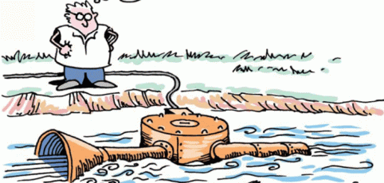
Background
Drivers for a water utility to consider “hydropower”:
Renewable energy source – Green City
Rising energy costs
Reduced revenues
Financial incentives
Public perception
Job creation
Extending the operational life of control valves
Remote power (alarms, communications etc.)

Slide 18
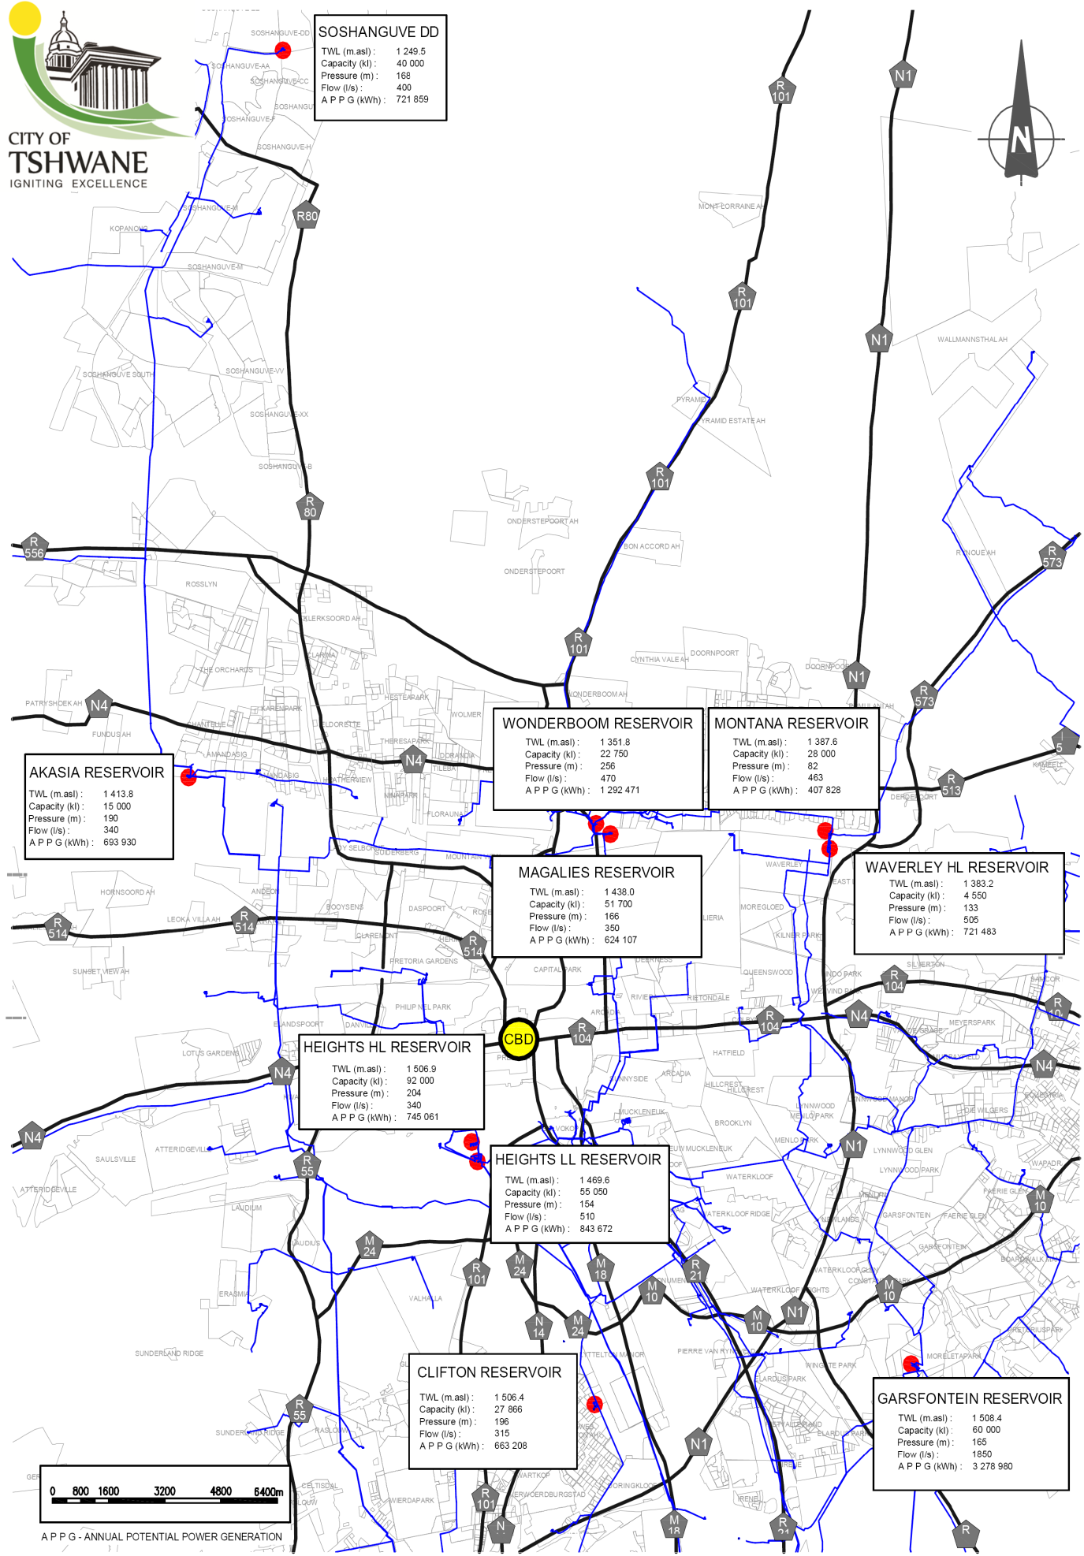
Background
Geographically speaking the City of Tshwane has a lower elevation then the bulk service Reservoirs of Rand Water which is the main water supply.
Water is then distributed through a large water system that includes 160 reservoirs, 42 water towers, 10677 km of pipes and more than 260 pressure reducing installations (PRV’s) that operates at pressures of up to 250 m.

Slide 19
Background Benefits and opportunities of CHP
Hydroelectric energy is a continuously renewable energy source.
Hydroelectric energy technology is proven technology offering reliable and flexible operations.
Hydroelectric stations have a long life
Hydropower stations achieve high efficiencies.
Conduit hydropower uses the available water distribution infrastructure and thus as long as there is a demand for water hydroelectric energy can be generated.
Conduit hydropower “piggy backs” onto existing water infrastructure resulting in a minimal environmental impact.
The feasibility studies indicate short payback periods.

Slide 20

Regulatory and legislative
Pertinent legislation that needs to be adhered to includes the Constitution, the Electricity Regulation Act (ERA), the National Water Act (NWA) and the National Environmental Management Act (NEMA).
The following legislative documentation is to be consulted in preparation of a small or large hydropower development proposal:
Municipal Systems Act (Act 32 of 2000)
Municipal Structures Act, Act 117 of 1998, as amended.
Municipal Finance Management Act (Act 56 of 2003) and Public Finance Management Act (1 of 1999)
Water Services Act (Act 108 of 1997)
Electricity generated from small conduit hydropower schemes in the City of Tshwane could be used for either:
“own use” or
connecting to a municipal distribution network.

Slide 21
Regulatory and legislative
Electricity generated (>100kW) by non-IPPs for connection to a municipal grid
Municipal Grid Connection >100kW
NERSA Generation Licence | Local electricity utility involvement | Proof of land ownership / permission to use land | Environmental Authorisation | Water Use Authorisation | Water allocation confirmation
Yes. Licence applications must include evidence of compliance with the Integrated Resource Plan (IRP) (Department of Minerals and Energy 2006) | Yes. Letter from Local Municipality/ electricity utility is required as part of the application to confirm their knowledge & acceptance of the designed connection onto the network | Needed for NERSA licensing requirements | Needs to be addressed for NERSA licensing requirements Yes, if required by NEMA Notice by Environmental practitioner if none is required | Needs to be addressed for NERSA licensing requirements Yes, if required by NWA Legal opinion if none is required | Needs to be addressed for NERSA licensing requirements If conduit hydropower, WSP must confirm that water is available and hydropower generation will not affect security of supply If conventional hydropower, this will be addressed through the water use authorisation process

Slide 22
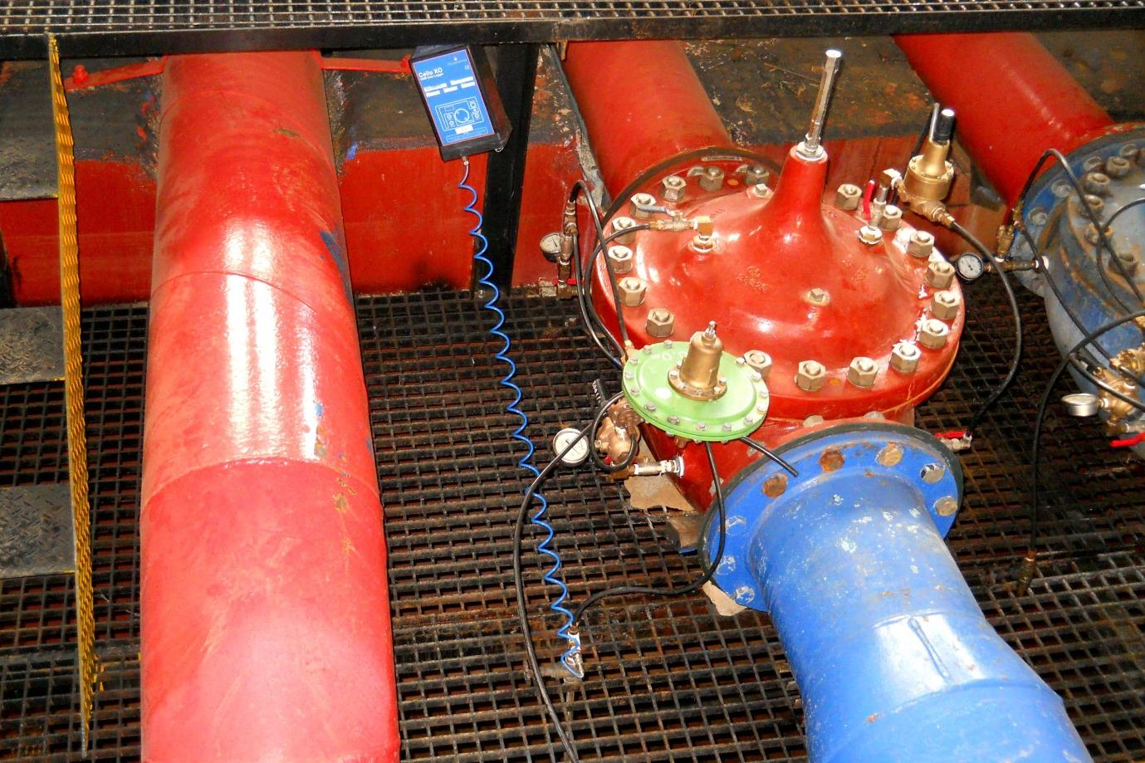
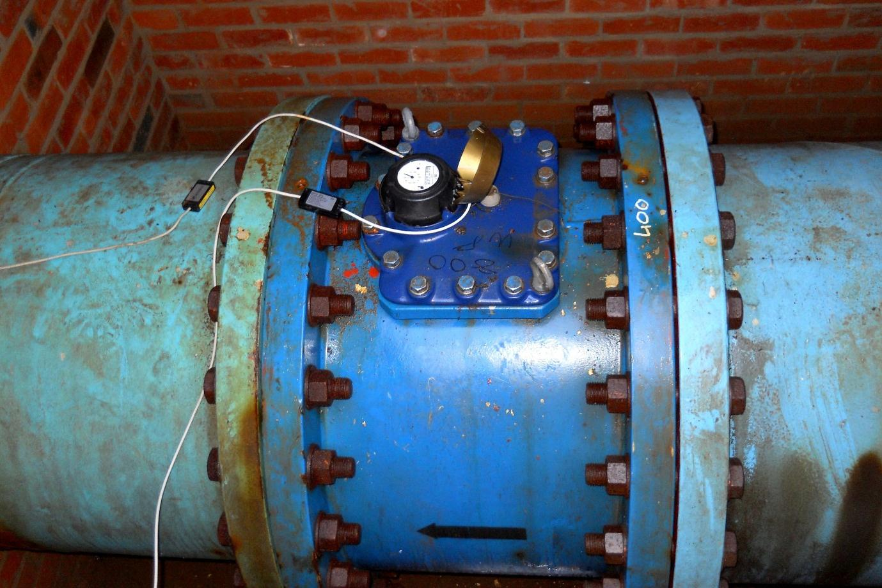
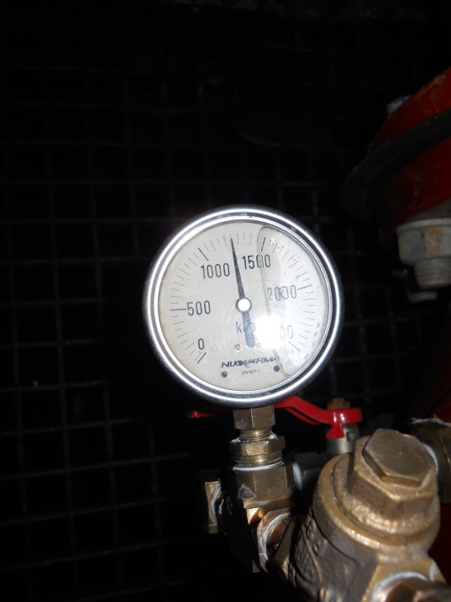
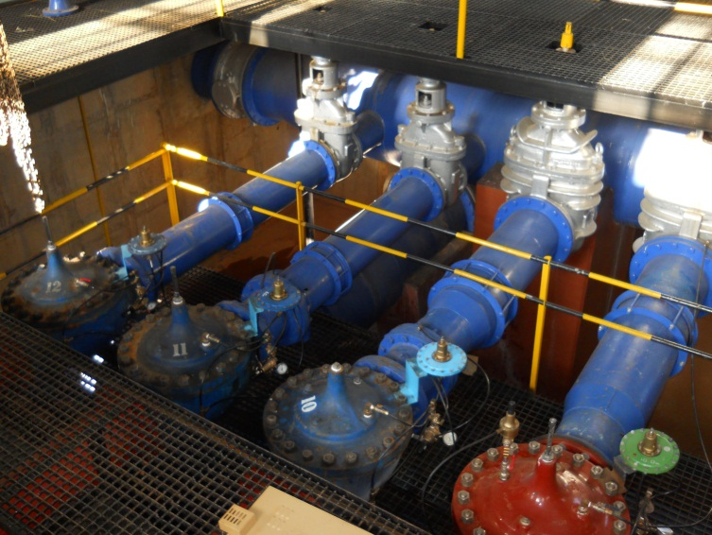
Data collection

Slide 23
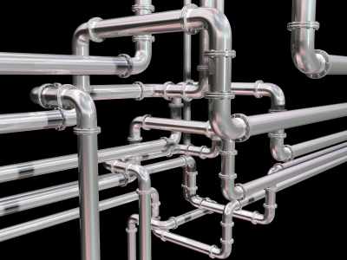
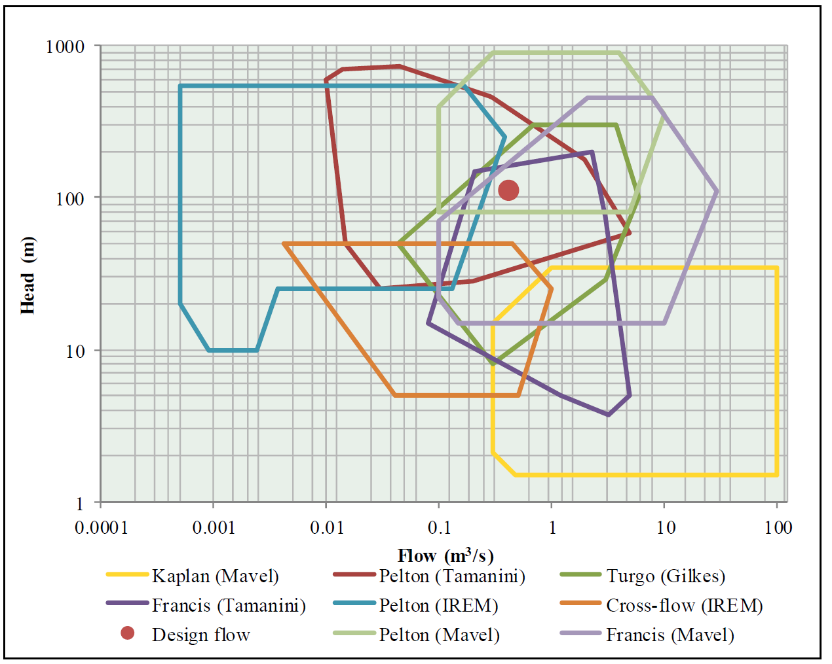
Hydraulic analyses
Flow rating curve, pressures, flow rates.
Optimization of generating capabilities (kwh/a)
Turbine selection

Slide 24

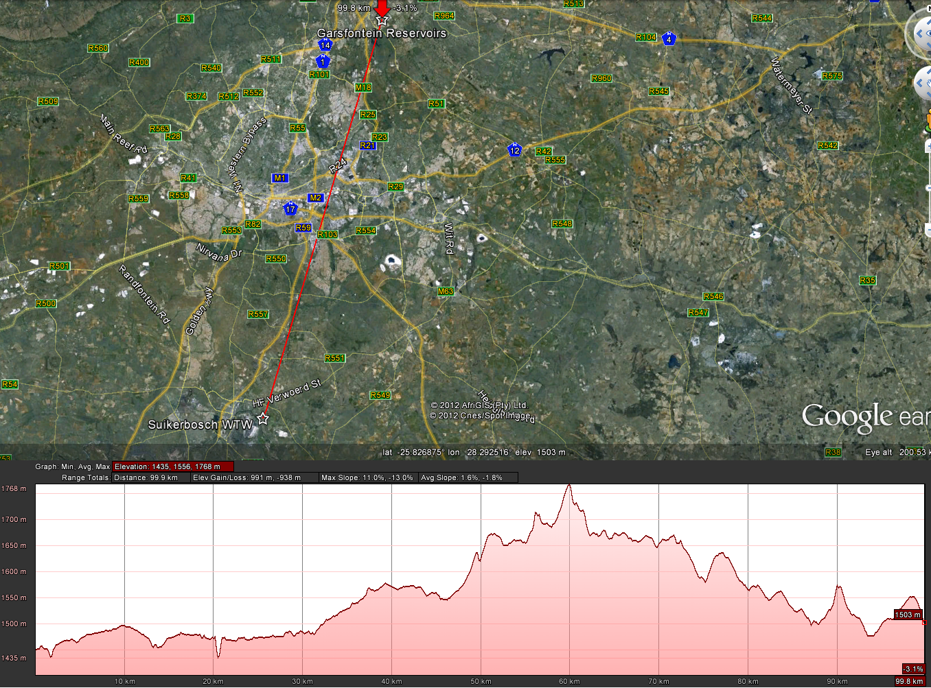

Description
Potential at Garsfontein Reservoir

Slide 25
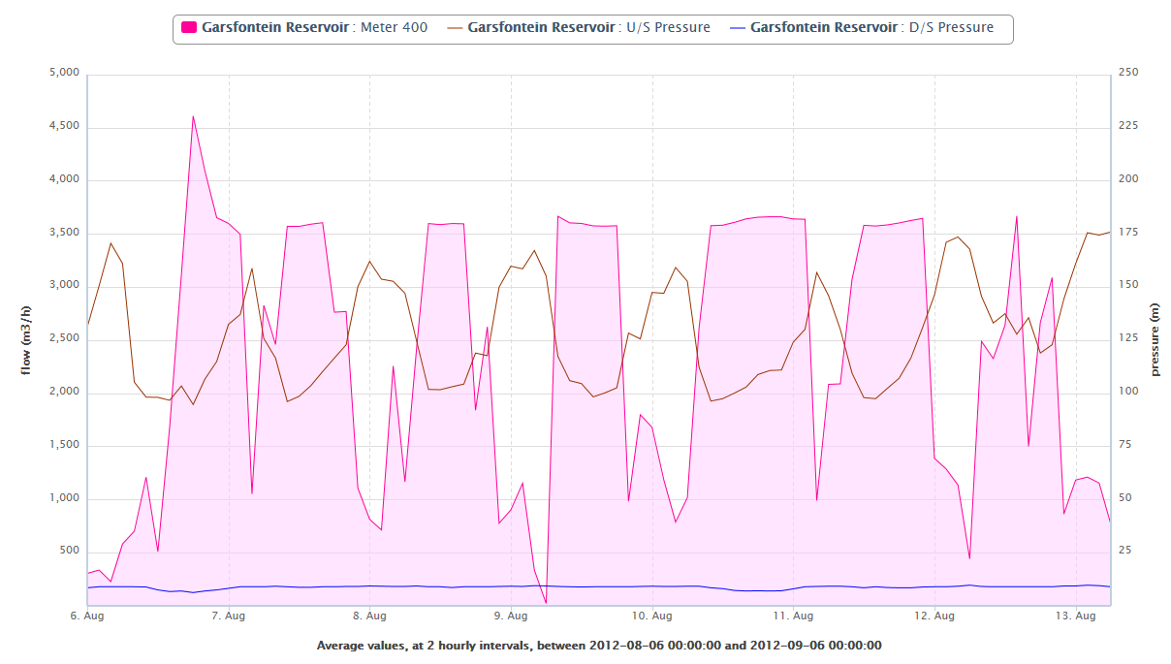
Hydraulic analyses
Pavg upstream = 117,4 m
Qavg = 0,671 m³/s
Data since April 2011 and
Pavg upstream = 120 m
Qavg = 0,77 m³/s
Potential for a week = 82 097 kwh
Annual potential = 4 257 309 kwh
Required turbine capacity 550 kW or 950 kW depending on operational approach adopted

Slide 26

Economic assessment
Cost Estimate for the implementation | Cost ID | Comments | Cost
Professional fees:
Planning and design costs:
Detail design | P1 | 9 % of implementation |  | R 1 729 014
Legal and regulatory | P2 |  |  | R 100 000
Dynamic analyses | P3 |  |  | R 280 000
Site survey | P4 |  |  | R 60 000
Subtotal A | A |  |  | R 2 169 014
Estimated Capital Cost:
Civil works:
Preparation of site | C1 |  |  | R 90 000
Turbine Room | C2 |  |  | R 970 000
Modifications to outlet works | C3 |  |  | R 0
Pipework and valves (supply and install) | C4 |  |  | R 770 000
Electro-mechanical Equipment:
Turbines | E1 |  |  | R 11 447 800
Generators | E2 | Included in E1 |  | R 0
Controls units (HPU, cooling and lubricating etc.) | E3 | Included in E1 |  | R 0
Transformer cost and integration into electrical grid (Transmission infrastructure) | E4 |  |  | R 2 160 000
Import costs | E5 | Import item at rate X2 |  | R 2 404 038
Implementation cost:
Commissioning, erecting and project management provided by the Supplier | I1 | 5 weeks |  | R 476 000
Construction supervision (Consultant) | I2 | 12 Man months |  | R 360 000
Training | I3 |  |  | R 60 000
Spare components to be stored on site | I4 | 3% of Sum of E1 to E3 |  | R 343 434
Integration of system components (telemetry etc.) | I5 |  |  | R 130 000
Contingencies | I6 | 5% of Sum of C, E and I items |  | R 960 564
Subtotal B | B |  |  | R 20 171 836
Exchange rate - Euro to Rand | X1 | R 17.0/€
Importing costs (Customs and transportation) | X2 | 21%
Total cost (Subtotal A + Subtotal B) |  |  |  | R 22 340 850
Calculated Implementation Cost per installed kW (R/kW) |  |  |  | R 30 190

Slide 27
Economic assessment
Operational Cost Estimate:
Expected Operational Life |  |  | 40 years
Planned year of implementation |  |  | 2017
Annual operation and maintenance cost (Note 1):
Cost component | Cost ID | % of Capital Cost | Cost
Civil works | M1 | 0.25% | R 4 575
Electrical and mechanical works | M2 | 2.00% | R 228 956
Transmission | OT1 | 0.80% | R 17 280
Operation | O1 | 0.40% | R 80 687
Insurance | OT2 | 0.30% | R 60 516
Subtotal (Annual O&M Costs) |  |  | R 392 014
Annual income for this development (Note 2):
Average value of generated electricity | EI1 | 0.73 R/kWh | R 4 667 328
Investment review:
Net present value of costs |  |  | R 67 592 455
Net present value of income |  |  | R 375 727 751
Total NPV |  |  | R 308 135 296
Internal rate of return |  |  | 25.57 %
Levelised Cost of energy |  |  | 26.43 c/kwh

Slide 28
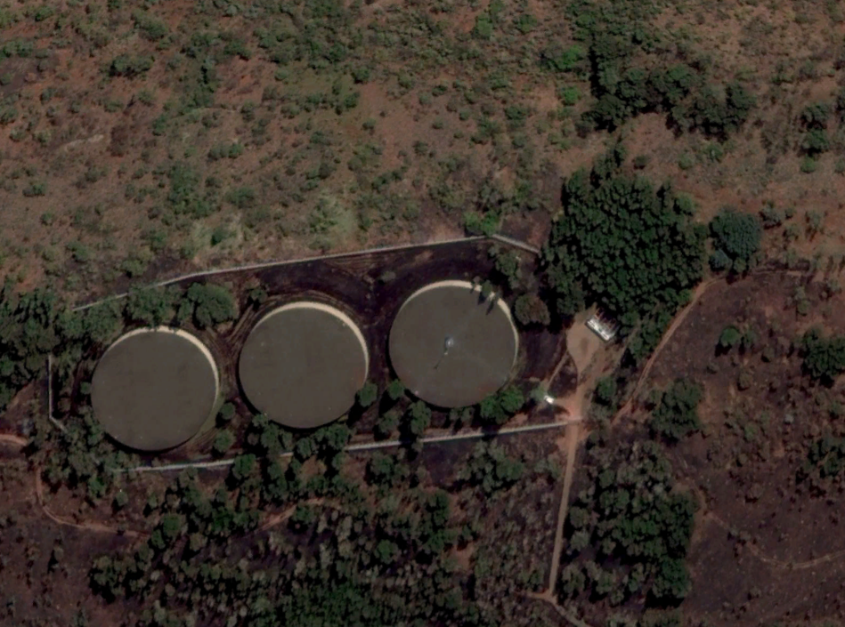
Conceptual Designs – Heights HL Reservoir
PRS

Slide 29
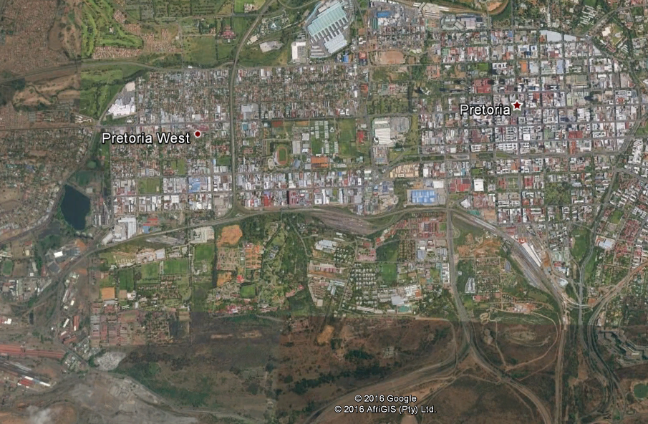
Conceptual Designs – Heights HL Reservoir

Slide 30
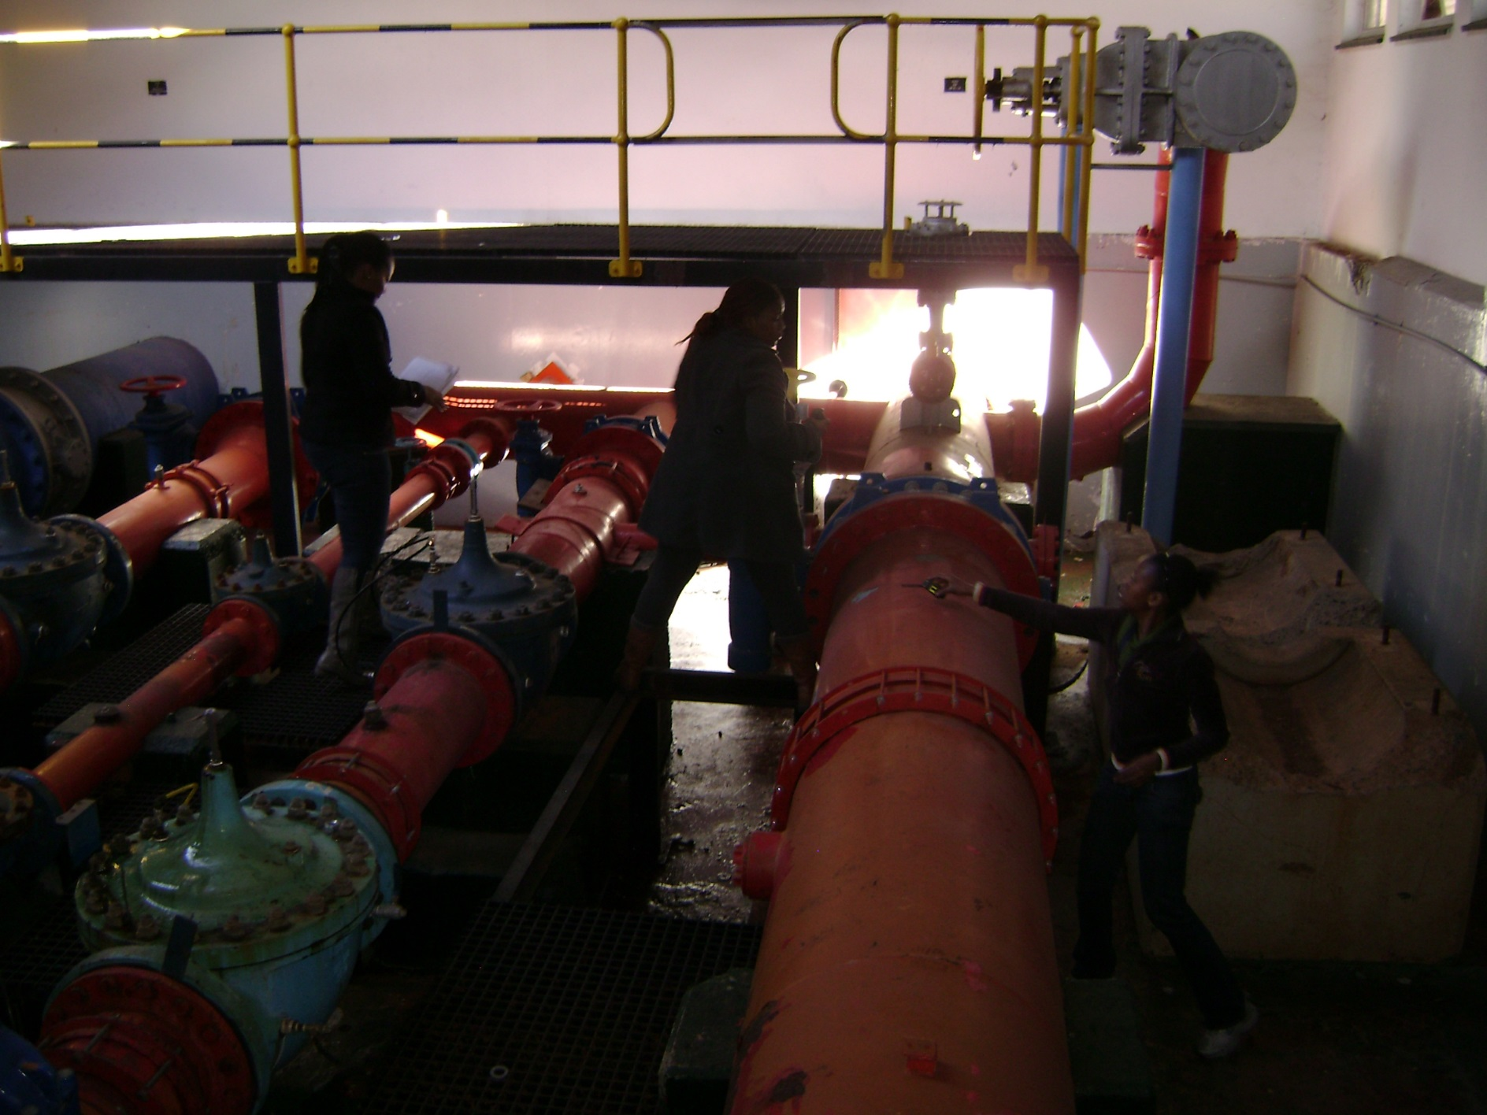
Conceptual Designs – Heights HL Reservoir

Slide 31
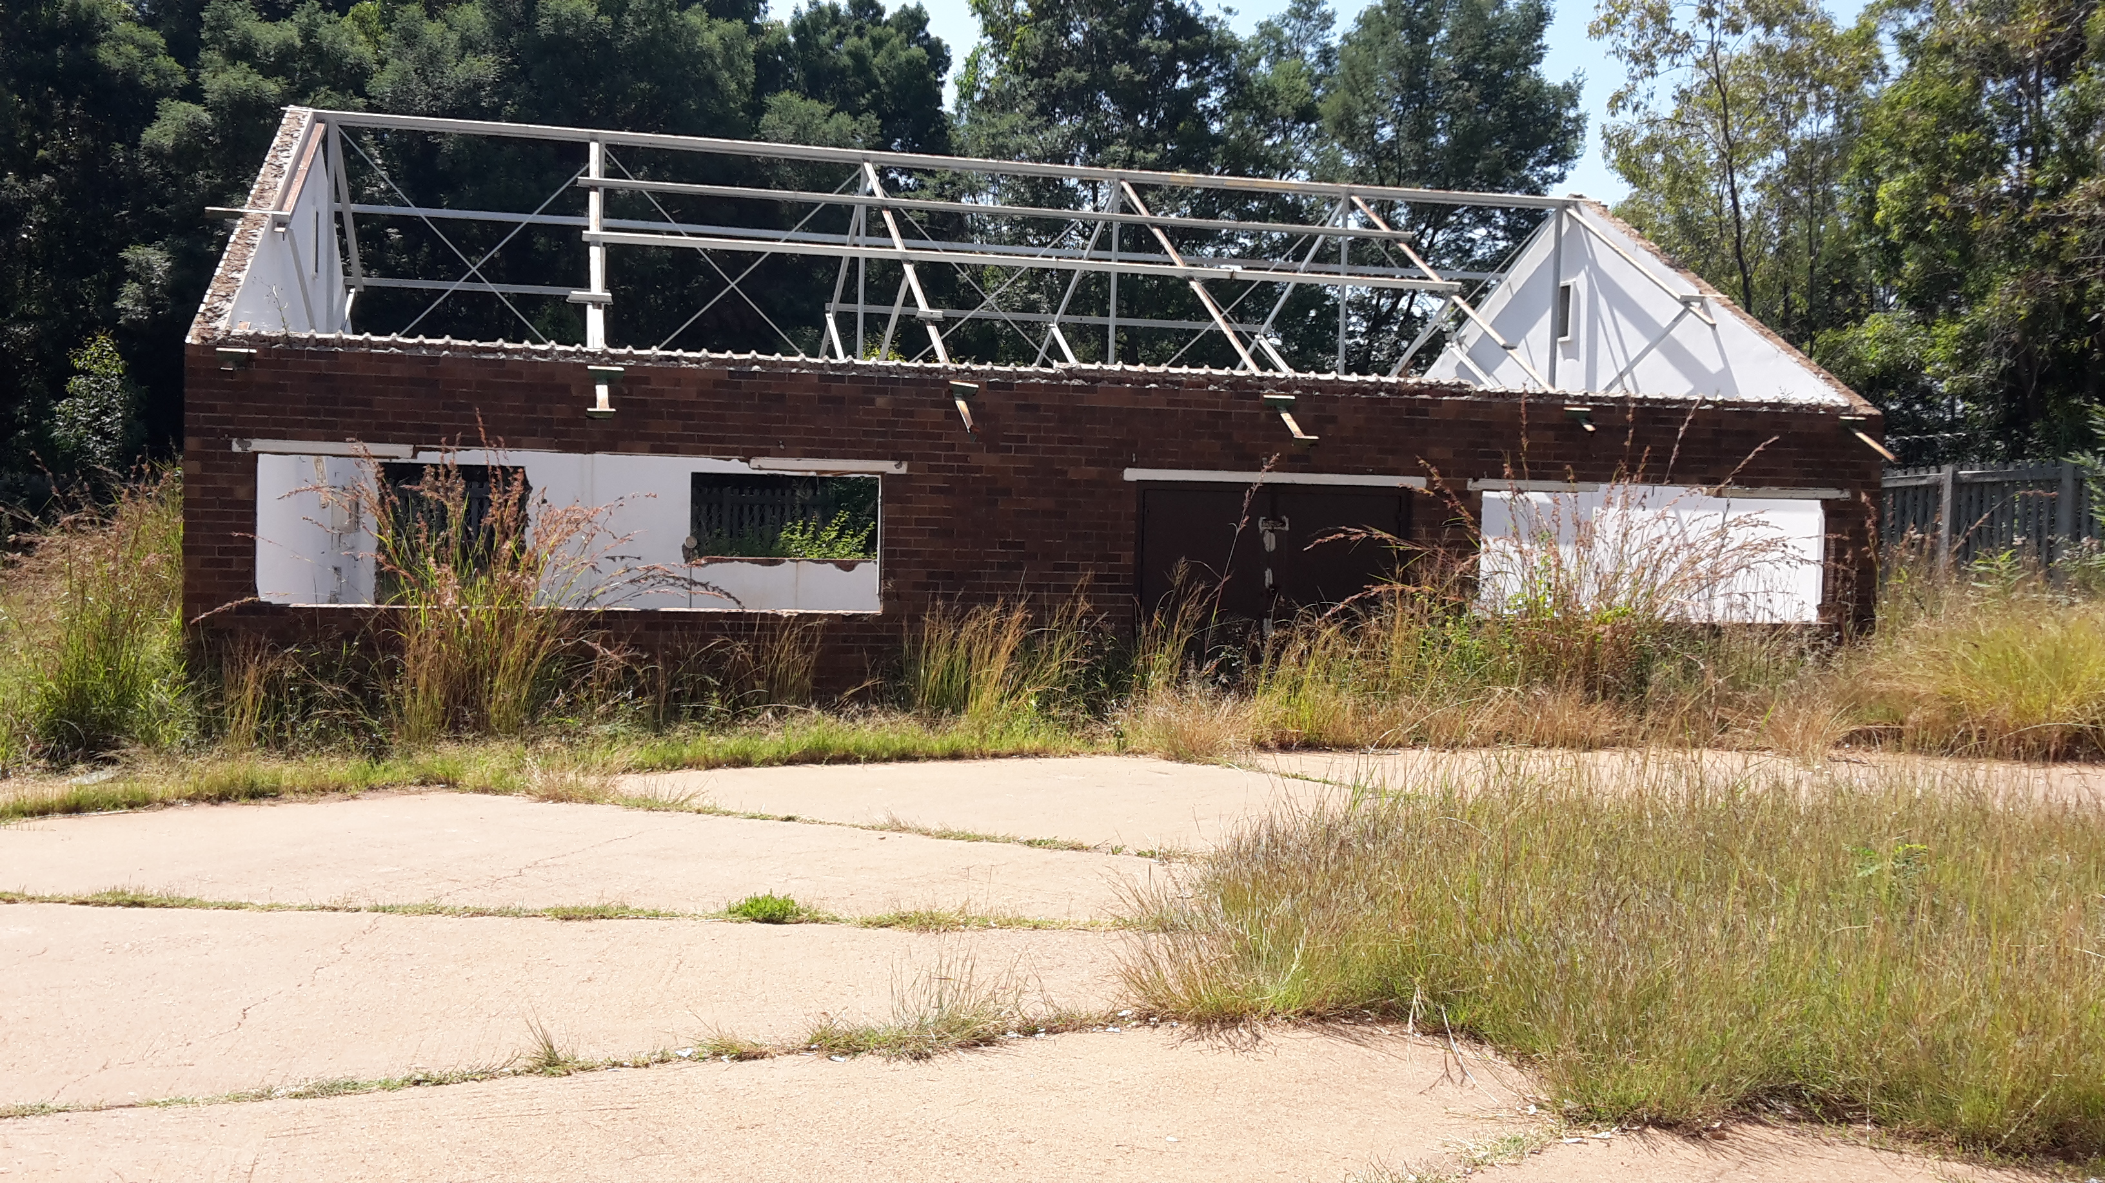
Conceptual Designs – Heights HL Reservoir

Slide 32
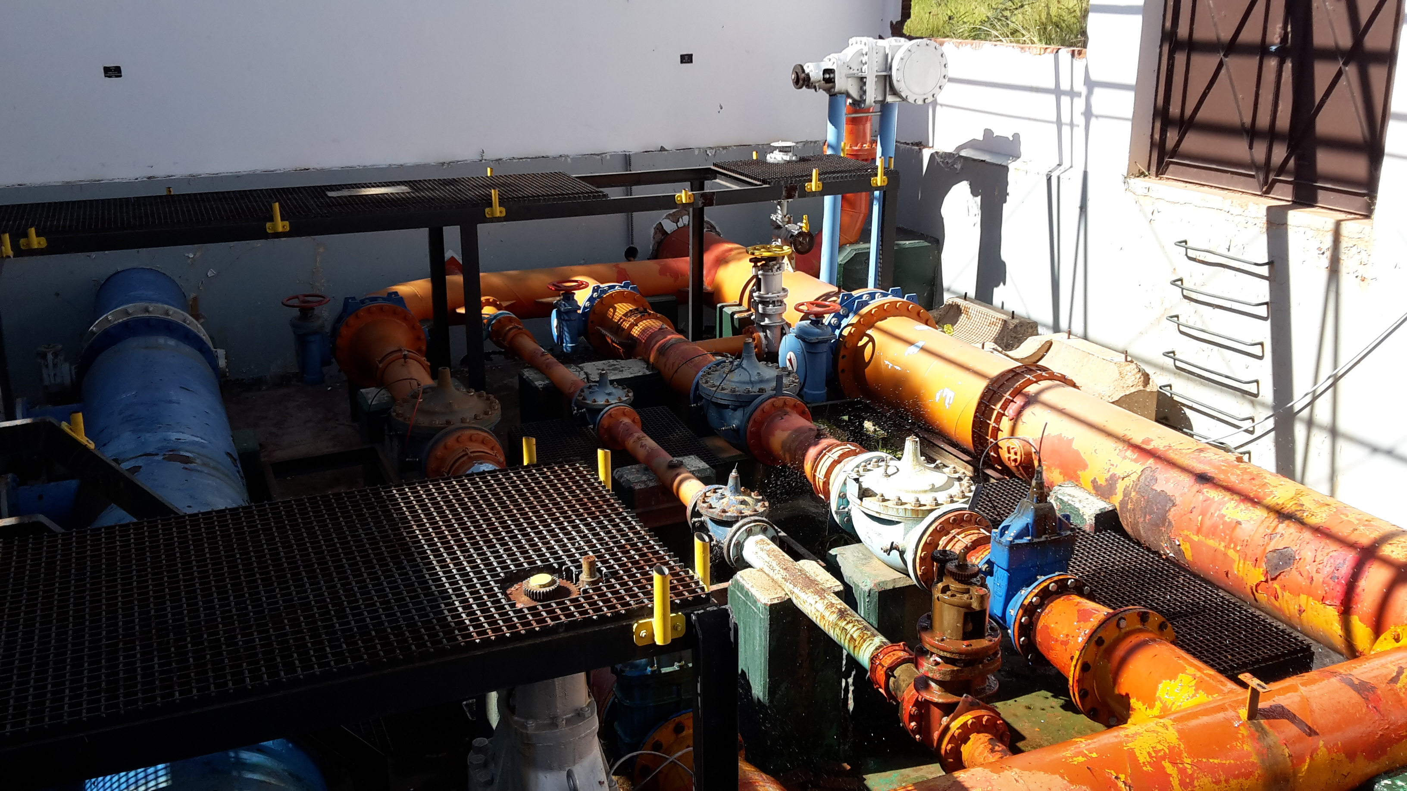
Conceptual Designs – Heights HL Reservoir

Slide 33
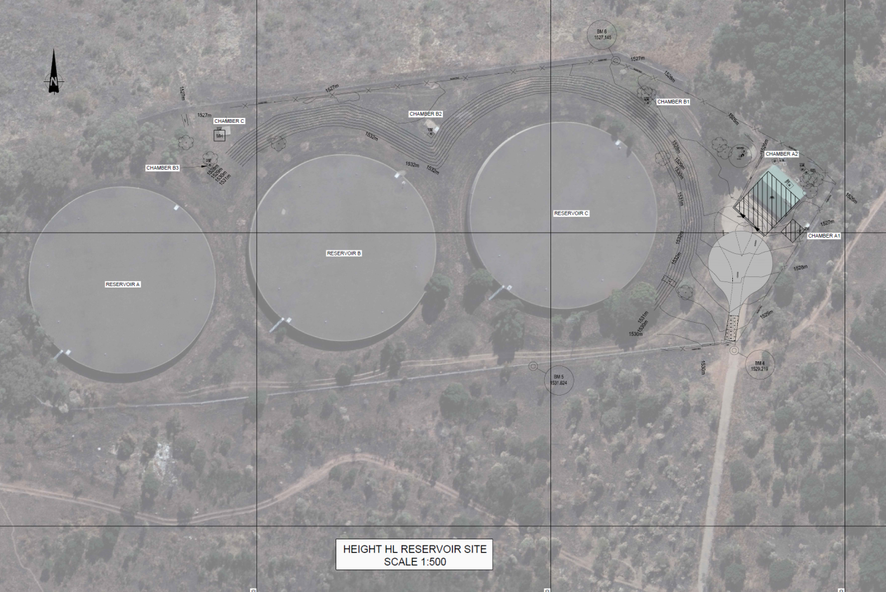
Conceptual Designs – Heights HL Reservoir

Slide 34
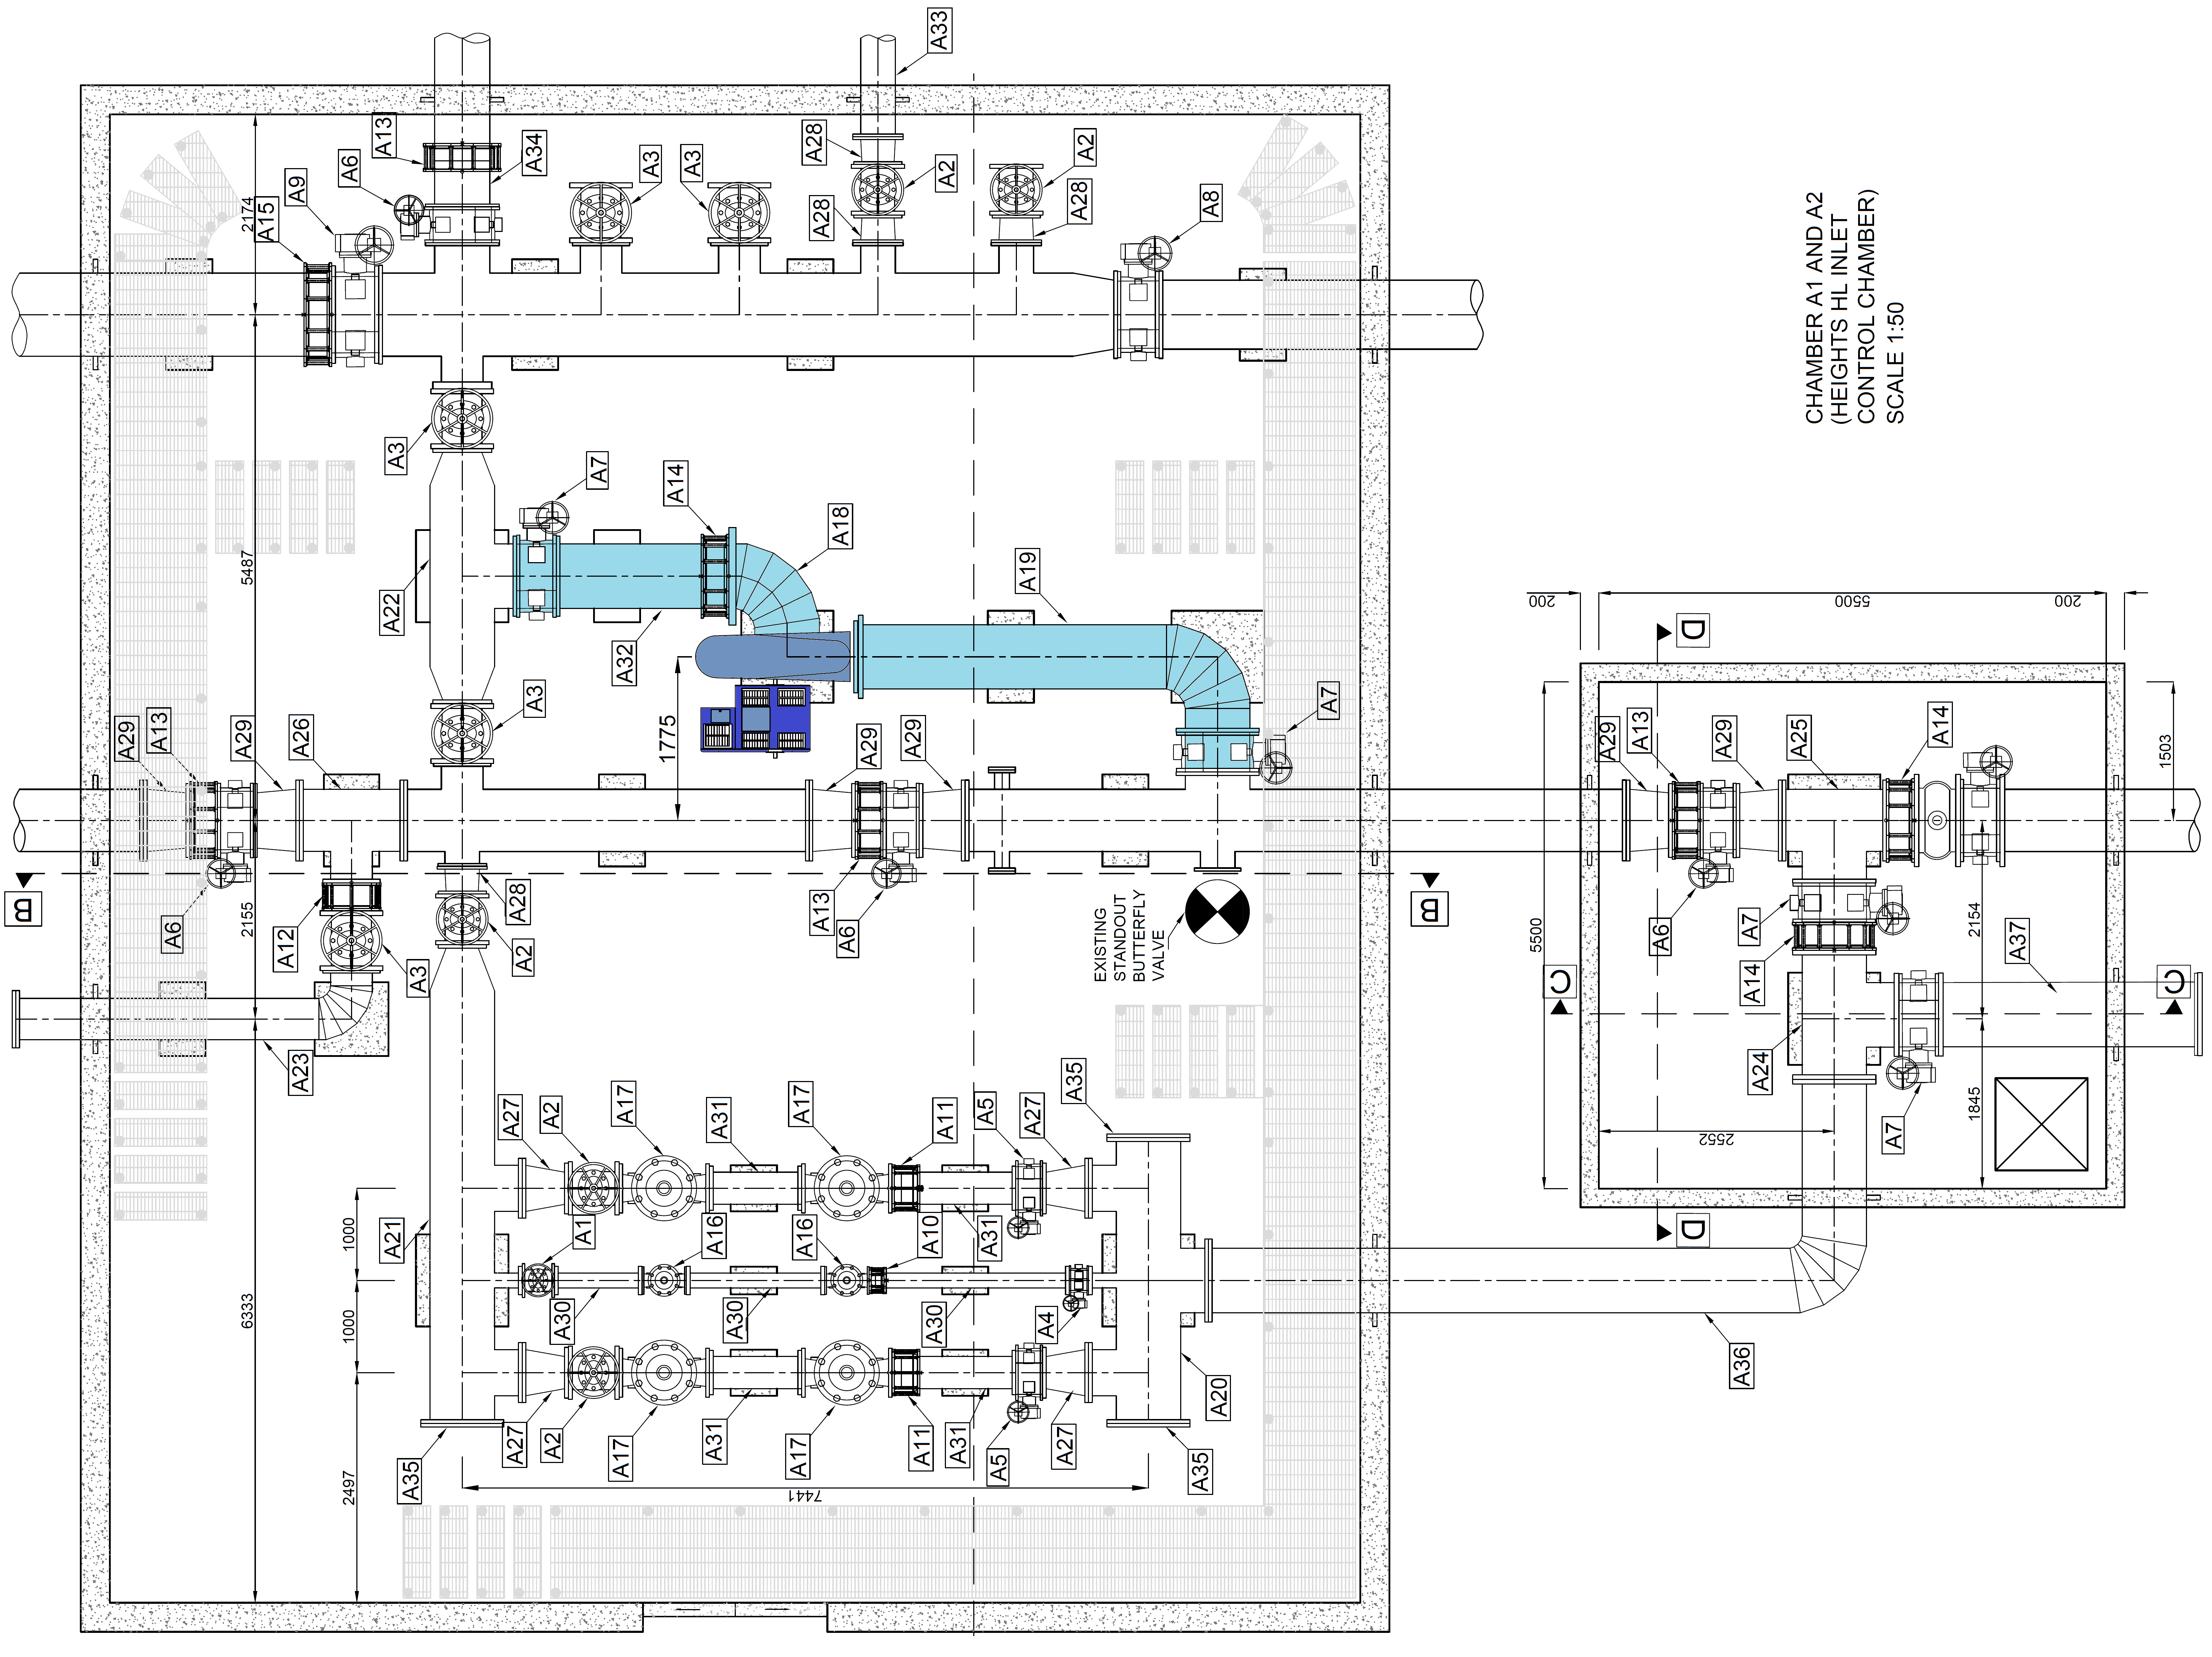
Conceptual Designs – Heights HL Reservoir
Potential 455 kW

Slide 35


Results
Site | Generating capacity (kW) | Average annual generated energy (kWh/a) | Total cost (R) | Implementation costs (R/kW) | IRR (%) | Levelised costs (c/kWh)
1 | 740 | 6393600 | R 22 340 000 | R 30 190 | 25.57 | 26.43
2a | 372 | 3214080 | R 13 069 000 | R 35 133 | 23.20 | 29.19
2b | 267 | 2306880 | R 10 055 000 | R 37 658 | 22.21 | 30.43
3 | 265 | 2289600 | R 8 253 000 | R 31 145 | 25.17 | 25.66
4 | 455 | 3931200 | R 12 806 000 | R 28 146 | 26.85 | 24.22
5 | 275 | 2376000 | R 9 212 000 | R 35 200 | 23.17 | 29.20
Total | 2374 | 20511360 | R 75 736 000
Development cost of conduit hydropower R16 to R40 million/MW

Slide 36
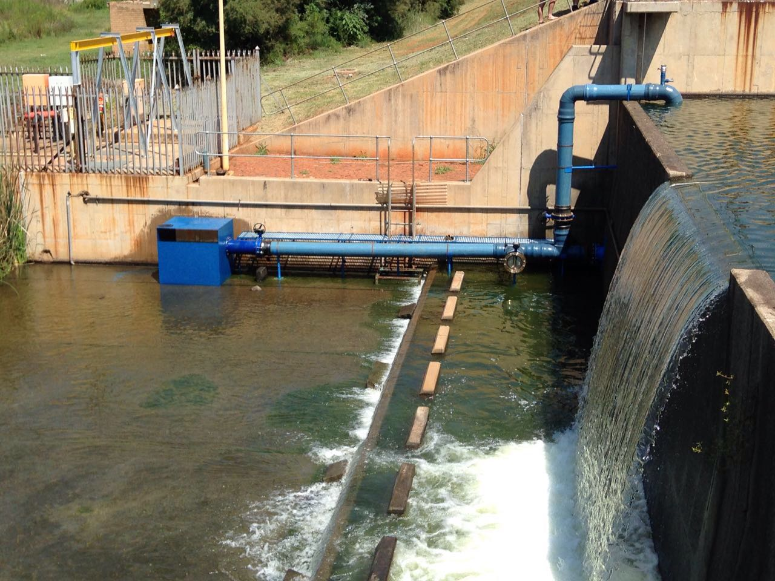
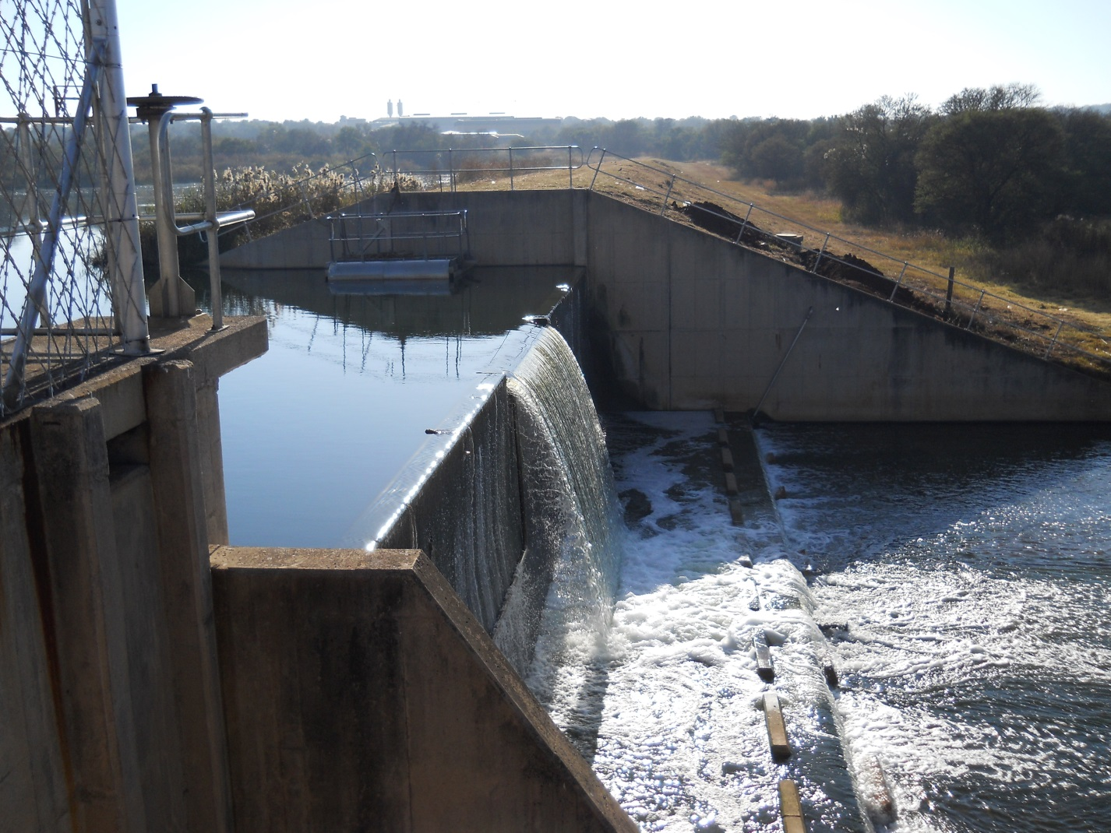
Other work
Low head turbine

Slide 37
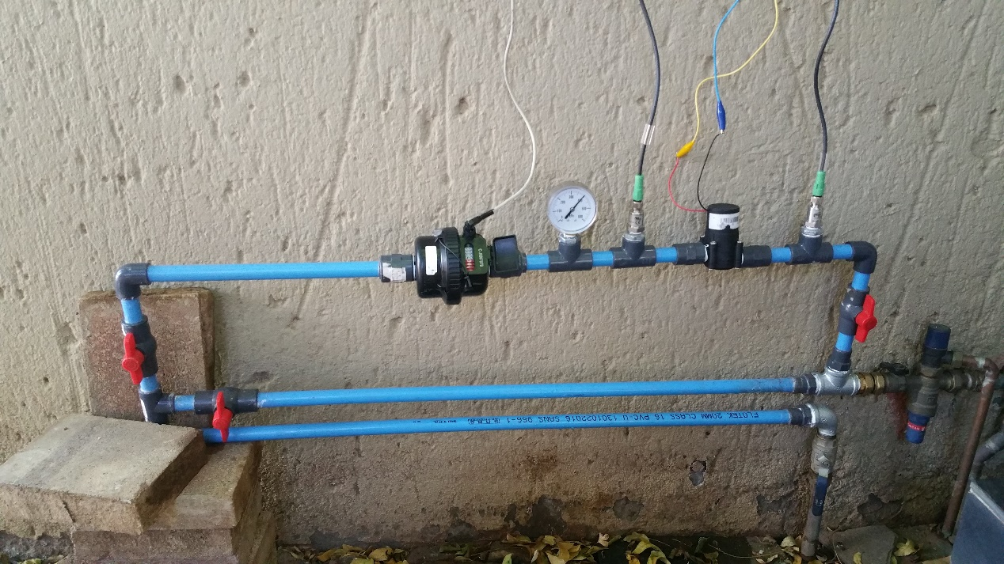
Other work
Household level
10 W potential
Pico hydropower unit

Slide 38
In summary
It is believed that there are numerous hydro power opportunities in South Africa in urban areas
Feasible and sustainable solutions without subsidies
Utilizing existing water infrastructure better (“piggy back”)
As an example City of Tshwane has linked up with industry and University of Pretoria and:
Built a pilot 16 kW plant in Pierre van Ryneveld Reservoir
Built a 150 kW plant at Annlin Reservoir
Mayoral resolution has been made
Feasibility studies for conduit hydropower sites completed and busy with detail design
Supports further pico hydropower turbine development
Skills development/ student training

Slide 39
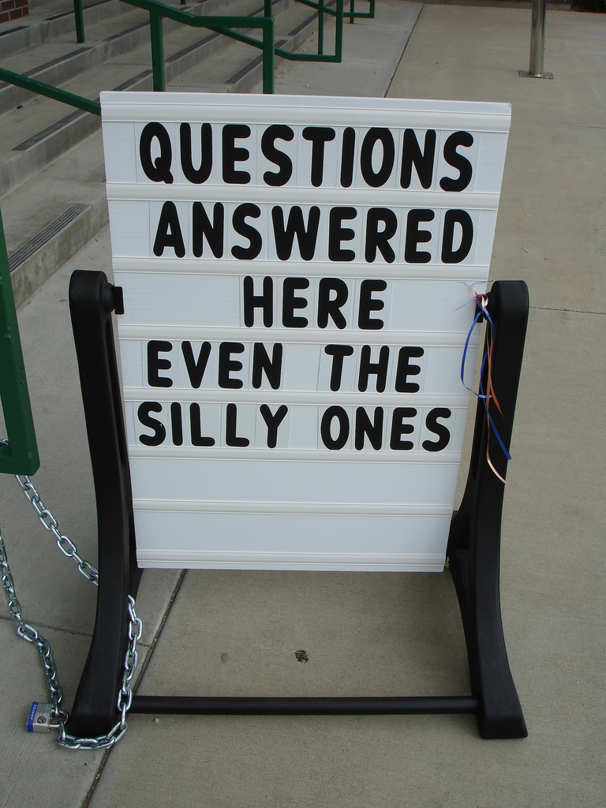

Thank you
Wish to thank the Water Research Commission of South Africa for funding the various research projects and City of Tshwane for taking it forward in their vision.

